Slide 1

Careers in Academic Psychiatry
Jo Doherty
Consultant Child and Adolescent Psychiatrist
Honorary Senior Research Fellow
Cardiff & Vale University Health Board
Cardiff University

Slide 2

Outline
Research opportunities in psychiatry
Clinical academic career pathways
My career journey
Hints and tips
Questions

Slide 3

Research opportunities in psychiatry
Taster days/weeks
Summer schools
Special interest days
Conferences and courses
Stand alone research projects
Formal research training e.g. research training fellowships, MD/PhD

Slide 4
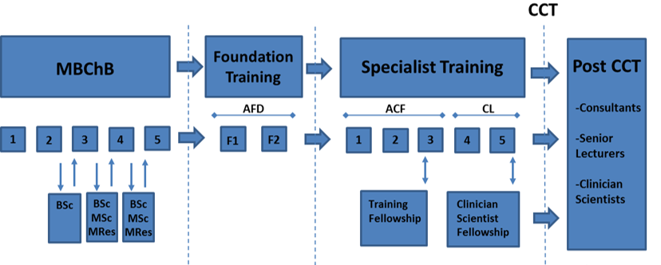
Clinical academic career pathways
Academic foundation programme
Academic clinical fellowships
Clinical lectureships
Integrated clinical academic training e.g. Wales Clinical Academic Track
Many alternatives….

Slide 5


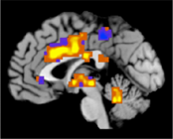
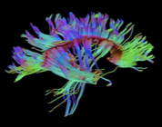
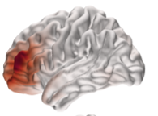
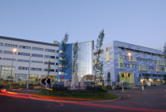



My career journey
2000
2003
2006
2008
2010
2013
2018/19
2022
Present
BA
Wellcome Trust CRTF
CCT
ACF
PhD
CAMHS training
Medical school
AFP
WCAT

Slide 6
My career journey
Consultant Child and Psychiatrist
  Medical input to a specialist service for children with intellectual disability
  All Wales 22q11.2 multidisciplinary clinic
  All Wales Psychiatric Genomics Service
Honorary Senior Research Fellow
  Research: Studies of children and young adults with high-risk genetic syndromes
  Teaching: Undergraduate and postgraduate
Genomics Education England
  Development of educational resources for clinicians
Committees/Royal Colleges
  CAPSS
  BPSU
  Study steering groups
Never (ever) bored!

Slide 7
My career journey
Main PhD output rejected
Molecular Psychiatry
Biological Psychiatry
Translational Psychiatry
Brain
WT CRTF rejected
MRC CRTF rejected
NARSAD grant rejected
2000
2003
2006
2008
2010
2013
2018/19
2022
Present
BA
Wellcome Trust CRTF
CCT
ACF
PhD
CAMHS training
Medical school
AFP
WCAT
Moved to Bristol
Illness
COVID
Marriage
Son born
Daughter born
House move
Multiple bereavements

Slide 8

Marathon not a sprint…
Work…
  Clinical vs academic commitments
  Rejections
    Two attempts to get WT CRTF
    Grant rejections
    Multiple paper rejections
Life…
  Marriage
  Multiple house moves
  Two children
  Illness
  Bereavements

Slide 9
Hints and tips
Get some hands on experience
Talk to clinical academics and different career stages to get their perspectives
Find mentors
Focus on something that really interests you
Have things that enrich your life outside work
Take regular breaks
Expect rejection
Never give up!!

Slide 10
Diolch yn fawr
Thank you

