Slide 1

On your Bike! Navigating academics in Psychiatry
A self-help guide
PROF ROHIT SHANKAR MBE FRCPsych

Slide 2
Disclosures
Professor Shankar has received institutional / research support,
lecture and consultation fees in the last 2 years from various government, charity and pharma
No cyclists or cycles were harmed in the preparation of this talk

Slide 3





CONTENTS
THE CONSTITUENT PARTS OF THIS TALK
THE VISION
THE DIFFERENT ROUTES
PSYCHIATRY TRAINING
THE GAP
THE TIMELINE
The broad church of academics
A review of current pathways
How can we support the vision?
All about challenges
What happens next?

Slide 4


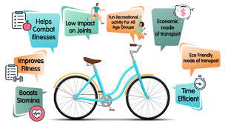


THE VISION
EVERY DOCTOR IS A SCIENTIST & SHOULD BE INVOLVED IN RESEARCH
ESSENTIAL - FACILITATORY
DESIRABLE - PARTICIPATORY
Essential to apprise evidence critically
Precision medicine
Essential to teach and communicate science as medical leaders
Why cycle?
Personalised medicine
Essential to give patients choice and options

Slide 5

THE DIFFERENT ROUTES
SUPPORT RESEARCH
RECRUIT TO EXISTING PORTFOLIO STUDIES
Intimidating
Not everyone’s interest
Thick skin needed
Prepare for failure
ALIGNMENT WITH YOUR INTERESTS
DO A HIGHER DEGREE/ WRITE A PAPER
BRING SKIN TO THE GAME
SPECIAL INTEREST SESSIONS & MENTORS
INTEGRATED ACADEMIC TRAINING
WALPORT REPORT

Slide 6
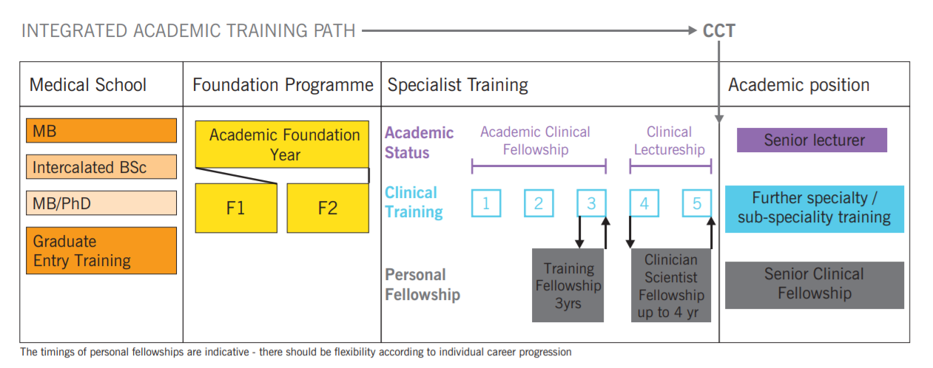
ACADEMIC CLINICAL FELLOWS/LECTURERS
THE PROGRAMME SUPPORTS RESEARCH EXPERIENCE WHEN IN CLINICAL TRAINING
DURATION
3 to 5 years: 25% time
REQUIREMENT
Early stages of speciality training
REQUIREMENT
Demonstrate outstanding potential
VERY COMPETITIVE
Approximate 400 places

Slide 7


PSYCHIATRY ACADEMIC TRAINING
WILL BENEFIT FROM A VARIED SET OF APPROACHES
new science development
Diminishing academic numbers
Patients lose out
Significant unique medical opportunities
Newer medication
Large fertile testbed neuroscience to psychotherapy
Complex need

Slide 8

BUT WE NEED YOU – SO SUCK IT AND SEE?
More serious work:
Consider an higher academic degree
ACF application
Identify a mentor:
Topic and area of interest
Join Academic Faculty
Connect to established academics in universities in your local area
Natural Language processing
Get engaged:
Offer data collection or roles in larger projects
Build your area of interest:
Case series/case report/Literature reviews
Apply for a small grant – charity supported
Become visible:
Contact the local research team for PI/ co-PI work
Research implementation & income generation

Slide 9
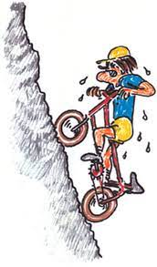
AS DOCTORS YOU HAVE A DUTY TO PARTICIPATE IN RESEARCH
with a view to improving patient care and supporting your team
Formal Route
Non Formal route
ACF/ACL
Higher degree
Less effort, less structured but at your pace
1
2
Think 30 years
3
What skillset & skill diversity would you like?
Support research implementation
I
Networks need establishing – Trust, College (Division –faculty), NIHR, Schools
4

Slide 10
The Thinking as per the Gospel of Rohit…
Personalized Holistic Care
Psychiatric -medical strategies
Social-environmental change
Genetics
Medication
Big Data
Technology AI & Apps
Co-production

Slide 11
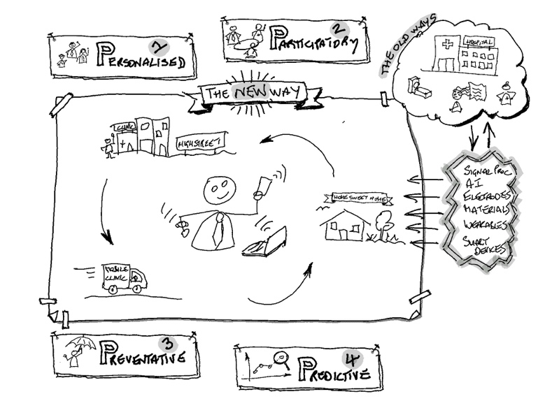

Slide 12
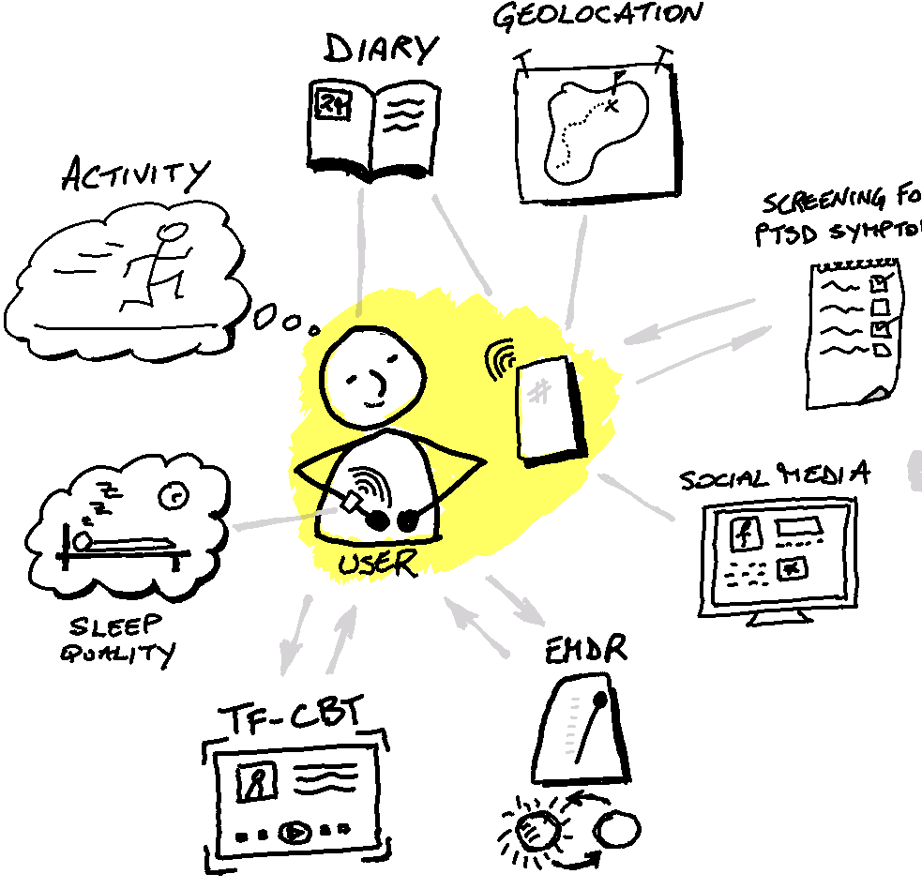
Questions?

