Slide 1

Welcome to
Eating Disorder Quality Network COVID-19 Webinar
Tuesday 14 July 2020
Julie Salt
Veronica Kamerling
Hosted by QED

Slide 2

Housekeeping
This session is a live event and your microphone and camera will be turned off
The webinar will be recorded and uploaded on the CCQI Webinars webpage
Please use the Q&A function to ask questions
If you are having any tech issues or would like to chat to other attendees, please use the chat function and ensure that your comments are going to ‘all panellists and attendees’
Email us at qed@rcpsych.ac.uk if you would like to present at one of our webinars or if you have a suggestion for a webinar

Slide 3
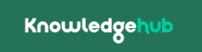
www.khub.net
Sign-up and access the group for more information:
COVID-19 Mental Health Improvement Network
→ Eating Disorder Quality Network (QED)

Slide 4
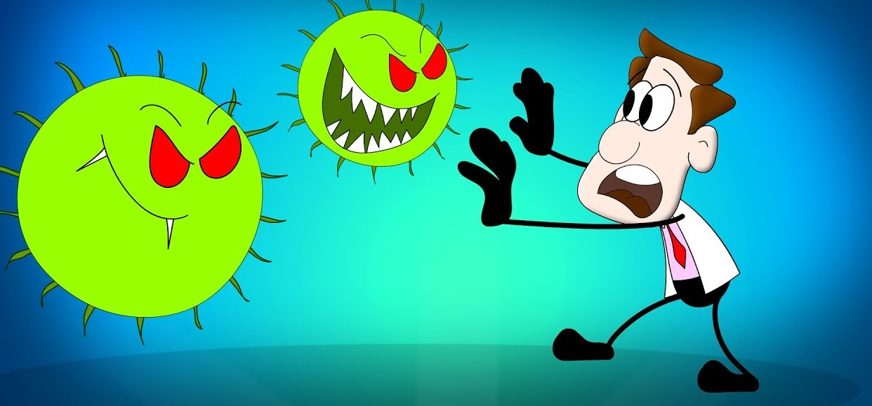
Lessons learnt from supporting a
loved one with an eating disorder through a global pandemic

Slide 5

The background
The fast growing spread of COVID-19 and the uncertainty is creating global anxiety
This has had a profound impact on all of our lives and has exacerbated anxiety and fear for not just those with a eating disorder but for their carers and families

Slide 6

What am I going to talk about
The challenges faced supporting loved ones with an eating disorder
The difficulties my daughters faced
What helped me/ worked well
Suggestions for services/ adaptations to support carers

Slide 7
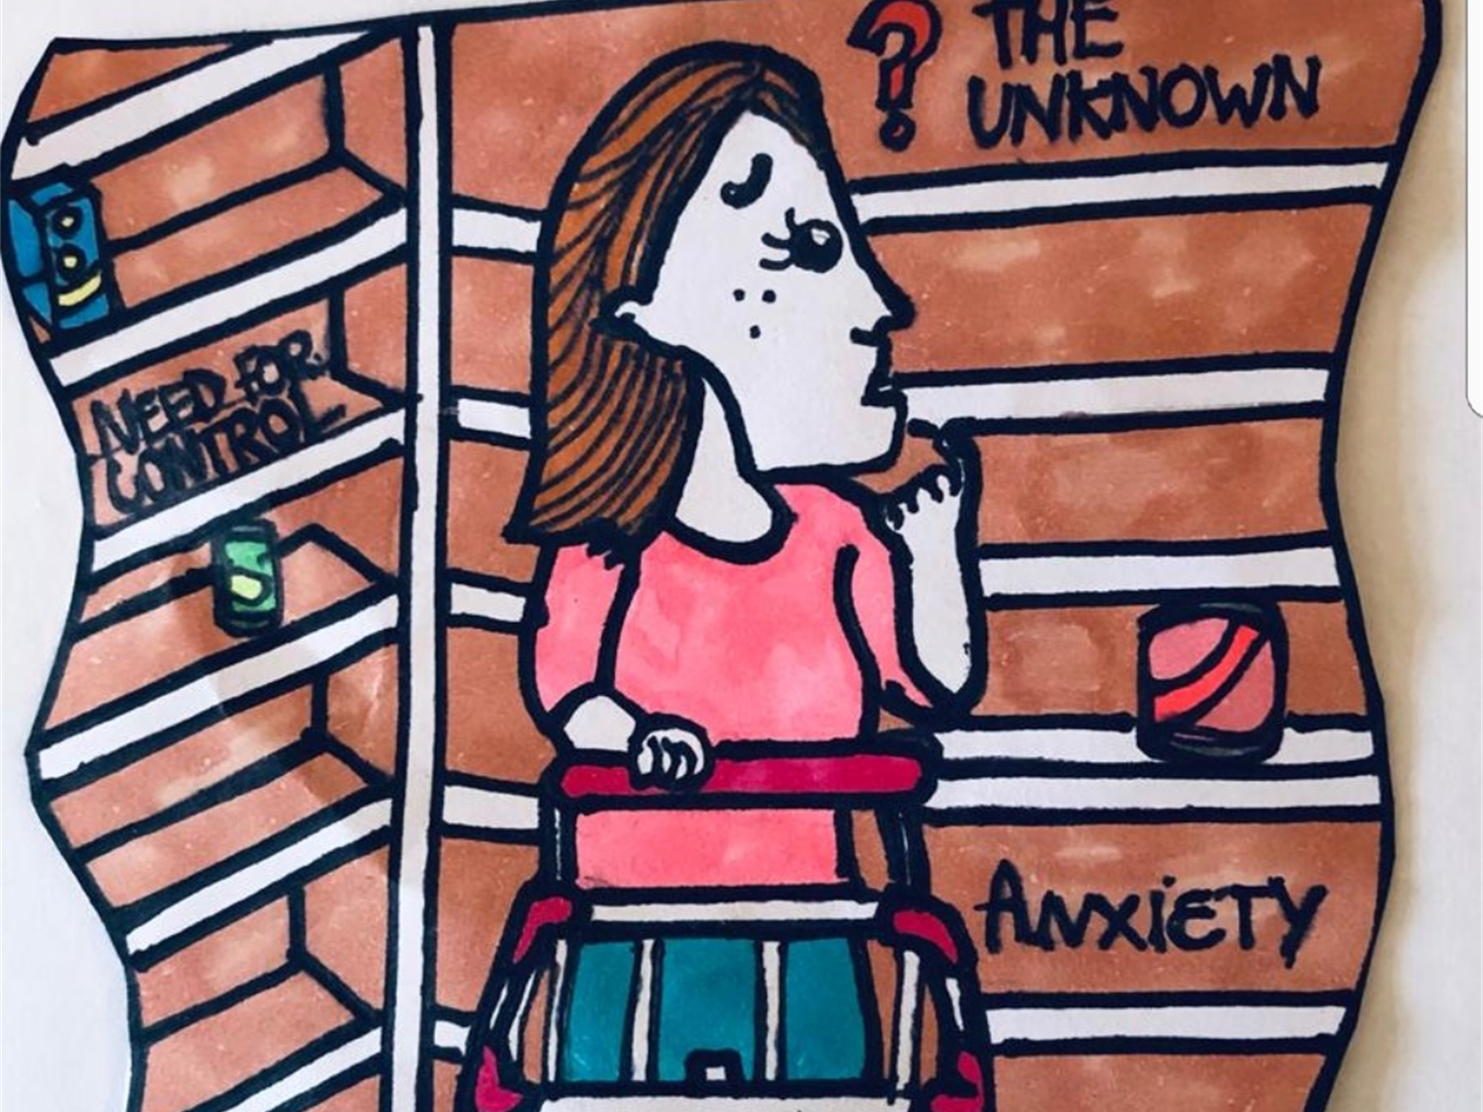

Slide 8

Difficulties faced
OCD behaviours, germ phobia coupled with a lack of anxiety and availability of hand sanitiser/ anti- bacterial wipes
Availability of food supplies and limitations in supermarket quantities
Increase in social anxiety with panic buying
Travel and movement restrictions- impact on physical and mental health

Slide 9
Difficulties continued
Disruption to services- stopping face to face contact /therapy sessions ( increased isolation)
Family uncertainty , anxiety around redundancy, job losses, hours reduction overnight
Loss of work and its associated purpose
Balancing needs of the loved one(s) with the needs of the whole family

Slide 10

What helped
Staying calm rather than getting drawn into the frenzy ! Not always easy to do….
Using the collective knowledge of peer online online support forums:
Beat- The Sanctuary
F.E.A.S.T community pandemic support
Anorexia & bulimia care
Making use of skills based communication skills

Slide 11
What helped….
Self-care- imperative to reduce own stress levels
Planning meals ahead- with shopping taking longer
Making plans for the future- individually and together
Using technology to connect- zoom, Teams
Taking focus off food- distraction
Nature- spending time outdoors- a positive influence
Toolkit- communication strategies
Establishing a routine and structure as a way of coping with change and preventing boredom- knock on effect for carers!
Encouraging limited use of social media other than for purposeful and positive engagement- helpful to loved one and carer

Slide 12

Suggestions for services
Recognise carer as pivotal in ‘ triangle of care’
Equip families with skills needed – communication, DBT
Information and support for carers
Using technology to connect with carers-to take part in reviews, in contact with loved ones
Dedicated access to clinical support ( even if no consent to share with family)
Facilitate peer support / up to date information on online support groups

Slide 13

Suggestions for services
Ask for feedback from carers on what their challenges were / are during covid and ask for their suggestions
Dedicated carer crisis support
Suggested by one carer-facilitate access to vulnerable shopping slots in supermarkets

Slide 14

In a nutshell
The most valuable source of support for me are the skills based communication skills I learnt-can be used in any challenging situation
If my daughter(s) are getting the right support at the right time (not fire fighting) from clinical staff with bespoke eating disorder training ( community) this goes a long way to my well being

Slide 15
What I have talked about…….
The challenges faced supporting loved ones with an eating disorder
The difficulties my daughters faced
What helped me/ worked well
Suggestions for services/ adaptations to support carers

Slide 16
Any questions?

Slide 17
RCPsych, King’s College London & Beat
Carer’s Survey
Do you have a close other with an eating disorder? The Royal College of Psychiatrists are collaborating with Kings College London and Beat to better understand the experiences of carers/close others in the UK. Share your thoughts and contribute to recommendations for change via our online survey.
https://kcliop.eu.qualtrics.com/jfe/form/SV_3U8HL9bxLFDBRM9

Slide 18
Thank you for attending!
If you are interested in presenting a webinar for QED, please email us at qed@rcpsych.ac.uk
This webinar will be uploaded to the following webpage shortly:
https://www.rcpsych.ac.uk/improving-care/ccqi/resources/ccqi-webinars/

