Slide 1



Julie Willoughby
Consultant Nurse – Dementia Services
Mobile: 07770800959
Email: j.willoughby@nhs.net

Slide 2
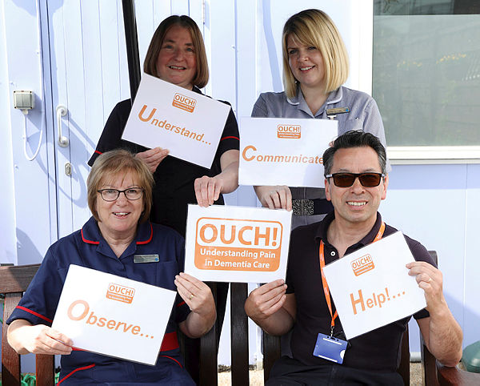
Our Team….

Slide 3
The Problem….
Evidence from research and clinical practice reveals that pain is often under recognised and under treated in people with dementia.
Aims….
Raise awareness and understanding amongst staff in relation to pain in dementia care.
Reduce unnecessary discomfort and distress for patients with dementia.

Slide 4

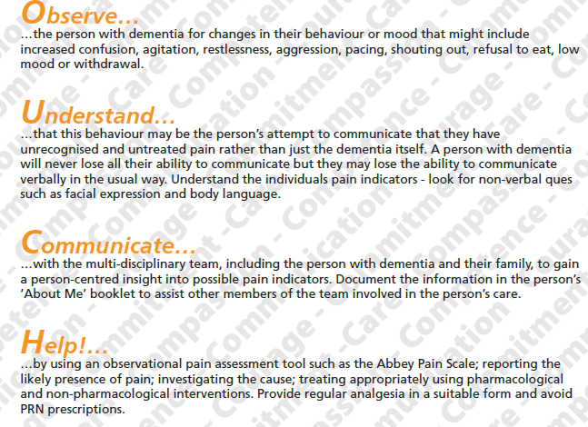

Slide 5
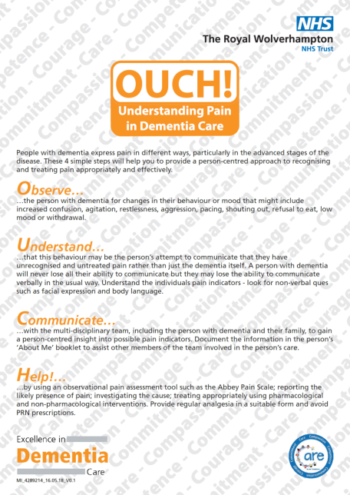
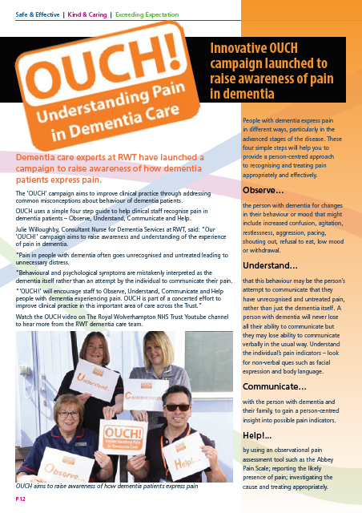
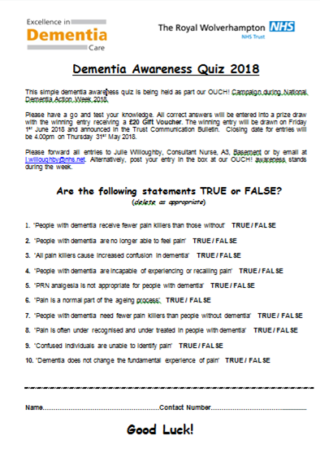

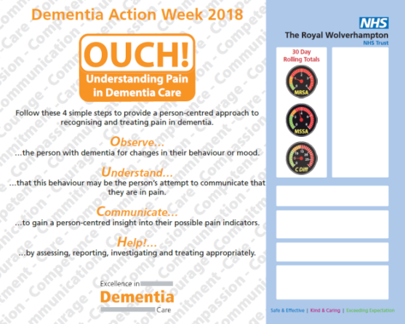
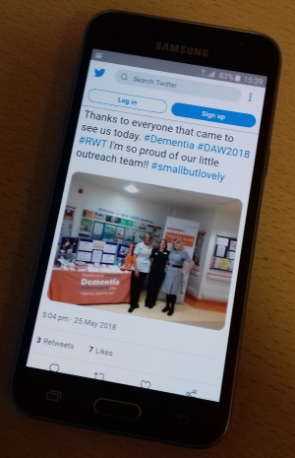
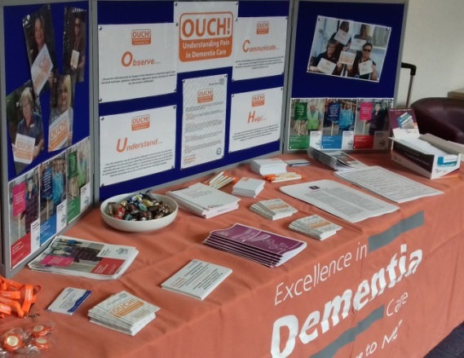
Raising Awareness….

Slide 6
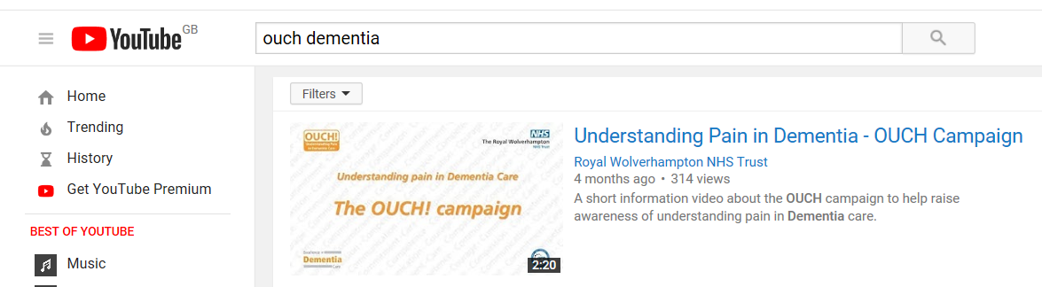
https://www.youtube.com/watch?v=4kEvhkzH27w

Slide 7
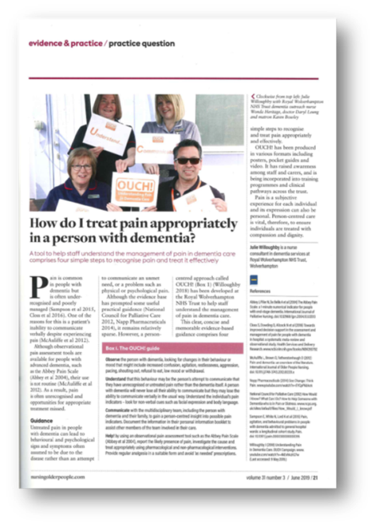

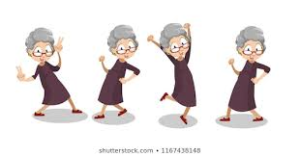
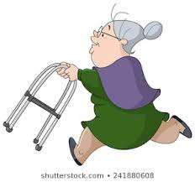
Results….
Positive feedback locally and nationally
Case Studies

Slide 8
What Next?
Quantitative evaluation of effect in clinical practice
Further qualitative evidence of positive outcomes
Continue to advocate the approach through clinical practice
Continue to include the approach in Dementia Training Programmes
Development of a package for family & informal carers
Development of ‘Dementia Friendly’ Prescribing Guidance
Promote the approach locally and nationally

Slide 9
“Thank you for listening”
Any questions?

