Slide 1

      Welcome to the NCAP Quality Improvement collaborative second round shared learning session one
Thursday 25th July 2024
13:30-15:00

Slide 2
Time: | Item: | Speakers:
13:30pm | Webinar opens- Welcome and outline of round two of the QI programme. | Maureen McGeorge and Sadhbh Fitzgerald-NCAP QI coaches.
13:40-14:30pm | Enhanced teams' presentations- we will split into two breakout rooms with two teams presenting an overview of the early stages of their QI projects followed by a Q&A session where attendees can submit questions to the QI teams. | Breakout group 1 (stays in main webinar) Cornwall and NAVIGO Lincolnshire EIP teams with Maureen. Breakout room 2- PATH Hertfordshire and Warrington & Halton EIP teams with Sadhbh.
 | Pocket QI training- we will cover the early stages of a QI project including question one of the Model for Improvement “What are you trying to accomplish?” | Maureen McGeorge and Sadhbh Fitzgerald-NCAP
15:00pm | Webinar closes

Slide 3
This year’s core QI programme
Core programme
Our core programme is open to any NCAP EIP or CYP team. It is an opportunity to learn how to use the Model for Improvement to tackle any aspect of your service’s performance against the NCAP key standards, we will be offering a range of support, including:
Monthly drop-in coaching sessions*.
Pocket QI training -which will feature in each of the four online shared learning sessions throughout the programme.
Online QI resources via a dedicated webpage.
* Our monthly drop-in QI sessions will be open to any NCAP team interested in receiving informal QI support from our QI coaches. These sessions will be offered on a first come first served basis where any team can book a call with a QI coach to discuss a QI. Your project topic can align with any of the NCAP key standards, and you will not be required to complete a registration form to join these sessions. A booking page will be made available with 30-minute bookable slots; teams will be required to complete and send back a short summary of what they are working on one week before their call.

Slide 4

NCAP QI collaborative round two shared learning session one
25th July 2024
13:30-15:00
Team name: Cornwall eip
Team locality: Cornwall

Slide 5
1. QI team membership
Team members:
Anne Gore
Catherine Tierney
Hazel Carter
Jordan Balding
Lois McLoughlin
Lynn Spurrell
How are you involving people with lived experience in your QI work ?
Anne is our Lived Experience addition to our team. She is currently working within EIT, but also has experience of caring for her child who experienced an episode of psychosis and received care from our early intervention service.
Notes:
Prompts- please list your QI team membership including lived experience representatives (don’t have not provide names if they do not consent)

Slide 6
2. What’s your problem/area for improvement?
Our area for improvement is improving the carer support that we offer as a team. This includes looking into what might be preventing carers from attending the groups we have attempted to set up in the past, and gathering data to try and improve the uptake of attendance to a carer support programme being offered by our team.
Notes:
Prompts- what is the problem you are tackling ? E.g. improve our team's performance on the Fi standard- can add details about how and why you chose to focus on this standard.

Slide 7

3. What diagnostic tools/exercises did you use to better understand your problem?
To begin with we sent out a questionnaire to our staff, to try and ascertain a better understanding of how they feel in their role of delivering carer support within EIT.
The questions included:
* Do you think carers groups in EIT matter
* Have you got confidence in promoting carers groups to family and friends of clients?
* Do you have confidence in delivering carers support
We received 9 responses from a possible 22. All 9 people responded saying that they believe carer groups matter. 8/9 people responded saying they would feel comfortable promoting carer groups. 8/9 people said they have confidence delivering carers support.
Notes:
Prompt- what have done to better understand your problem ? Staff surveys’, team meetings, collected your baseline data (add in what this is)

Slide 8
3. Continued…
We then used a very basic and easy to use questionnaire to gather data around the main things we wanted to learn about regarding carer support. These questionnaires were distributed among the team and we asked each care co-ordinator to try and get feedback from at least 3 carers within the space of a month. We received 15 responses to our questionnaire which was lower than we hoped.
Carer questionnaire:
1: what support do you feel you would need?
2: what would you identify as a barrier to attending groups?
3: would you prefer to attend groups or have 1-1 support?
4: would you prefer to attend face to face or online?
5: would you prefer to have a structured group or free flowing conversation?
6: what would encourage you more to come to groups?

Slide 9
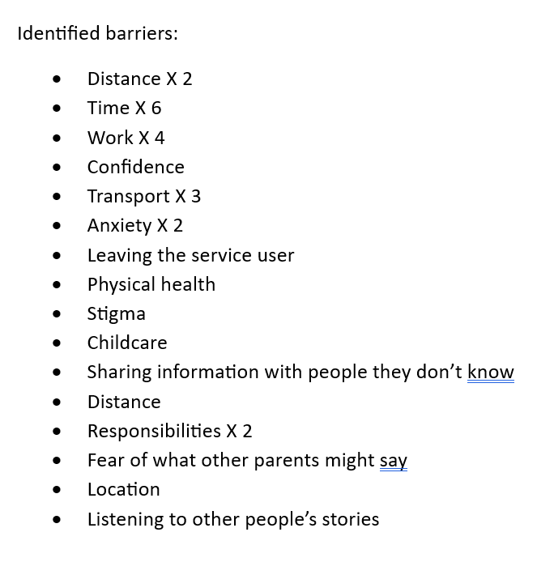
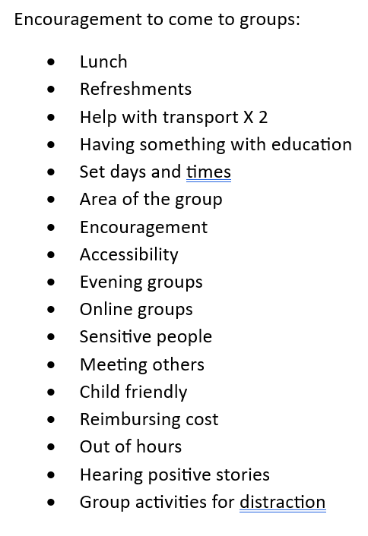
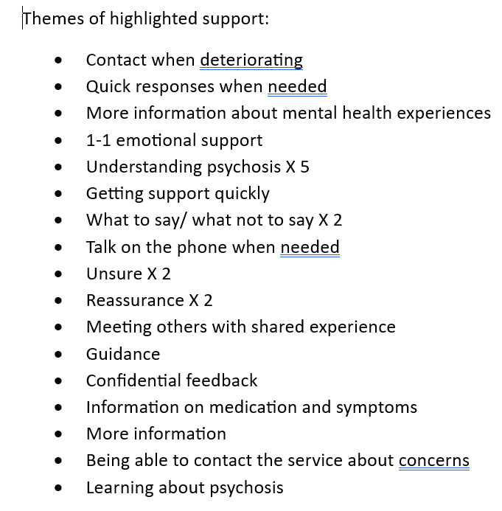
Data Collection

Slide 10
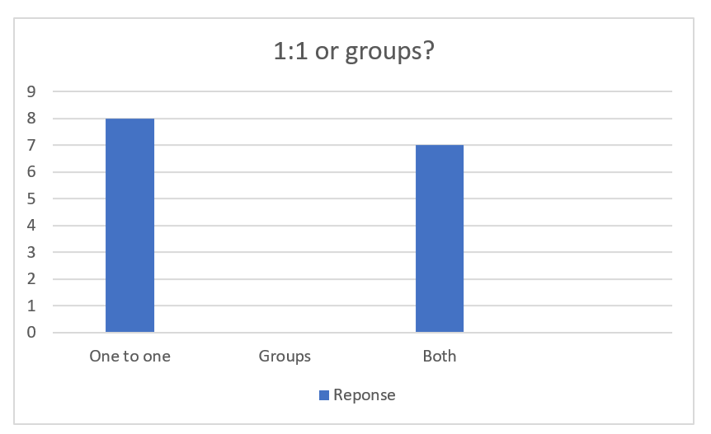
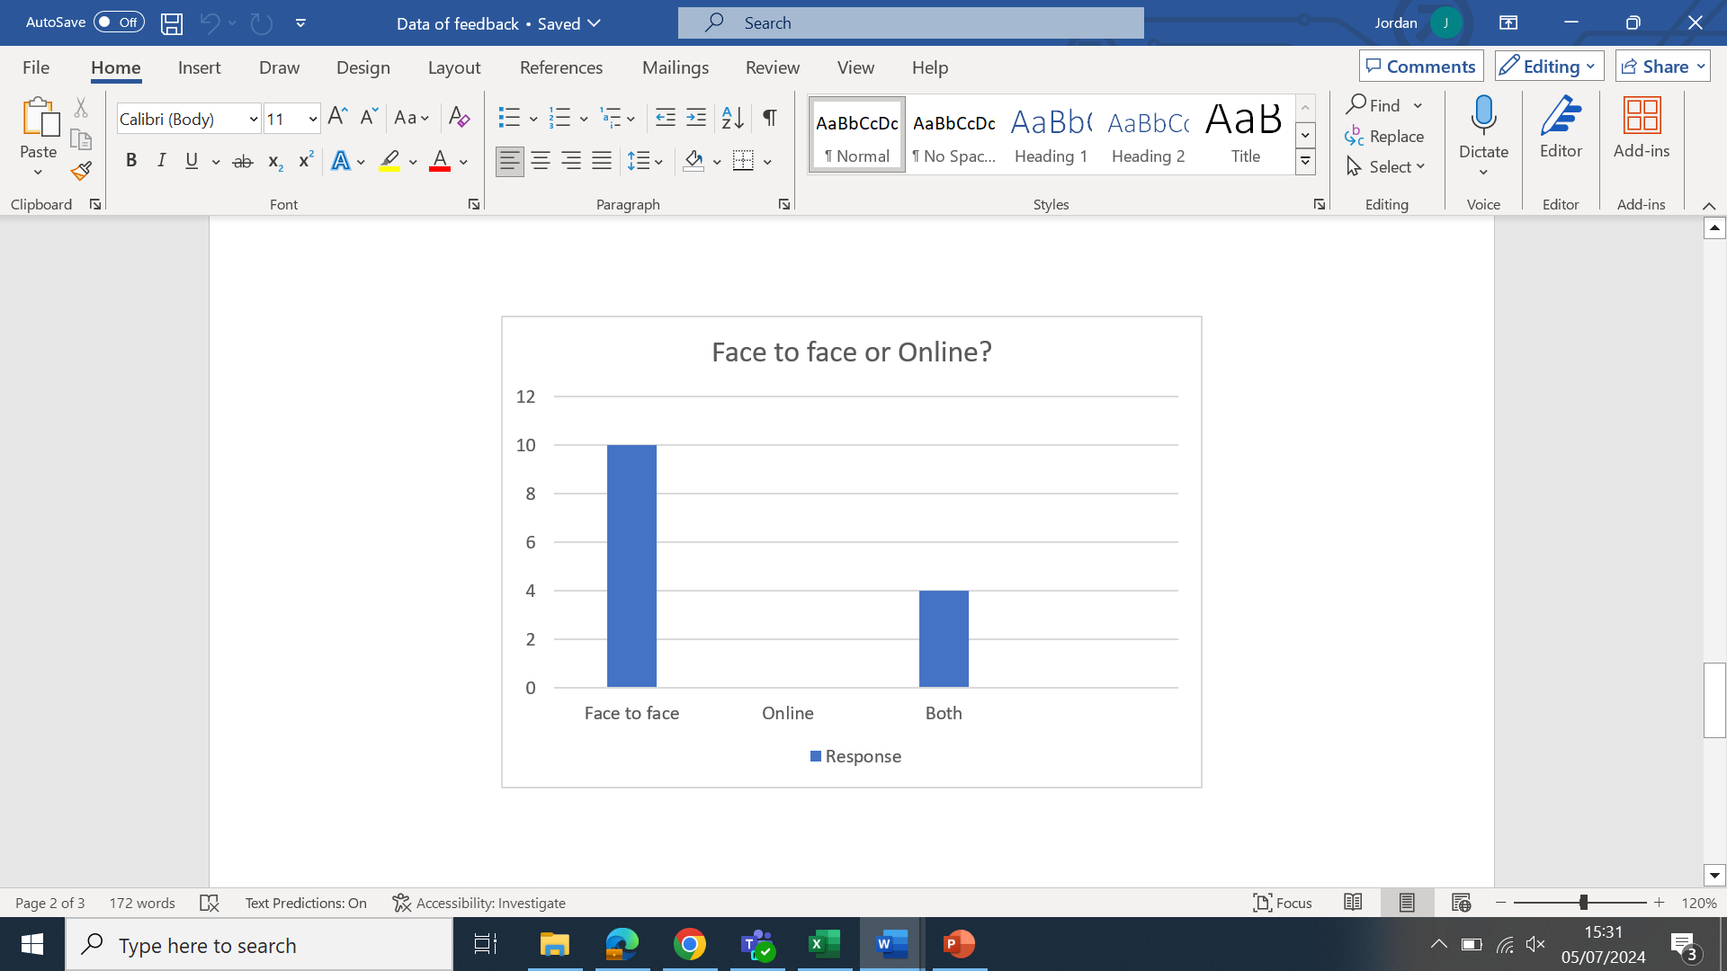
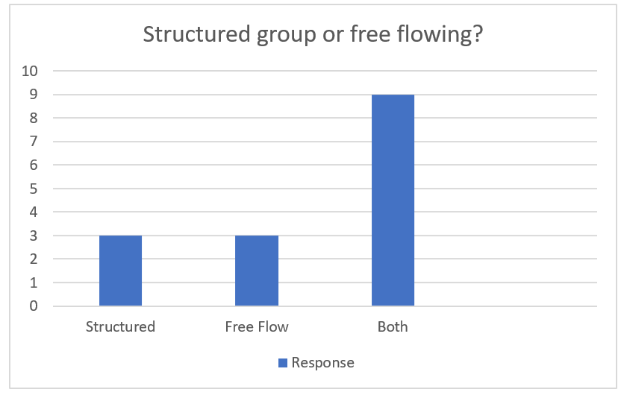

Slide 11
4. What was your key learning about the area you want to improve?
From looking at the results of our data collection, we were able to identify that 1-1 appointments were widely selected above groups. Whilst a few people identified that they would like both 1-1 and groups, no one highlighted that they would like groups alone. This has influenced us into setting up a trial of 1-1 appointments. Taking advice from our FIS workers within the team, we have decided to start working with the friends and family of people newly confirmed to caseload first.
The most common them of what people identified they wanted to get from friends and family meetings was more education around understanding psychosis. As well as that, people identified wanting more reassurance and help knowing what to say/what not to say. This has given us ideas of what we could include in the 1-1 appointments.
2/3 of people stated that they wanted only face to face appointments, and so this is what we will attempt to offer in the first instance.
Notes:
Prompt- did anything come up you didn’t expect ? It would be helpful for teams to think about whether there was any difference between what you thought was the problem versus what actually came up via survey's, conversations with staff/service users, trends in baseline data etc.

Slide 12

5. What is your statement of aim?
To increase the uptake of carer’s support by 40% to reach 50% of friends and family of newly confirmed clients on our caseload. We aim to do this by May 2025. To achieve this we will be promoting and facilitating a mixture of 1-1 appointments and group opportunities to meet the expectations highlighted in the data from our carer survey.
We agreed on our aim statement by reviewing the data collected and working with staff and carers. We reviewed the requirements of the NCAP audit, and this helped us identify a percentage to work towards, to meet the criteria. In our last NCAP audit, we scored ‘needs improvement’ for our carer support, indicating that this is something we want to work on.
Notes:
Prompt- E.g to Improve the uptake of Fi for all eligible service users by 10% by May 2025. please add in some detail about how your team arrived/agreed on your aim statement.

Slide 13

6. What are you going to measure?
We have collated a number of measurable questions using a Likert scale based on the themes highlighted in our original questionnaire. These questions will be asked prior to the 1-1 appointment, and then again within the week following the appointment. The results of these questionnaires will provide us with comparative quantitative data, to assess the outcome of the 1-1 appointments, and how they have helped people.
The questions are as follows:
On a scale of 1 to 10 how confident are you that you understand psychosis?
On a scale of 1 to 10 how confident are you in caring for someone with psychosis?
On a scale of 1 to 10 how confident are you in recognising the symptoms of psychosis?
On a scale of 1 to 10 how much understanding of medication for psychosis do you think you have?
On a scale of 1 to 10 how likely are you to call into the office and ask for support when you feel you need it?
Would you be interested in attended a supportive educational group?
Notes:
Prompt- thinking about your aim and change ideas what are you going to measure to understand the impact of your change ideas ? E.g. ongoing outcome measure will be how many families start FI per week/month or staff confidence levels before and after refresher training etc.

Slide 14
7. Our next steps
Based on the data we collected, we have decided to start by offering one off 1-1 appointments, delivering educational based support to friends and family of clients recently confirmed to our caseload. We will trial this on a face to face basis for 3 months before collecting more data on what people thought of the appointments, and what they highlight would be useful going forward. Using this data, we can study the quality of the support offered, and adapt where needed to develop another plan going forward. This will enable us to work within a PDSA model whilst carrying out the QI project and meeting our goal.
Notes:
Prompt- this can include a list of the change ideas you have come up with (can be provisional ones and don’t have to be in the order you are going to test them in if that’s not been decided), reviewing your survey results, meeting with carers groups etc.

Slide 15
NCAP QI collaborative round two shared learning session one
25th July 2024
13:30-15:00
Team name: PATH
Team locality: Hertfordshire

Slide 16
1. QI team membership
Team members:
Tamar Haye – PATH Family Intervention Lead Practioner
Amy Lucas – PATH Psychology Lead
Mary Ingram – PATH & ARMs Service Line Lead
Louise Raymond – PATH & ARMs Operational Team Leader
Nicola Green – Head of Adult Mental Health Psychological Services
Tim Dobson – Expert by Experience
Keith Brown – PATH Occupational Therapist (Family Intervention trained)
How are you involving people with lived experience in your QI work ?
We have an Expert by Experience as part of our QI membership team

Slide 17
2. What’s your problem/area for improvement?
Family Intervention – capacity to deliver this intervention
The take up % for the intervention is low
We’ve previously been an outlier for FI on NCAP audits up to 2022 audit.
Too few staff trained to deliver FI
High turnover of trained staff from Team
A one year waiting list for therapy
Current model – Kings Model - The need for pairings – one of which needs to be a professionally qualified member of staff – limited to B5s & above to access training
Yearly intake for training places & limited allocated places
Time taken to arrange session start up
Frequency of sessions offered – currently fortnightly

Slide 18
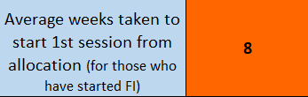
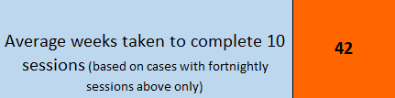
3. What diagnostic tools/exercises did you use to better understand your problem?
* Feedback from away days for FI Trained staff * Staff surveys to wider PATH team & FI Trained staff
*Fortnightly FI Tracker meetings * PATH EIP Reporting Dashboard
*Audit completed in Nov 2023 of current FI cases
at that time

Slide 19
4. What was your key learning about the area you want to improve?
What we thought we needed
Improvements to the way we prepare & setup sessions
Increase the frequency to weekly sessions
Results of staff surveys
Workload management
Support for people on FI training
Increase the number of staff going onto training
Reduce the dropout of staff on training
Explore the reluctance to go onto training
Wider PATH staff want to be trained
Refresher/ongoing training for FI workers

Slide 20
5. What is your statement of aim?
To increase the uptake of FI from 8% to 16% by May 2025.
Overall NCAP Audit level 3 attainment by end 2024-25 – 16% for FI = level 3
MHSDS reporting (whole caseload) is currently 8% = level 2

Slide 21
6. What are you going to measure?
Continue to measure from the EIP reporting dashboard:
- Take up %s and numbers of service users
- Waiting list sizes & longest waits
- Offers of FI to service users who aren’t on waiting lists
Service user & family survey to gather experience levels & capture feedback from FI therapy sessions
Staff surveys around experience of change of ideas & repeat confidence level surveys from training sessions
Change ideas – take baseline data & review after these are setup

Slide 22
7. Our next steps
Moving to a dedicated clinic slot for FI pairings to protect time for FI delivery
Enhance the FI Tracker to include the rationale for sessions being extended beyond 15 sessions & detailed narrative on gaps in sessions taking place
FI reporting – needs to be updated to include FI specific sessions only
Embed refresher training sessions for FI staff – simulation hub
Service user & Family questionnaire to be developed & sent out to all current recipients of FI on caseload.
Job planning for FI workers – how to build in protected time & balance workload
Explore moving to a different FI model
Increase dedicated workforce for FI by changing budget skill mix

Slide 23
NCAP QI collaborative round two shared learning session one
25th July 2024
13:30-15:00
Team name: NAVIGO EIP
Team locality: NORTH EAST LINCOLNSHIRE

Slide 24
1. QI team membership
Team members:
Jeanette Blythe – EIP Team Manager/Clinical Lead
Vickie Nielsen – EIP CBT Therapist
Becky Witte – EIP Peer Support Worker
Lucy Sumpter – EIP Nurse Practitioner
Zara Downham – EIP Social Work Practitioner
5/of a staff of 11.
How are you involving people with lived experience in your QI work ?
-Questionnaire
-Peer Support Worker
Notes:
Prompts- please list your QI team membership including lived experience representatives (don’t have not provide names if they do not consent) Slide one:
Navigo’s EIP is made up of 6x clinicians (3x Social Workers, 1x Occupational Therapist and 3x Nurses (one of those being the teams manager), a CBT Therapist, A Consultant Psychiatrist, 1x Support worker and 1x peer support.
The Peer support worker role is recognised within the team as crucial and instrumental in the functionality of the team as a whole. It is firmly understood that there is no better understanding of the complexities and experiences of our service user group then that of someone who has experienced Psychosis and continues to live with this themselves.
Becky’s provides insight and self-describes as a ‘Beacon of hope’, which is exactly what she is ☺
In terms of considerations for this particular project, the Peer Support worker role has been utilised to obtain the voice of our service users, particularly the individuals who have previously declined Family Intervention in the past.
Becky has constructed a questionnaire designed to explore the initial notions behind declining FI and what service users expectations would be. Although not many of these have been completed yet, the information obtained has been really useful and suggests that language is important. This is something that has been considered largely in the development of advertising the intervention through redesigned leaflets and a new programme name – bridging the gap.

Slide 25
2. What’s your problem/area for improvement?
An extremely low up-take of family intervention, which violates NICE guidelines and NCAP statistical information.
Which is associated with:
-Staff Training (4/8)
-Smaller team then most EIP’s
-Socioeconomical deprivations of the local area
Notes:
Prompts- what is the problem you are tackling ? E.g. improve our team's performance on the Fi standard- can add details about how and why you chose to focus on this standard. Slide two:
The most general element of our proposed problem is that we have an extremely low up-take of family intervention, which violates NICE guidelines and NCAP statistical information. The reasoning behind this is multifaceted in that there are a number of contributing factors:
-The number of qualified staff in a position to deliver FI in the initial stages of this NCAP QI ‘activity’ was 4 out of 8 eligible members of the team. This is in the process of rectification as four more members of the team are currently undertaking training through Kings College London. This aids in the team increasing only slightly, the figures for uptake when compared to the last year. Each of the FI students are required to undertake practice with 2x families before December.
-A lot of teams have described an apprehension in delivering FI, however our team have widely understood that this is a crucial element of role specifications, which was conveyed at the point of employment.
-The team is based in North East Lincolnshire, covering predominantly the area’s of Grimsby and Cleethorpes and smaller surrounding towns. These are considered socioeconomically deprived area’s with high uptake of social support systems, low employment/educational prospects, high levels of substance abuse and co-morbidity and domestic violence/abuse. There is also a high level of county line factions embedded amongst the culture of the area’s young people and tackling this is becoming increasingly more difficult.
The majority of individuals that enter into services have had some form of intervention in the past, such as that of Children’s services which carries with it a lot of negative stigma and personal connotations for services user. As such in the planning stages, we considered that words such as ‘Family Intervention’ are being negatively received by services users and their families as this is similar to the name that Children’s Social services called their intervention programme. Also the word ‘intervention’ appears to generate notions that there is a problem that needs to be fixed or that families that receive FI are broken in someway. This is further hindered by staff’s inability to fully describe what the FI programme is designed to do – due to a lack of training and understanding.
-Another area of consideration is that FI uptake has never been formally measured and monitored and so we are in the process of trying to construct and implement specific process measurements which can be periodically reviewed to ensure the team remains on track and is able to identify achievable goals. Moving forward, the process measurements can be utilised to assess outcomes, effectivity and identify a new level of achievable outcomes to continue to progress this particular objective.

Slide 26
3. What diagnostic tools/exercises did you use to better understand your problem?
Questionnaire constructed and delivered by the teams Peer support worker
Weekly MDT discussions
Monthly FI MDT/Group supervisions
Monthly supervisions with Kings College for FI students (Four members of the team)
Notes:
Prompt- what have done to better understand your problem ? Staff surveys’, team meetings, collected your baseline data (add in what this is). Slide Three:
-As previously stated, we have constructed a questionnaire toll which was designed to guide a conversation between the teams Peer Support Worker – Becky – and service users that had formally declined FI. Although this is still being disseminated, the few that have been completed so far do provide evidence that language and communication are key considerations for improving uptake moving forward.
-As such, a new information leaflet has been constructed by Vickie – the teams CBT therapist which has been designed to convey the FI process, reduce anxiety with knowledge, encourage participation through understanding, validation and unity. This was designed with the considerations made during team supervision sessions and also led to a programme rename: Bridging the gap.
-Regular supervision sessions designed to focus specifically on FI and the NCAP QI project have also helped the Navigo NCAP QI team to identify that the current processes applied with care delivery and reviewing service users care plans can be rigid. This has led to an overhall of the service menu to enable all interventions offered to services user to be revisited and re-offered
-Carers education groups

Slide 27
5. What is your statement of aim?
To increase the uptake of FI for all eligible service users by 10% by May 2025.
To measure the baseline data (63 x on caseload, 13 x accepted, 3x unsure, 47 declined) which would represent who is accepting, attending and completing.
This would generate change ideas and set targets along the way which will hopefully provide a detailed account of what is working
Notes:
Prompt- E.g to Improve the uptake of Fi for all eligible service users by 10% by May 2025. please add in some detail about how your team arrived/agreed on your aim statement.
April: 63 x on caseload, 13 x accepted, 3x unsure, 47 declined

Slide 28
6. What are you going to measure?
Uptake of FI for all eligible service users
Attendance at first appointment
Completion of agreed number of sessions.
Notes:
Prompt- thinking about your aim and change ideas what are you going to measure to understand the impact of your change ideas ? E.g. ongoing outcome measure will be how many families start FI per week/month or staff confidence levels before and after refresher training etc.
You’ll be measuring your uptake of FI but we also spoke abpit attendance at first session and completion of agreed number of sessions.

Slide 29
NCAP QI collaborative round two shared learning session one
25th July 2024
13:30-15:00
Team name: Early intervention team in psychosis
Team locality: Warrington & Halton

Slide 30
1. QI team membership
Team members:
Stephanie Smith, Clinical Team Manger.
Tracy Harrison, Clinical Lead.
Rachel Nolan, Research Assistant.
How are you involving people with lived experience in your QI work ?
Carers, who have participated in Behavioural Family Therapy, to provide video/ audio recordings.
Notes:
Prompts- please list your QI team membership including lived experience representatives (don’t have not provide names if they do not consent)

Slide 31
2. What’s your problem/area for improvement?
FI is needed to reduce relapse.
Date informed us that: not enough meaningful offers are being made.
Team is not delivering enough FI to patients & families.
Data not captured correctly due to codes used on Rio.
Staff’s enthusiasm towards FI.
Notes:
Prompts- what is the problem you are tackling ? E.g. improve our team's performance on the Fi standard- can add details about how and why you chose to focus on this standard.

Slide 32
3. What diagnostic tools/exercises did you use to better understand your problem?
Barriers
Change ideas
Themes: Time, Caseloads, Confidence, Engagement, Education.
“Completing the training a while ago, therefore not feeling comfortable with facilitating”
“Managing a big caseload and not working full time hours.”
“Not interested, don't feel it is relevant to their care”
“Complex relationships with family, engagement and motivation can be poor”
Themes: Staffing, Supervision, Training, Update materials
“Protected time for staff to deliver FI, Regular supervision. Newly trained doing FI with experienced staff. Top up training”
“Increase in number of care coordinators to free up time for staff to engage in BFT work with families”.
“Think leaflet for family members could have more about the research into BFT, and degree of success for people that engage with it”.
“I do feel that our team having a full time staff member to focus on FI would benefit us”.
Notes:
Prompt- what have done to better understand your problem ? Staff surveys’, team meetings, collected your baseline data (add in what this is)
Staff Survey:
Importance of FI: Scores range from 4-10 (average 9)
FI apart of your role: Scores range from 1-10 (average 6)
Confidence in explaining to families: 3-10 (average 8)
Confidence in delivering to families: 4-10 (average 7)

Slide 33
4. What was your key learning about the area you want to improve?
Time/ non protected time
Workload/ high caseloads
Confidence
Team not viewing FI as a part of their role
Education to patients & families
Feeling the family are to ‘blame’
Not interested/ feeling it is not important
Notes:
Prompt- did anything come up you didn’t expect ? It would be helpful for teams to think about whether there was any difference between what you thought was the problem versus what actually came up via survey's, conversations with staff/service users, trends in baseline data etc.

Slide 34

Statement
To increase the uptake of BFT, for all eligible patients and their families. The aim is to have a 10% increase in the uptake by May 2025.
Notes:
Prompt- E.g to Improve the uptake of Fi for all eligible service users by 10% by May 2025. please add in some detail about how your team arrived/agreed on your aim statement.

Slide 35
6. What are you going to measure?
Change ideas
Measure
Regular supervision
Offering BFT earlier
Updating the BFT leaflet, provided to patients and families
Expert by experience to discuss with families on their experience of BFT.
Regular training/ refresher role plays.
Attendance sheet, feedback sheets.
Monitoring offers made in MDTs.
Survey to staff and patients/ families on their views of the current leaflet.
Uptake numbers of BFT from families.
Confidence scale, pre & post EIT away day.
Notes:
Prompt- thinking about your aim and change ideas what are you going to measure to understand the impact of your change ideas ? E.g. ongoing outcome measure will be how many families start FI per week/month or staff confidence levels before and after refresher training etc.

Slide 36
Next steps
Supervision: To ask facilitators to add role plays to supervision.
Offer BFT earlier: To discuss in MDT’s, organise carers group (once a month) for new patients on the First Episode Psychosis (FEP) pathway.
Leaflet: Distribute survey to staff and patients/ families.
Expert by experience: Ask families to provide video/ audio videos.
Training/ role plays: Organise EIT Away Day.
Notes:
Prompt- this can include a list of the change ideas you have come up with (can be provisional ones and don’t have to be in the order you are going to test them in if that’s not been decided), reviewing your survey results, meeting with carers groups etc.

Slide 37
Pocket QI training

Slide 38
Choosing your QI team: things to think about from the start
Think systematically about who needs to be involved.
What sort of things are you going to need and who can help you get hold of them? e.g., admin support, staff cover?
Who understands the parts of the system that you are trying to improve so you can work out what is causing the problem?
Who’ll be affected by the changes you are trying to make? Are they likely to stop you?
Who are the people who like to get involved with new ideas?
For all the above: do they need to be involved on a day-to day basis (actively) or kept up to speed (passively)?

Slide 39
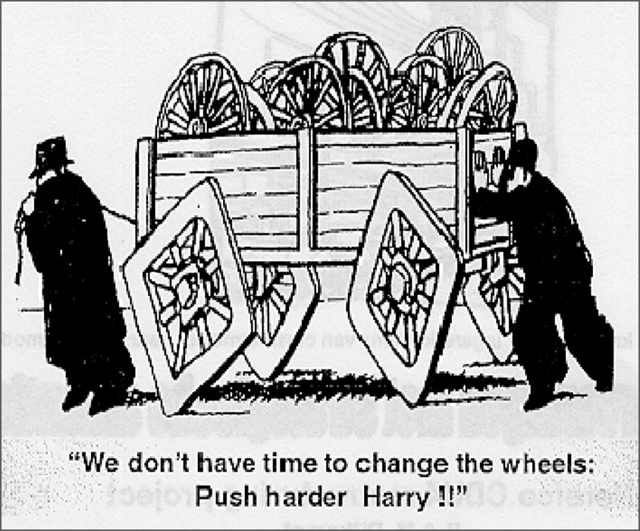

Setting the scene: improving quality
Is it easy to improve
something when we
want to improve? For
example:
Perfecting a recipe
Improving our best time for a 5K run
So, what happens if …
….. someone else tells us to improve something we think is fine as it is, or …
… we have to rely on other people to help us make the improvement.

Slide 40

Setting the scene: so, what are we trying to say?
Improving things isn’t (usually) easy.
Improvement does not just ‘happen’.
We don’t always know that improvement is needed.
We don’t always ‘fix’ things that are broken.
We don’t always see how much easier things could be … if only we stopped and thought about how we could do things differently.
We need a ‘consistent’ way of testing out different ideas so we can achieve better results and improve quality.

Slide 41

Setting the scene: how we deal with complex problems ?
Trial and error?
Chaos
Detailed prior study?
Paralysis
Too much action, not enough thinking
Too much thinking, not enough action
“Just go ahead and do it”.
“We can’t do anything until we know exactly what to do….”
‘Trial and Learning’ approach
Jeremy Heimens, Henry Timms
New Power: How it’s changing the 21st century and why you need to know(2018)

Slide 42
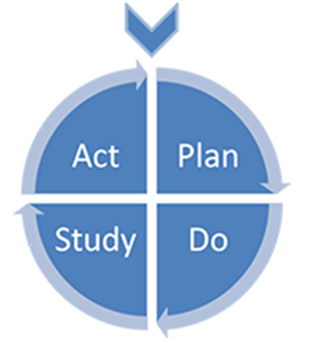
Setting the scene: The Model for Improvement
1. What are you trying to accomplish?
2. How will you know that a change is an improvement?
This is not a linear process!!!
3. What change can you make that will result in improvement?
Langley G, Nolan K, Nolan T, Norman C, Provost L, (1996), The improvement guide: a practical approach to enhancing organisational performance,
Jossey Bass Publishers, San Francisco

Slide 43
Setting the scene: The 5 stages of Improvement
1. What’s your problem? Understand what you need to improve and why.
2. How will you know whether you are improving? Agree one or more ‘measures’ so you can track your progress.
3. What are the ideas that you can test to show whether you are improving? Develop effective change ideas or interventions that will result in improvement.
4. Test changes before implementing. Try them out on a small scale to find out whether that change will lead to improvement on a larger scale.
5. Implement/embed: make any effective changes permanent.

Slide 44
The Model for Improvement
1. What are you trying to accomplish?
Understanding the problem and why it’s happening. Knowing what you’re trying to do – a clear and desirable aim.
2. How will you know that a change is an improvement?
3. What change can you make that will result in improvement?
Langley G, Nolan K, Nolan T, Norman C, Provost L, (1996), The improvement guide: a practical approach to enhancing organisational performance,
Jossey Bass Publishers, San Francisco

Slide 45
Q1: Examples of tools and techniques
Review the ‘data’- old and new; qualitative and quantitative e.g. staff surveys, NCAP data, patient and carer feedback.
Brainstorming
Process mapping
The “5 whys”
De Bono’s 6 hats
Pareto Charts

Slide 46
Q1: Don’t forget the importance of contributory factors in improving quality
A ‘contributory factor’ is something that helps cause a result.
An example: I cut my finger badly slicing a loaf of bread.
What were the contributory factors?
It was a new, sharp knife (equipment).
My cat jumped up on the table while I was cutting (distraction).
The bread was crusty and hard to cut (difficulty of task).
I’m not very good at cutting bread (skills).
Not all are amenable to improvement!

Slide 47
Q1: Don’t forget the importance of contributory factors in improving quality
Example problem: Carers are not receiving adequate support
Diagnostic exercises reveals LOTS of contributory factors;
Time: staff are concerned about the time allocated to offer support sessions
Confidence: not all staff feel confident to offer support to carers
Information: not all carers know support is available
Access: not all carers are able to attend support sessions
In your service, which would be amenable to improvement?

Slide 48
Q. 1 What are you trying to accomplish?
What is your problem?
Diagnosis/analysis
What are you going to do about it?
So now you REALLY understand your problem and what’s causing it….

Slide 49
Q1: How to write a statement of aim
An effective aim addresses an issue that is important to those involved. It is specific, measurable, and answers these questions:
What? State the focus of your improvement effort, which should relate to the problem you’re trying to solve, or patient /staff need.
How good? Agree a numerical goal for the outcome (should be ambitious but achievable).
By when? Specify the timeline for when you want to reach that goal.
For whom? Who will benefit from the improvement?
Where? Define the process or system you want to improve. What is the scope? What are the boundaries? (it's important to be realistic as well as ambitious)

Slide 50
Q1: How to write a statement of aim
Make sure it is clear so that everyone who hears it will have the same understanding (an ‘operational definition’).
Make sure everyone agrees it is important.
AND
Remember: a statement of aim is often most powerful when you write it from the perspective of the service user or staff.

Slide 51
Q1: key learning points
When a problem keeps happening, there are lots of different things you can do and people that you can ask to help you understand why.
This can take a long time so it’s important to choose carefully so you don’t waste time, effort and money.
Your statement of aim needs to be clear so that everyone understands the same thing.
You may need to take a slightly different perspective on how you write it to make sure that everyone agrees with it.
You may need to modify your aim if you reach your goal more quickly than you expected.

Slide 52
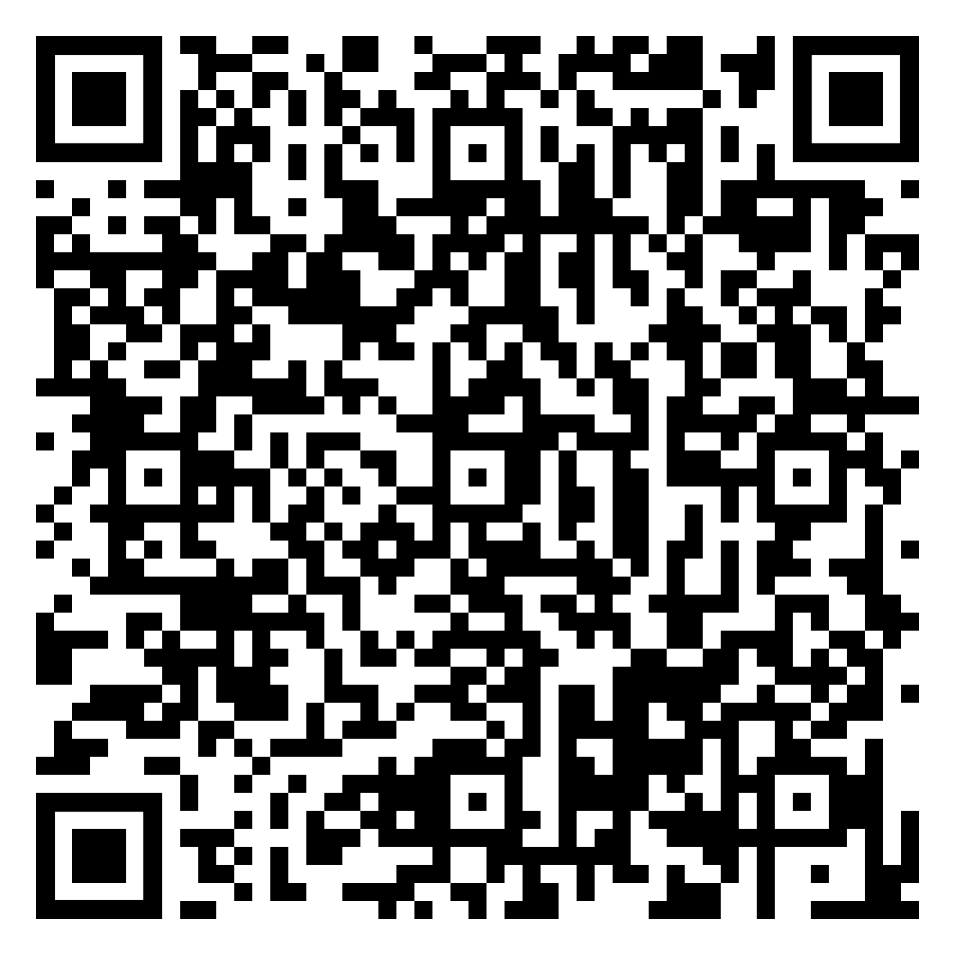
Thank you for joining us for the first shared learning session of round two of the NCAP QI programme May 2024-May 2025.
For webinar recordings and more information about this year's programme please scan the QR code which will bring you to the NCAP QI webpage.

