Slide 1

NCAP QI collaborative round two shared learning session two
Monday November 18th 2024
11 am –12.30 pm
Team name : West Cornwall EIS
Team locality: Cornwall

Slide 2
1. Your Project Aim
To increase the uptake of carer’s support by 40% to reach 50% of friends and family of newly confirmed clients on our caseload. We aim to do this by May 2025. To achieve this, we will be promoting and facilitating a mixture of 1-1 appointments and group opportunities to meet the expectations highlighted in the data from our carer survey.
We agreed on our aim statement by reviewing the data collected and working with staff and carers. We reviewed the requirements of the NCAP audit, and this helped us identify a percentage to work towards, to meet the criteria. In our last NCAP audit, we scored ‘needs improvement’ for our carer support, indicating that this is something we want to work on.

Slide 3
2. Your Project Measures
Our project measures can be determined by looking at statistics and data collated in the yearly NCAP audit. In order to ensure this is done effectively we need to be inputting data onto our clinical information system- RIO.
Throughout the project, we will be gathering feedback from carers. We are also carrying out means tested questionnaires to
assess the effectiveness of our sessions and see if we are meeting the aims identified in our initial questionnaires. We are
asking these questions prior to our appointments and again within the couple of weeks following.

Slide 4
3. List change ideas that you have tested or planned to test
We initially started our carer programme by running groups. This groups were poorly attending, and this sparked an interest for research to see why these groups didn’t work and what could be better for offering a carer support and education programme. In our initial questionnaires it was highlighted that the majority of friends and family members would prefer a 1-1 session. Therefore, for the first part of this project we are offering 1-1 carer appointments.
We have also been offering these appointments to people newly confirmed to our caseload, as opposed to the whole
Caseload. This makes the project more controlled as friends and family of newly confirmed clients haven’t had experience
under our service before. As well as that, it’s offered us a small and gradual working group to set up initial appointments,
making it easier for us to begin and measure the effectiveness.

Slide 5
4. Thinking about one of the change ideas that you have tested, outline the first PDSA cycle, then any tweaks you made during subsequent cycles
Analysed data from initial
Questionnaires. Identified a
Want for 1-1 sessions.
We have decided to start calling/sending text reminders on the day of the appointment.
We have created a spreadsheet of potential carers and started to offer
and carry out 1-1 sessions.
We had 2 DNAs out of
4 scheduled appointments.
The appointments that went ahead were successful.

Slide 6
5. Results so far/Run chart(s)
“Definitely more useful than I thought it would be”.
“Its been good to ask questions without the (individual) around”.

Slide 7
6. What has been challenging about the process so far ?
Managing expectations from the wider team.
Managing the admin processes such as booking rooms, identifying locality, making contact, confidentiality processes and documentation.
Protecting our time to ensure that we are regularly meeting amongst other clinical pressures.

Slide 8
7. Next steps
Continue to gather feedback and measurable outcomes from 1-1 appointments
Start thinking about offering 2 appointments per week as opposed to 1 to cover potential DNAs
Start to send text/phone call reminders (person dependant) prior to appointments
Think about the next part of the project and assess whether we continue 1-1 appointments or offer alternative

Slide 9
NCAP QI collaborative round two shared learning session two
Monday November 18th 2024
11 am –12.30 pm
Team name: Navigo EIP
Team locality: North East Lincolnshire

Slide 10
1. Your Project Aim
To increase the uptake of Family Intervention
Covid
Staffing levels
Decline in offering FI
Notes:
The reason why the team embarked on the QI journey was to focus on increasing the uptake of Family Intervention. Like with most services, FI became less of a priority during the years of Covid and so the uptake of this particular intervention declined to a point of no existence.
As well, a change in clinical staffing over the years, meant that the number of trained clinicians also declined – this led to there only being four trained staff, with two of these being CBT Therapist and clinical lead, which presented issues in its self.
The team also had trained members of staff leave their post, and new, non-trained ones join - which left a shortfall.
Previous years NCAP results highlighted that there was a serious decline in FI delivery. This was something that had also been acknowledged by the senior members of the organisation and so when funded placements were made available, it was agreed that all clinical members of the team that had not previously undertaken training, would be put forward.
FI training was always considered an element of role specification – highlighted at the point of interview, but due to covid, staffing issues etc, this was never something that ‘got off the ground’.
The real focus on the project started in Feb 2024 when four members of staff began training in CBT FI through Kings College. This shaped the discussions that were taking place within the office and through MDT’s, but there were a number of issues that presented.
The four team members had to be taken off the rota for other duties within the functionality of the service, which applied pressure for the remaining staff.
To give context, Navigo’s EIP is made up of 6x clinicians (3x Social Workers, 1x Occupational Therapist and 3x Nurses (one of those being the teams manager), a CBT Therapist, A Consultant Psychiatrist, 1x Support worker and 1x peer support. The general number of individuals on the teams caseload is around 11-15 per Clinician. At present this figure is 65 for the whole team.
With half the team being on the training, the opportunity for the QI programme and coaching became available and following a successful bid, we began to focus on the actually FI figures:

Slide 11
2. Your Project Measures
Looking at how many people have accepted – highlighted through the service menu completion
Notes:
The first stage of this project was to consider, how we are going to formally measure outcomes.
This started by considering the baseline data.
We started by focusing on the service menu’s – looking at the individuals that have accepted the FI. Following this we considered how many of the accepted families/support networks then went on to engage in the initial session of FI and those that had completed FI
Data we are going to measure are;
Number of service users accepting FI
Attendance at first session
Completing planned number of sessions
Through the QI programme process and supervision sessions with Maureen, we began to realise the importance of language and exactly how we measure the uptake and effectivity. In other words, we needed to breakdown the overall process – posing questions such as do we consider just the accepting cases, engagement with allocated family workers, how many sessions do we consider for formal measurement.
In making such considerations and breaking things down in this way, it has allowed us set more achievable goals and look at what the barriers are and what is actually working well – providing a detailed account for reflection.
This helps to implement change, such as more detailed service menu and a family work leaflet

Slide 12
3. List change ideas that you have tested or planned to test
Language and wording
Leaflets
Training
Menu’s
Peer Supervision
Other teams
Survey
Verbal language and how the intervention is ‘sold’
MDT Agenda
Notes:
There are a number of considerations that we made such as –
*Language and wording – Service menus and leaflets - will be covered on the next slide
*Training – four members of the team undertaking the CBT FI
*Peer supervision – allocated and protected time for group supervisions. This has also been opened up to other teams who are undertaking the training
*Survey – developed to establish the reasons behind the high number of declines.
*MDT agenda – which now offers an average of 6x opportunities to discuss FI cases within a month – Weekly team meeting, Monthly FI Supervisions and practitioner supervisions. Prior to this there had been none.

Slide 13

4. Thinking about one of the change ideas that you have tested, outline the first PDSA cycle, then any tweaks you made during subsequent cycles
Notes:
Vickie:
Language and specific wording was a key consideration that needed to be addressed early on within this project. Through team discussions, it was quickly identified that terms such as ‘intervention’ and the name of the intervention itself – ‘Family work’, have strong links to specific interventions that have been implemented by Children’s Services within the local area. This automatically discouraged people from engagement.
As a result, we renamed the intervention ‘Bridging the Gap’ and created a leaflet to provide information for service users and their families.
We also restructured the service menu to provide more detail & guide staff and give information to be given to service users in the initial stages of their care spell. This coined with the training undertaken by other members of the team, has helped to ‘sell’ the intervention, which the data is representative of.
It is also notable that the training has had a really positive impact on the overall team culture in that it reignited a drive for the team. Part of this is that in order to pass the course, the trainee’s have had to work with two families engaging in sessions – which has naturally increased uptake.
The supervision sessions with Maureen have also been instrumental in encouraging the direction of the project and constructing a projective action plan, through her ability to objectively filter information in a professional manner.

Slide 14
5. Results so far/Run chart(s)
Notes:
This slide shows the results so far:
April 2024: -63x in total on the teams caseload – with 50x (79%) declining FI – 13x (21%) accepted and undergoing
Seven months later:
November 2024: -65x in total on the teams caseload – 46x (71%) declining FI – 19x (29%) accepted and undergoing
It is important to note that the data is not fully accurate given how fluid the figures are – considering that people are being discharged, pending discharge, new care spells, extended assessments etc. Which is ever changing.
The initial goal had been to increase the uptake by 10% by May 2025, as can be seen from the charts, this is well underway.

Slide 15
6. What has been challenging about the process so far ?
Staff training
Selling the intervention
Notes:
There have been a number of factors contributing to challenges faced by the team. Knowing where to start for example – but with support and guidance during this QI process and from Maureen, this has been simplified.
There has also been a lot of stress, the staff member that have been undertaking the training have not found this an easy process with having to manage work, life and now uni commitments. Also, the tutor of the course had advised not to work with drug induced psychosis, however this particular service user group makes up a high proportion of overall team caseload. This caused a lot of anxiety for those staff members through fears that they will not be able to pass the course – which has since been addressed.
Another area of consideration was the way in which FI was being sold to service users and their families - there is still a high percentage of people declining this services but this would be considered in the next steps. Overall improvements are being made as represented by the last slide– as previously mentioned through the introduction of the leaflet and the restructured menus and discussing in the carer’s focussed education programme. The leaflet construction was also a barrier in itself as it had to be agreed by the organisation, which is time consuming process, which required a lot of prompting for agreement.
Another barrier was trying to source a regular room for the peer supervision to take place on a monthly basis.
But there have also been a lot of positives:
-The overall motivation and drive for making positive change within the team has been notable and led to a ripple effect within the organisation itself. Other teams are in the process of training in BFT and have approached us to request joining our peer supervision groups. This will have a positive impact on the team and the organisation as a whole and bring newer dynamics to the role that supervision plays in both service and professional development.
-Navigo is a social enterprise and so we as individuals and as a team plus service users involvement have had a good say in service delivery and implementation.
-Leadership has also been instrumental and has helped to breed an open culture – again evidence by the overall motivation of the team.

Slide 16
7. Next Steps
Open pathways
Surveys.
Notes:
In terms of this project, we would like to really focus on the surveys to ascertain why people are still declining, although the changes in the data are positive.
This will be in the form of collecting further evidence such as video and audio recordings. This is an element of the training and has proven to be instrumental in supervision sessions and so it has been agreed that this will continue as it enables the opportunity for practitioner reflection and strategy sharing.
We will also be looking at reviewing with the families that have completed FI at the end of session to ascertain their views, hopefully obtaining direct comments and quotes which can be shared with prospective families we are hoping to sell the idea to or sharing with the participants of the carers education groups.
The ultimate goal is to focus on opening the pathways – 14-65 for both.

Slide 17
NCAP QI collaborative round two shared learning session two
Monday November 18th 2024
11 am –12.30 pm
Team name: PATH
Team locality: Hertfordshire

Slide 18
1. Your Project Aim
To increase the take up of family intervention therapy from the current 8% delivery to 16% by May 2025.

Slide 19
2. Your Project Measures
Continue to measure from the EIP reporting dashboard:
- Take up %s and numbers of service users
- Waiting list sizes & longest waits
- Offers of FI to service users who aren’t on waiting lists
Service user & family survey to gather experience levels & capture feedback from FI therapy sessions
Staff surveys around experience of change of ideas & repeat confidence level surveys from training sessions
Change ideas – take baseline data & review after these are setup

Slide 20
3. List change ideas that you have tested or planned to test
Revisit service understanding of the effectiveness of FI, clinical outcomes and experience of service users and their families
Bank work for out of hours clinical sessions
Moving to a dedicated clinic slot for FI pairings to protect time for FI delivery
Enhance the FI Tracker to include the rationale for sessions being extended beyond 15 sessions & detailed narrative on gaps in sessions taking place
FI reporting – needs to be updated to include FI specific sessions only
Embed refresher training sessions for staff ( both qualified in FI and non qualified)– simulation hub
Service user & Family questionnaire to be developed & sent out to all current recipients of FI on caseload.
Job planning for FI workers – how to build in protected time & balance workload
Explore moving to a different FI model
Increase dedicated workforce for FI by changing budget skill mix
MDT – bringing top 5 on waiting list – suitability of service user starting & gather relevant family information

Slide 21
4. Thinking about one of the change ideas that you have tested, outline the first PDSA cycle, then any tweaks you made during subsequent cycles
Changing the culture within the team to engage the whole service in the promotion of Family intervention, creating an enthusiasm/passion for the therapy, recognising the NICE guidance & evidence based benefits, and translating this to families at the beginning of and during the pathway, giving equal importance to other pillars of the pathway
Trying to bridge the gap between a specific team delivering FI to making it everyone’s business – bringing the whole service into the process from discussing the benefits of the intervention to it’s delivery

Slide 22
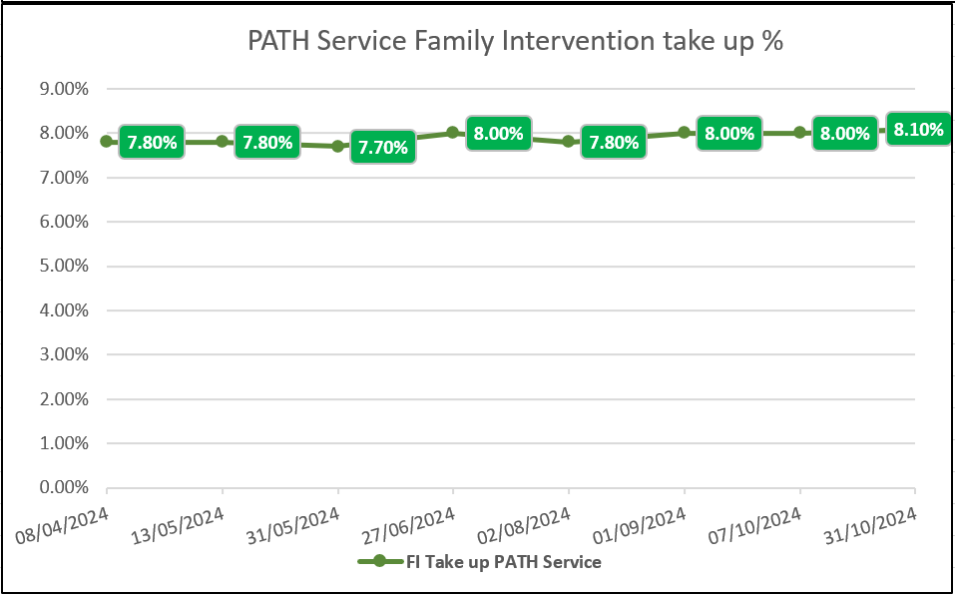
5. Results so far/Run chart(s)

Slide 23
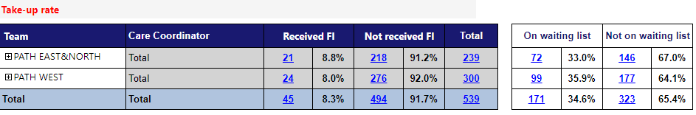
5. Results so far/Run chart(s)

Slide 24
6. What has been challenging about the process so far ?
Changing the culture within the service- making it everyone’s business
Having the dedicated time to focus on testing the change ideas and being able to properly review using the PDSA cycle
Long waiting list for Family Intervention therapy and limited resource to effect change
Time taken for matching availability of families with staff pairings to get therapies started as soon as possible
.Is the Kings model and training programme sustainable to effectively increase the delivery of FI given the limitations on training places and qualified staff
Notes:
The number of staff being able to be trained under the Kings model is limited to annual allocations, the course is very academic and this puts people off completing ( high drop out rates)– is this a sustainable model for us to continue using., expensive to keep putting staff through training who then leave. It also creates a separation between the staff team because not all staff can access the training, difficulty pairing as 1 has to be a registered qualified professional – challenge on agreeing to move to a different model whereby we could buy the training package and train all staff regardless of banding
The back log is on average a 2 year wait, therefore service users receiving FI at the end of the pathway are subsequently discharged & don’t count as part of the audit. There are not enough FI trained staff to work through the back log to make an effective change
Trying to find families to match with staff pairing and availability – this should change in the future with change idea of developing a database with admin support
Specific members of the team that are delivering & the mini teams not feeling enthusiastic about FI and this projects into clinical conversations with service users and family– trying to bridge the gap

Slide 25
7. Next steps
Enhance the support for staff whilst on training and afterwards to protect time to deliver FI
Influencing the role of the mini teams being part of meetings, getting them more involved in discussions and finding different ways to translate the enthusiasm and benefits of FI therapy
Continue with testing change ideas and using PDSA cycle
Think about workforce that we have to deliver FI and is it fit for purpose – look at demand and whether the current caseload requires more resource to deliver FI
Exploring whether the current model is a barrier to increasing the delivery of family Intervention, for example training 5 staff in 2025, only 1 is a qualified registered clinician, this will not improve pairings – how many service users they will be able to work with off the waiting list
Explore other EIP services percentage of FI delivery using alternative models e.g. Meriden model
Exploring the introduction of peer support workers – developing co-production to deliver Family Intervention, think about how other EIP services are using peer support
Notes:
We have done things slightly differently this year in being very clear about the course content, the expectations and what support we as a service will provide during the training and afterwards when staff are practising. This has meant the staff booked onto the training in 2025 have a clear understanding and are committed to the course and delivery of FI once qualified.

Slide 26
NCAP QI collaborative round two shared learning session two
18th November 2024
11:00am- 12:30
Team name: Early intervention team in psychosis
Team locality: Warrington & Halton

Slide 27
1. QI team membership
Team members:
Stephanie Smith, Clinical Team Manger.
Tracy Harrison, Clinical Lead.
Rachel Nolan, Research Assistant.
How are you involving people with lived experience in your QI work ?
Those that have been through the process of BFT are assisting the service with re-design of the leaflets, to help make the offer more appealing and hold greater meaning.
Carers, who have participated in Behavioural Family Therapy, to provide video/ audio recordings.
Notes:
Prompts- please list your QI team membership including lived experience representatives (don’t have not provide names if they do not consent)

Slide 28
2. What’s your problem/area for improvement?
FI is needed to reduce relapse.
Data informed us that: not enough meaningful offers are being made.
Team is not delivering enough FI to patients & families.
Data not captured correctly due to codes used on Rio.
Staff’s enthusiasm towards FI.
Notes:
Prompts- what is the problem you are tackling ? E.g. improve our team's performance on the Fi standard- can add details about how and why you chose to focus on this standard.

Slide 29

3. What diagnostic tools/exercises did you use to better understand your problem?
Barriers
Change ideas
Themes: Time, Caseloads, Confidence, Engagement, Education.
“Completing the training a while ago, therefore not feeling comfortable with facilitating”
“Managing a big caseload and not working full time hours.”
“Not interested, don't feel it is relevant to their care”
“Complex relationships with family, engagement and motivation can be poor”
Themes: Staffing, Supervision, Training, Update materials
“Protected time for staff to deliver FI, Regular supervision. Newly trained doing FI with experienced staff. Top up training”
“Increase in number of care coordinators to free up time for staff to engage in BFT work with families”.
“Think leaflet for family members could have more about the research into BFT, and degree of success for people that engage with it”.
“I do feel that our team having a full time staff member to focus on FI would benefit us”.
Notes:
Prompt- what have done to better understand your problem ? Staff surveys’, team meetings, collected your baseline data (add in what this is)
Staff Survey:
Importance of FI: Scores range from 4-10 (average 9)
FI apart of your role: Scores range from 1-10 (average 6)
Confidence in explaining to families: 3-10 (average 8)
Confidence in delivering to families: 4-10 (average 7)

Slide 30
4. What was your key learning about the area you want to improve?
Time/ non protected time
Workload/ high caseloads
Confidence
Team not viewing FI as a part of their role
Education to patients & families
Feeling the family are to ‘blame’
Not interested/ feeling it is not important
Notes:
Prompt- did anything come up you didn’t expect ? It would be helpful for teams to think about whether there was any difference between what you thought was the problem versus what actually came up via survey's, conversations with staff/service users, trends in baseline data etc.

Slide 31


Statement
To increase the uptake of BFT, for all eligible patients and their families. The aim is to have a 10% increase in the uptake by May 2025.
Notes:
Prompt- E.g to Improve the uptake of Fi for all eligible service users by 10% by May 2025. please add in some detail about how your team arrived/agreed on your aim statement.

Slide 32

6. What are you going to measure?
Change ideas
Measure
Regular supervision
Offering BFT earlier
Updating the BFT leaflet, provided to patients and families
Expert by experience to discuss with families on their experience of BFT.
Regular training/ refresher role plays.
Attendance sheet, feedback sheets.
Monitoring offers made in MDTs.
Survey to staff and patients/ families on their views of the current leaflet.
Uptake numbers of BFT from families.
Confidence scale, pre & post EIT away day.
Notes:
Prompt- thinking about your aim and change ideas what are you going to measure to understand the impact of your change ideas ? E.g. ongoing outcome measure will be how many families start FI per week/month or staff confidence levels before and after refresher training etc.

Slide 33
Next steps - UPDATE
1) Supervision: To ask facilitators to add role plays to supervision.
There has been a request that BFT supervisions incorporate opportunity for role play.
2) Offer BFT earlier: To discuss in MDT’s, organise carers group (once a month) for new patients on the First Episode Psychosis (FEP) pathway.
This is now ongoing within the EIP weekly MDT. This has also been moved to the first agenda of the MDT as it was noted that this may allow emphasis to the importance of its delivery.
3) Leaflet: Distribute survey to staff and patients/ families.
This has been actioned, there was not an initial great response from staff, so a further push has been made to gain further data.
4) Expert by experience: Ask families to provide video/ audio videos.
1 family to date has been approached.
5) Training/ role plays: Organise EIT Away Day.
During the recent away day on the 15th October, simulations were run for staff to gain an experience and exposure to the delivery of BFT. Staff were provided with opportunity to observe the delivery of a particular skill (example- problem solving).
Notes:
Prompt- this can include a list of the change ideas you have come up with (can be provisional ones and don’t have to be in the order you are going to test them in if that’s not been decided), reviewing your survey results, meeting with carers groups etc.

Slide 34

NCAP Quality Improvement collaborative round two
QI project training
18 November 2024

Slide 35
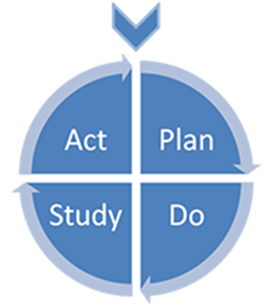
Question 3: The Model for Improvement
1. What are you trying to accomplish?
2. How will you know that a change is an improvement?
3. What change can you make that will result in improvement?
What change ideas do you want to test?
Langley G, Nolan K, Nolan T, Norman C, Provost L, (1996), The improvement guide: a practical approach to enhancing organisational performance,
Jossey Bass Publishers, San Francisco

Slide 36
Q3: Change ideas
What is a ‘change idea’?
Where do you get them?
How do you work out which you are going to test first?
How can you tell whether they are making a difference?
36

Slide 37
Q3: What is a ‘change idea’?
A change idea is a specific idea for how you can do thing differently so that you will get the results that you want.
37

Slide 38
Q3: Where do you get your change ideas?
A number of possible places:
The ‘evidence’
Other services/people’s experiences
Anyone can have a great idea
‘Steal shamelessly’ (remembering you may have to ‘adapt, not adopt’)
38

Slide 39
Example driver diagram- add into the chat what change ideas can you think of ?
Aim:
Increase uptake of FI from 10% to 20% by May 2025
Systemic factors
Lack of supervision available for BFT
Service user factors
Limited protected time for FI
Staff factors
Staff not confident in offering FI
Lack of staff trained in FI
SU’s don’t understand what FI is
Change idea?
Change idea?
Change idea?
Change idea?
Change idea?
Change idea?
Cultural factors
Not viewed as a meaningful intervention
Change idea?
Other interventions are prioritised over FI
SU concerns about family burden
Change idea?

Slide 40
Q3: using the example
Aim: To increase uptake of FI from 10% to 20% by May 2025.
Possible causes … and some ideas for changes.
Possible causes | Change ideas
Staff don’t feel confident explaining FI | Improve staff confidence in explaining FI
Service users don’t know what will be involved in receiving FI | Test ways of providing more information about FI
40

Slide 41
Q3: How do you work out which change ideas you are going to test first?
Things to think about:
Which are the team most excited about?
How much effort would be needed?
Do you need a ‘quick win’?

Slide 42
Q3: How can you tell whether your change ideas are making a difference?
By measuring.
How do you choose any extra measures?
- It’s sometimes hard to know when you start your project.
- Extra measures are linked to your ‘change ideas’ (so you won’t know what they are until you have found out what is causing your problem).

Slide 43
Q.3: Some examples
Causes | Change idea
Staff don’t feel confident explaining FI | Improve staff confidence in explaining FI
Measure
Self rating of confidence before and after training
Causes | Change idea
Service users don’t know what will be involved in receiving FI | Test ways of providing more information about FI
Measure
Percentage of families that agree to have FI
43

Slide 44
Q3: Key learning points
A change idea is a specific idea for how you can do things differently so that you get the results that you want.
Your team may come up with a lot of ideas, so choose carefully.
You may need to add an extra measure to show whether you change idea is working.
Some change ideas work better than others, so think about the logistics of how you would test out a change idea in a short testing period (weeks, not months of testing).
Any questions?
44

