Slide 1
NCAP 2024 State of the Nation Report
Supplementary Analysis

Slide 2
NCAP Standards
Access and waiting times/Timely access: For a service to achieve ‘Standard Met’, its service users with first episode psychosis were allocated to and engaged with an EIP care coordinator within 2 weeks of receipt of referral. | Carer Focused Education and Support Programmes (CESP): To achieve ‘standard met’, the identified carer/family member/friend has commenced a course of carer focused education and support programme.
Cognitive Behavioural Therapy for Psychosis (CBTp): For a service to Achieve ‘Standard Met’, service users must have taken up Cognitive Behavioural Therapy for psychosis. | Outcome Measures (OM): To achieve ‘Standard Met’ the service user must have at least two different outcome measures recorded at least twice (assessment and other time point). Outcome measures include: HoNOS, HoNOSCa, DIALOG, GBO, ReQoL-10, QPR, Other.
Supported Employment (SEE): For a service to achieve ‘standard met’, the service user- who is not in work, education or training at the time of their initial assessment- has taken up supported employment and education programmes. | Clozapine: To achieve ‘Standard Met’, service users who have not responded adequately to or tolerated treatment with at least two antipsychotic drugs are offered clozapine.
Family Intervention (FI): To achieve ‘Standard Met’, service users who have a contactable carer, family member or friend who supports them take up ‘Family Intervention’ | Physical Health (PH): To achieve ‘Standard Met’ the service user has been offered all physical health screenings and the relevant physical health interventions.
PH Screening: | PH Interventions:
Smoking status Alcohol intake Substance misuse BMI/Rapid weight gain Blood pressure Glucose Blood lipids | Smoking cessation Harmful alcohol use Substance misuse Weight gain/obesity Hypertension Diabetes/high risk of diabetes Dyslipidaemia

Slide 3
England

Slide 4
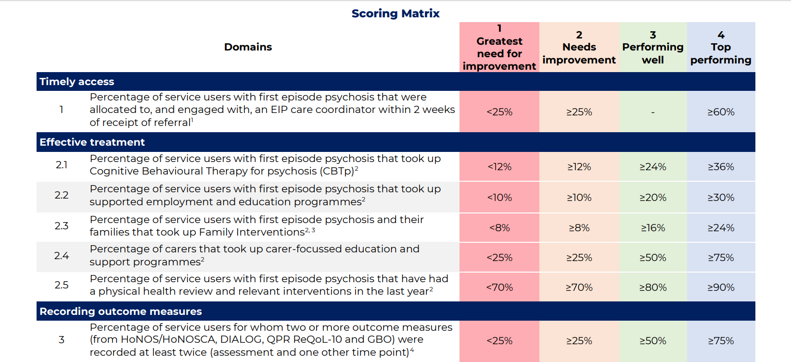
Scoring Matrix (NHSE 2024)
Notes:
The Scoring Matrix is a tool made in partnership with NHS England and Improvement to enable Early Intervention in Psychosis (EIP) teams to monitor their performance against objectives for EIP care set out in the NHS Long Term Plan (LTP). Scores are allocated for each item in the table above and an overall score is calculated based on performance across all items. This data was collected in the EIP Audit 2024 (bespoke data) as part of the National Clinical Audit of Psychosis (NCAP). L3 throughout the slides denotes whether the Performing well threshold has been achieved.

Slide 5
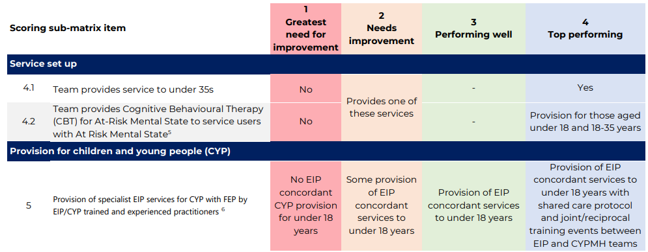
Scoring sub-matrix (NHSE 2024)
For more information on the scoring for item 5 provision for children and young people (CYP) please refer to pages 6-7 of the scoring matrix.

Slide 6
Change over time (%)
Audit Year | Performing Well (L3 Target) | 2018/19 (n=9527) | 2019/20 (n=10560) | 2020/21 (n=10033) | 2021/22 (n=10557) | 2022/23* (n=10196) | 2023/24 (n=10386)
Total Number of Trusts |  | 57 | 55 | 55 | 54 | 52* | 54
Standard 1: Timely Access | ≥60%
Standard 2: Cognitive behavioural therapy for psychosis | ≥24%
Standard 3: Family intervention | ≥16%
Standard 4: Prescribing of clozapine | N/A
Standard 5: Supported employment and education programmes | ≥20%
Standard 6: Physical health screening | N/A
Standard 7: Physical health interventions | ≥80%
Standard 8: Carer-focused education and support programmes | ≥50%
Outcome measures recording | ≥50%
Change over time performance – England
* In 2023, some Trusts were excluded from the national averages due to the carenotes outage

Slide 7
EIP and CBT for ARMS Provision – England
No EIP Service | 2022/23 (n=145) | 2023/24 (n=155)
Under 18 | 1.40% (2) | 3.87% (6)
18-35 | 0.70% (1) | 0 (0)
36+ | 9.70% (14) | 6.45% (10)
No CBT for ARMS | 2022/23 (n=145) | 2023/24 (n=155)
Under 18 | 29.70% (43) | 27.70% (43)
18-35 | 30.30% (44) | 25.20% (39)
36+ | 64.10% (93) | 65.80% (102)
Notes:
EIP: Early Intervention in Psychosis
ARMS: At-Risk Mental State

Slide 8
Outcome Measures – 2023/24 England
Pie chart representing number of times each Outcome Measure was recorded more than once.
REQOL-10 and GBO were only introduced in Feb 2023 so most teams would not have had time to implement and repeat measures in time for 23/24 audit.

Slide 9







Physical health screening 2024 (England)
Smoking
Offered – 94.6% (-1.2%)
Alcohol
Offered - 94.9% (-0.8%)
Substance misuse
Offered - 94.7% (-1%)
BMI
Offered – 91.9% (-1.8%)
Blood pressure
Offered – 92.9% (-0.8%)
Blood glucose
Offered – 89.7% (-2.6%)
Cholesterol
Offered - 89% (-2.6%)
Notes:
Core20PLUS5 (adults) Blood pressure and Lipid management are one of the five clinical areas of focus which require accelerated improvement. Cholesterol is the measure with lowest % of screening offered.

Slide 10

Physical health interventions 2024 (England)
Smoking
Offered – 97.1%
Harmful alcohol use
Offered – 97.6%
Substance misuse
Offered – 92.2%
Weight
Offered – 93.46%
Elevated blood pressure
Offered - 89.7%
Abnormal glucose control
Offered – 91.7%
Abnormal lipids
Offered – 91%
Notes:
Core20PLUS5 (adults) Blood pressure and Lipid management are one of the five clinical areas of focus which require accelerated improvement​. Blood Pressure is the measure with lowest % of Intervention offered.

Slide 11
Regional data – England

Slide 12
L3+ performance (Overall score) variation by region
The 2023/24 LTP target for achievement of Level 3+ NICE concordance (95%) hasn’t been met by any region.
Level 1 “Greatest Need for Improvement” was scored by 1 service in the Midlands.
EIP services in East of England have improved their achievement of Level 3+ NICE concordance since 2022/23 (when 64% services achieved Level 3+). North West and North East and Yorkshire also recorded improvements of 0.8% and 1.6% respectively.
For all other regions performance has decreased (vs. 2022/23) this is most apparent in Midlands (20% decrease), followed by South West (19% decrease), South East (10% decrease), and London (2% decrease).
Notes:
Regions with L3+ performance are those who fall within the L3 (Performing Well) or L4 (Top Performing) categories of the NHSE Scoring Matrix.
The NHS Long Term Plan (LTP) sets out objectives for EIP care. This plan includes a 2023/2024 target for achievement of Level 3+ NICE concordance among 95% of services.

Slide 21
Health Inequalities – England

Slide 22
Health Inequalities (Age, Gender, Ethnicity) – England
CBTp
Age: Increased uptake in all age categories, greatest increase in under 18s (+3.6%) since 2022/23, though under 18s had the lowest uptake rate (40.3%, n=106).
Gender: Increased uptake for male and female since 2022/23. Uptake by female is higher than male (approx. 10% difference).
Ethnicity: Increased uptake for White, Mixed, Other, and Unknown populations since 2022/23. White population has the highest uptake rate (53.1%).
Family Intervention
Age: The under 18s category had highest uptake of family intervention (43.5%) compared to the 18-35 (29.69%) and 36+ (26.64%) categories. Note that there is a much smaller sample for under 18 (n=107).
Gender: Female (29.5%) and male (28.7%) had similar uptake.
Ethnicity: White (30.8%) and Mixed (31.9%) populations had a higher uptake rate than other ethnicities.
Clozapine
Age: Under 18s (69.2%, n=18) and 18-35 (63.9%, n=391) categories had a higher percentage of Clozapine offered than 36+ age group (49.5%, n=108).
Gender: Males (63%) had a higher percentage of Clozapine offered than females (55.7%).
Ethnicity: Asian and Black populations have highest percentage of Clozapine offered. Increase in percentage Clozapine offered in Black population (+10.4%) since 2022/23.
Supported Employment and Education Programmes
Age: 18-35 (44.8%) had higher uptake rates than under 18s (22.5%) and 36+ (29.8%). Under 18s face higher % of intervention not offered (40%)
Gender: Similar levels of uptake between females and males.
Ethnicity: The Black population is the most likely to take up ‘Supported Employment’, and the least likely not to be offered this intervention.

Slide 23
Health Inequalities (Age, Gender, Ethnicity) – England
Physical Health Screening and Interventions
Age: 36+ age group had the highest screening and related intervention offered rate (81.9%, n=3162), while the under 18s age group had the lowest screening and related intervention offer rate (66.9%, n=176).
Gender: Male (78.7%) and female (79.8%) have similar percentages of relevant interventions offered.
Ethnicity: White population had a higher screening and related intervention offered rate and was the only ethnicity category that achieved over 80% (L3+ NICE concordance).
Carer-focused education and support programmes
Age: Similar levels of uptake across all age groups.
Gender: Carers of male service users had a higher uptake rate (63.6%) than that of female service users (59%).
Ethnicity: Carers of White service users had the highest uptake rate (64.4%). Black and Other ethnicity groups had the lowest uptake rates at 52.1% and 51.9% respectively.
Outcome Measures
Age:. The 36+ category has the highest percentage of outcome measures recorded (69.6%, n=2686), while the under 18s category has the lowest percentage of outcome measures recorded (44.1%, n=116).
Gender: In 2024, female (69.4%) had a higher percentage of outcome measures recorded than male counterparts (63.8%).
Ethnicity: The White population is most likely to have outcome data recorded at 69.4%.

Slide 24
Other/Non-binary category (n=4) excluded due to small sample size

Slide 25
Health Inequalities – Age

Slide 26
N.B. Small numbers for SEE, FI and Clozapine, read with caution

Slide 27
Psychosocial interventions (detailed) by Age

Slide 28
Health Inequalities – Gender
* Other/Non-binary category not shown due to small numbers

Slide 29
* Other/Non-binary category not shown due to small numbers

Slide 30
Psychosocial Interventions (detailed) by Gender
* Other/Non-binary category not shown due to small numbers

Slide 31
Health Inequalities – Ethnicity
White
1 = White British;
2 = White Irish;
3 = White Any other background;
Mixed
12 = Mixed Asian & white;
13 = Mixed Black African & white;
14 = Mixed Black Caribbean & white;
15 = Mixed Any other mixed background;
Asian or Asian British
7 = Asian/Asian British Bangladeshi;
8 = Asian/Asian British Indian;
9 = Asian/Asian British Pakistani;
11 = Asian/Asian British Any other Asian background;
Black
4 = Black/Black British African;
5 = Black/Black British Caribbean;
6 = Black/Black British Any other black background;
Other
10 = Asian/Asian British Chinese;
16 = Any other ethnic background;
Unknown
17 = Declined;
18 = Unknown/not documented;
Source: Ethnicity - NHS England Digital

Slide 34
England Psychosocial Interventions by Ethnicity

Slide 35
Percentage of psychosocial interventions Not Offered by Ethnicity
*Other category includes ‘Asian/Asian British Chinese’, and ‘Any other ethnic background’;
Unknown category includes ’declined’, ‘unknown’, and ‘not documented’.

Slide 37
Wales

Slide 38
Change over time (%)​
Audit Year​ | 2018/19 (n=247)​ | 2019/20 (n=205)​ | 2020/21 (n=248)​ | 2021/22 (n=239)​ | 2022/23 (n=212)​ | 2023/24 (n=239)​
Total Number of Teams​ | 6​ | 6​ | 6​ | 6​ | 7​ | 8​
Standard 1: ​ Timely Access​ | N/A​ | ​ | ​ | ​ | ​ | ​
Standard 2: ​ Cognitive behavioural therapy for psychosis​ | ​ | ​ | ​ | ​ | ​ | ​
Standard 3: Family intervention​ | ​ | ​ | ​ | ​ | ​ | ​
Standard 4: ​ Prescribing of clozapine​ | ​ | ​ | ​ | ​ | ​ | ​
Standard 5: ​ Supported employment and education programmes​ | ​ | ​ | ​ | ​ | ​ | ​
Standard 6: ​ Physical health screening ​ | ​ | ​ | ​ | ​ | ​ | ​
Standard 7: ​ Physical health interventions​ | ​ | ​ | ​ | ​ | ​ | ​
Standard 8: ​ Carer-focused education and support programmes​ | ​ | ​ | ​ | ​ | ​ | ​
Outcome measures recording​ | ​ | ​ | ​ | ​ | ​ | ​
Change over time performance – Wales

Slide 39
EIP and CBT for ARMS Provision – Wales
No EIP Service | 2022/23 (n=7) | 2023/24 (n=8)
Under 18 | 0 | 0
18-35 | 0 | 0
36+ | 85.7% (6) | 100% (8)
No CBT for ARMS | 2022/23 (n=7) | 2023/24 (n=8)
Under 18 | 71.4% (5) | 62.5% (5)
18-35 | 71.4% (5) | 62.5% (5)
36+ | 100% (7) | 75% (6)

Slide 40
Outcome Measures – 2023/24 Wales
DIALOG and ‘Other’ were the most used outcome measures in Wales. Most common outcome measures in "Other" include CORE-10, LUNSERS, GASS.
Pie chart representing number of times each Outcome Measure was recorded more than once.

Slide 41
Physical health screening 2024 (Wales)
Smoking
Offered – 90.8% (-1.7%)
Alcohol
Offered – 91.6% (+0.1%)
Substance misuse
Offered - 91.2% (-0.8%)
BMI
Offered – 85.8% (+1.8%)
Blood pressure
Offered – 88.3% (+2.5%)
Blood glucose
Offered – 86.2% (+7%)
Cholesterol
Offered - 86.6% (+7.8%)
Notes:
BMI screening is the measure with lowest % of Intervention offered.

Slide 42
Physical health interventions 2024 (Wales)
Smoking
Offered – 91.3%
Harmful alcohol use
Offered – 100%
Substance misuse
Offered – 97.3%
Weight
Offered – 92.24%
Elevated blood pressure
Offered – 84.6%
Abnormal glucose control
Offered – 87.5%
Abnormal lipids
Offered – 100%
Notes:
Blood pressure screening is the measure with lowest % of Intervention offered.

Slide 43
Health Board Data – Wales

Slide 45
Health Board variation in AWT standard (2024)

Slide 46
Health Board variation in CBTp provision (2024)

Slide 47
Health Board variation in Family Intervention provision (2024)

Slide 48
Health Board variation in Clozapine provision (2024)

Slide 49
Health Board variation in Supported Employment and Education provision (2024)

Slide 50
Health Board variation in Physical Health Screening provision (2024)

Slide 51
Health Board variation in Physical Health Interventions provision (2024)

Slide 52
Health Board variation in Carer Support provision (2024)

Slide 53
Health Board variation in Outcome Measures recording (2024)

Slide 54
Health Inequalities (Age, Gender, Ethnicity) – Wales
CBTp
Age: There was no uptake for Under 18s in 2022/23 and 2023/24. Uptake for 18-35s decreased by 5% between 2022/23 and 2023/24. Small sample sizes for 36+ category.
Gender: Uptake decreased for both female and male between 2022/23 and 2023/24.
Ethnicity: Uptake in the White population decreased between 22/23 and 23/24 from 44.9% to 35.1%.
Family Intervention
Age: 43.2% service users aged 18-35 declined family intervention and 24.5% was not offered it. Small sample sizes in other age groups.
Gender: Similar levels of uptake between females and males in 2023/24.
Ethnicity: 27.6% of service users of White ethnicity took up family intervention, while 42.2% declined and 25.9% was not offered the intervention. Small sample sizes across all other ethnicities.
Clozapine
Age: Clozapine offer increased among 18-35s between 2022/23 and 2023/24 from 84% to 87.2%. Small sample sizes in other categories.
Gender: Clozapine offer increased across all genders between 2022/23 and 2023/24.
Ethnicity: Clozapine offer increased from 77.4% to 89.7% for the White population between 2022/23 and 2023/24. Small sample sizes across all other categories.
Supported Employment and Education Programmes
Age: Among 18-35s, uptake has increased from 27% to 36.2% between 2022/23 and 2023/24. Small sample sizes in other categories.
Gender: Uptake increased across all genders between 2022/23 and 2023/24.
Ethnicity: Uptake increased from 28% to 41.1% for the White population between 22/23 and 23/24. Small sample sizes across all other categories.
N.B. Caution in interpretations due to small sample numbers

Slide 55
Health Inequalities (Age, Gender, Ethnicity) – Wales
Physical Health Screening and Interventions
Age: Physical health reviews and related interventions were offered to 72.9% of service users aged 18-35. Small sample sizes in other categories.
Gender: 73.9% of male service users were offered physical health review and relevant physical health interventions, 9% more than females in 2023/24.
Ethnicity: White population had largest percentage of physical health review and related interventions offered (74.7%).
Carer-focused education and support programmes
Age: Increase in uptake among 18-35s from 36% to 45.5% between 2022/23 and 2023/24. Small sample size in other categories.
Gender: Uptake by carers of female service users increased by 21.4% from 22/23 to 23/24.
Ethnicity: Uptake increased in the White population from 40.5% in 22/23 to 48.7% in 23/24. Small sample size in other categories.
Outcome Measures
Age:. Outcome measures recorded only among 18-35s. Small sample size in other categories.
Gender: Similar levels of outcome measures recorded between 2022/23 and 2023/24
across genders.
Ethnicity:. Approximately 20% increase in outcome measures recorded for the black population (n=19) since 2022/23. Similar levels in the White population between 22/23 and 23/24.
N.B. Caution in interpretations due to small sample numbers

