Slide 1
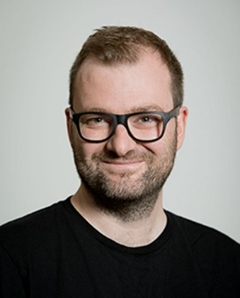
Tom Ayers
Senior Associate Director
NCCMH

Slide 2
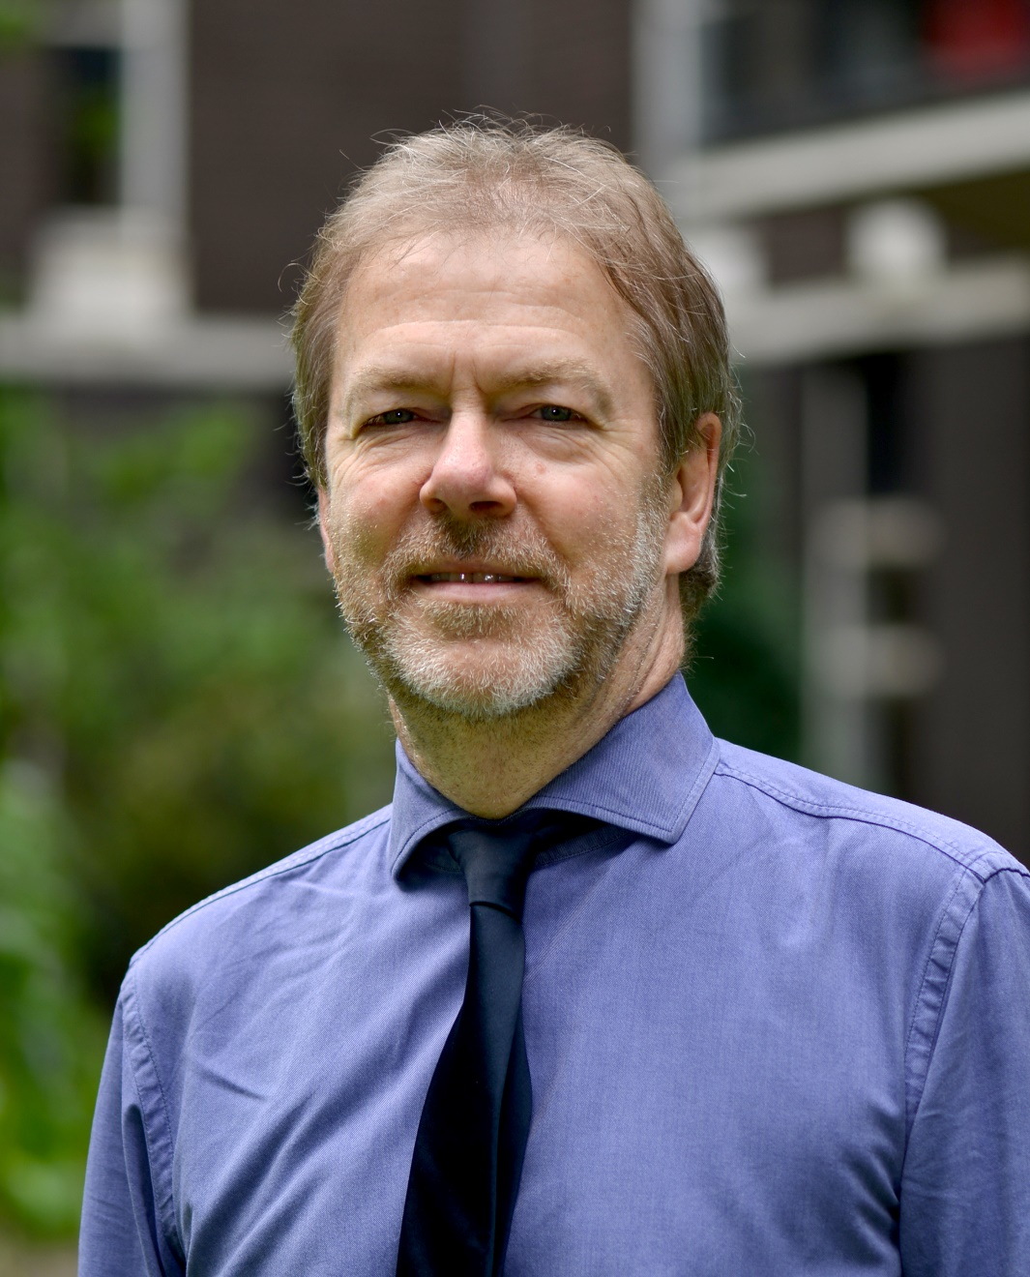
Professor Louis Appleby
Director of NCISH, Professor of Psychiatry

Slide 3
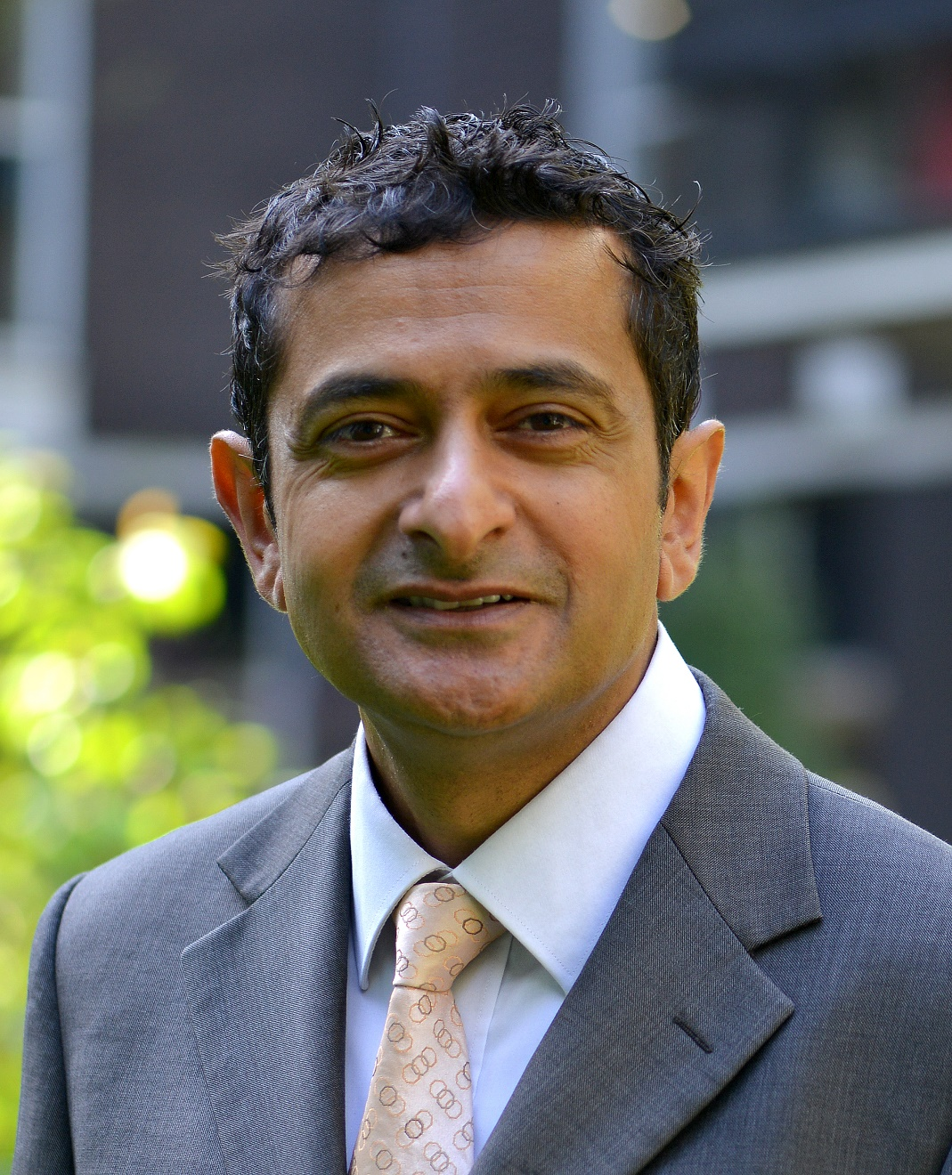
Professor Nav Kapur
NCISH Head of Suicide Research,
Professor of Psychiatry and Population Health

Slide 4
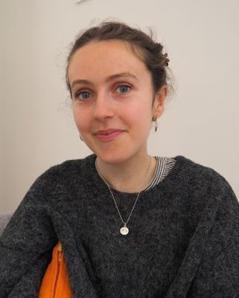
Lara Ferguson
Researcher and Lived Experience Campaigner

Slide 5

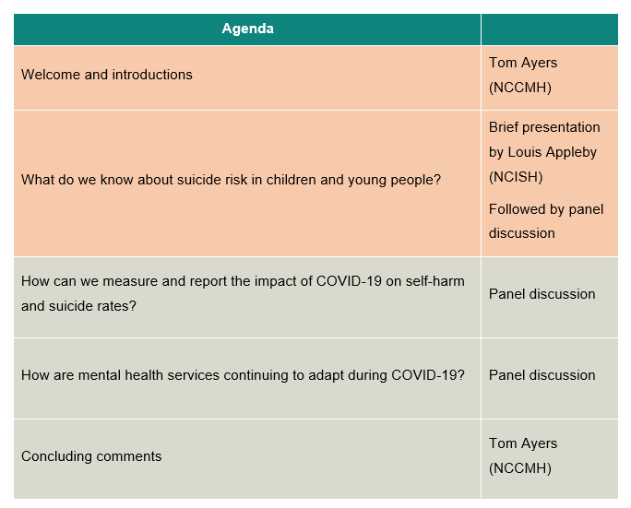

Slide 6


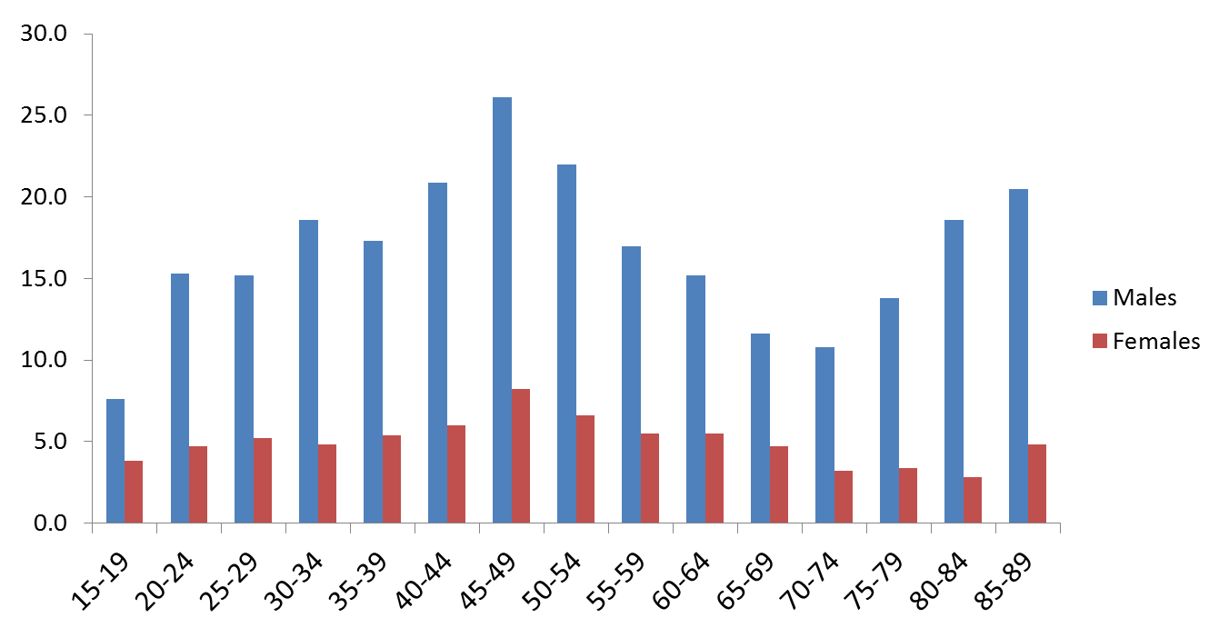
Age-specific suicide rate, 2018, England
Suicide in age & sex groups
Source: ONS, England

Slide 7

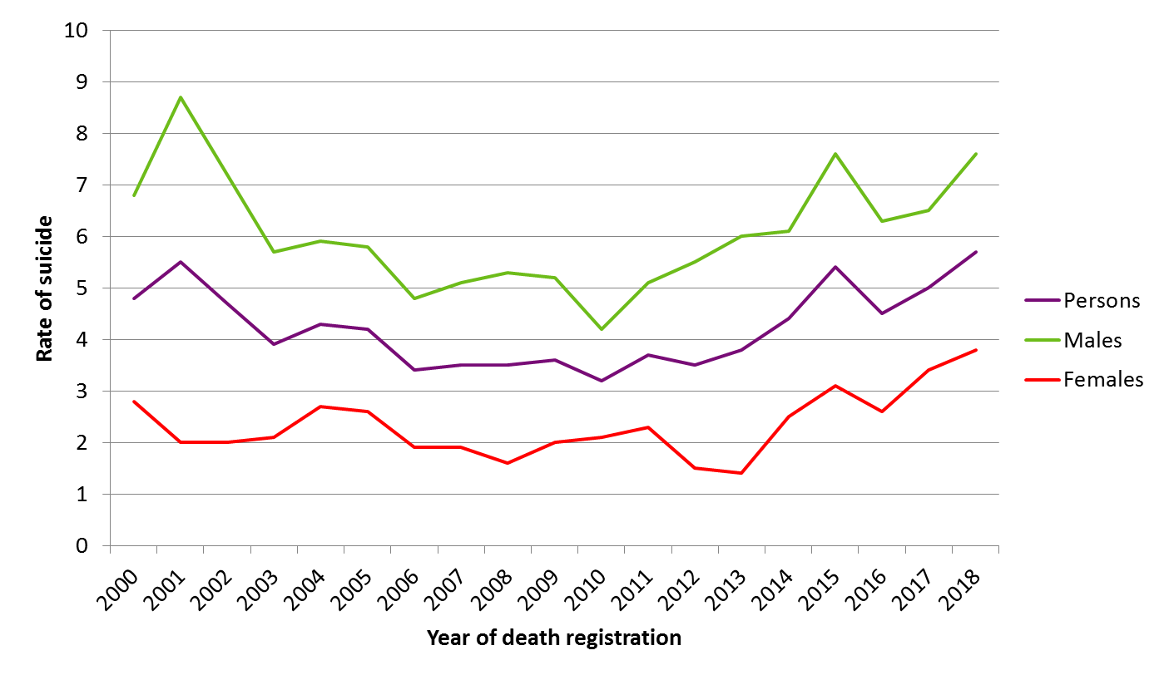
Suicide rates 15-19 year olds
Source: ONS, England

Slide 8

Suicide in people aged <20
595 suicides, UK 2014-2016
Themes of bereavement, bullying, physical health, self-harm, internet use
40% no service contact
PEOPLE YOUNGER THAN 20 (2006-2016)
© National Confidential Inquiry into Suicide and Safety in Mental Health. All rights reserved.
Not to be reproduced in whole or part without the permission of the copyright holder.

Slide 9
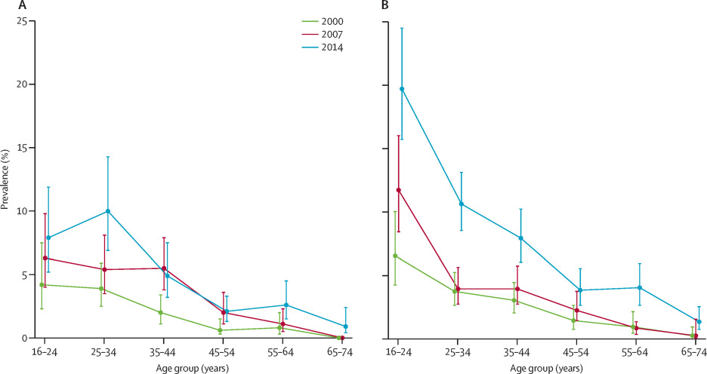
Rising self-harm rates
Prevalence of non-suicidal self-harm in men and boys (A) and women and girls (B), by age group
McManus S, Gunnell D, Cooper C, Bebbington PE, Howard LM, Brugha T, Jenkins R, Hassiotis A, Weich S, Appleby L. Prevalence of non-suicidal self-harm and service contact in England, 2000–14: repeated cross-sectional surveys of the general population. The Lancet Psychiatry. 2019 Jun 4.

Slide 10
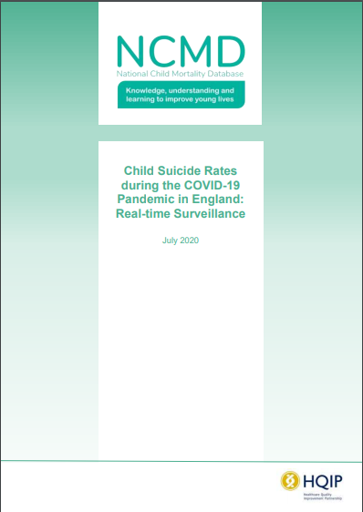
Child suicide rates during the COVID-19 pandemic
Child suicide deaths may have increased during the first 56 days of lockdown
Risk remains low
Numbers too small to reach definitive conclusions
Restriction to education and other activities, disruption to care and support services, tensions at home and isolation appeared to be contributing factors

