Slide 1


Webinar: Restrictive practices during COVID-19
Learning from three healthcare teams, panel Q+A and reflections
Thursday 28 May 2020
14:00 – 15:00

Slide 2
Housekeeping
This is a live event, therefore unless you are an invited speaker you are on mute.
Please use the Q+A function to ask any questions you may have and vote for questions you would like answered. There will be a Q+A section at the end of the webinar facilitated by a member of our team who will present the questions to the speakers.
This webinar will be recorded and the link will be shared after the event.

Slide 4
Lauren Henden,
Deputy Ward Manager
Lily Bowers,
Deputy Ward Manager
Keats Ward, Greater Manchester Mental Health NHS Foundation Trust

Slide 5
Beth Hargreaves, Speech & Language Therapist
Danielle Simpson,
Staff Nurse
Mersey Care NHS Foundation Trust

Slide 6
Steve Andrews,
Associate Director Leadership
East and North Hertfordshire NHS Trust

Slide 7
Patient Engagement
Lauren Henden and Lily Bowers
Deputy Ward Managers
Keats Ward, Greater Manchester Mental Health NHS Foundation Trust

Slide 8
How have we engaged patients?

Slide 9
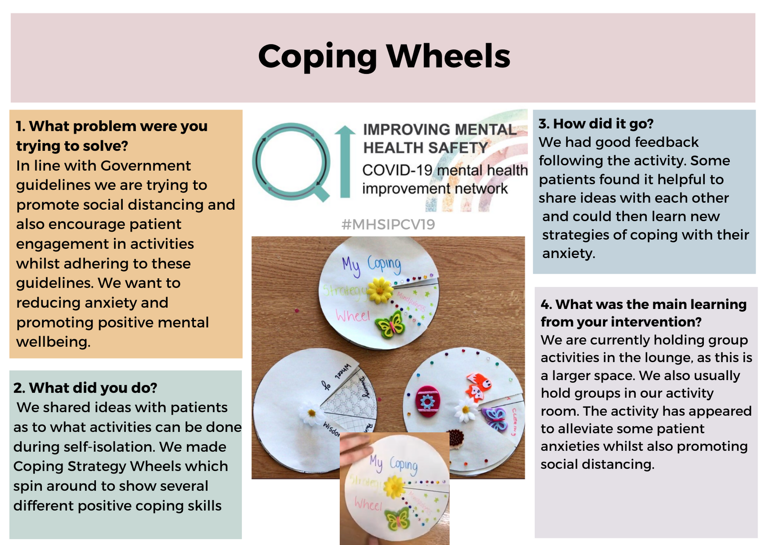

Slide 10
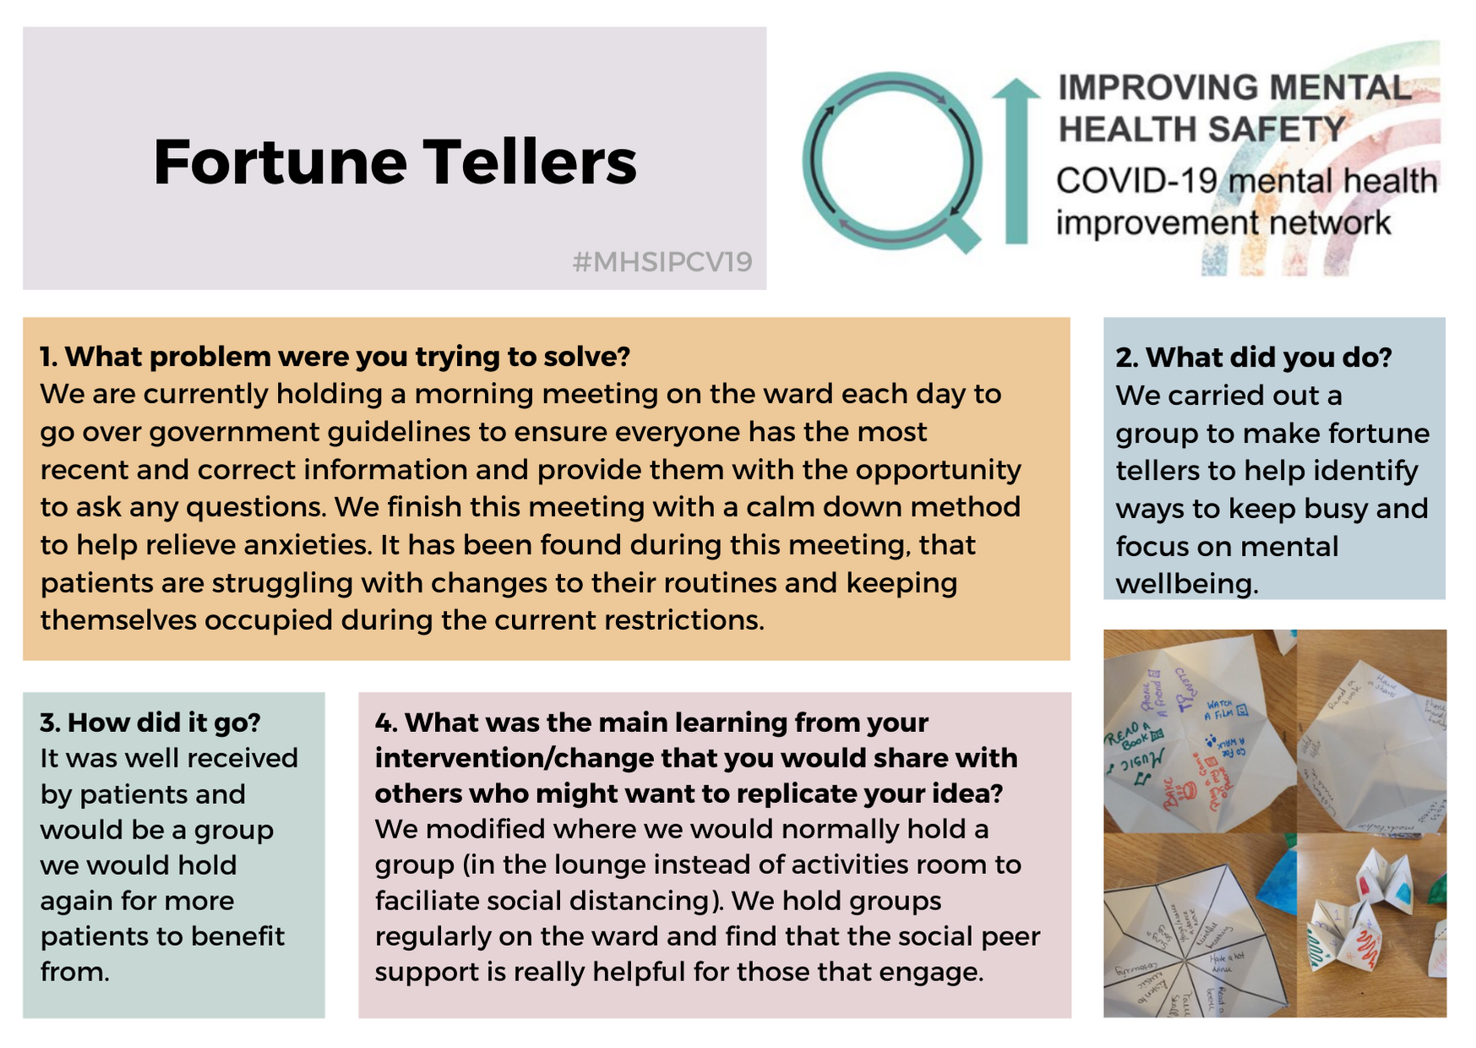

Slide 11


Communication: with families and carers, service users and staff
To prevent the rise in the use of restrictive practices during the COVID-19 pandemic
Secure & Specialist LD Division
Danielle Simpson (Staff Nurse)
Beth Hargreaves (Speech and Language Therapist)

Slide 12
Communication with family and carers
What was the problem?
Due to COVID-19 visiting restrictions, family and carers’ contact with their loved ones has been limited.
What did we do?
We have provided updates in the Carer’s Newsletter, including example resources of how we are still providing some therapy and meaningful activity for service users. The aim was to provide families and carers with reassurance that we are still supporting their loved ones at this challenging time.
Service users have been supported to have ‘virtual visits’ via Skype with family, carers or friends. Social Workers have supported families and carers to set up email accounts and understand Skype where needed.
Service users have been given the opportunity to make a handmade post card or picture to send to their family, carers or friends.
A service user and some staff took part in a dance video to send to the service user’s parent for their birthday.

Slide 13
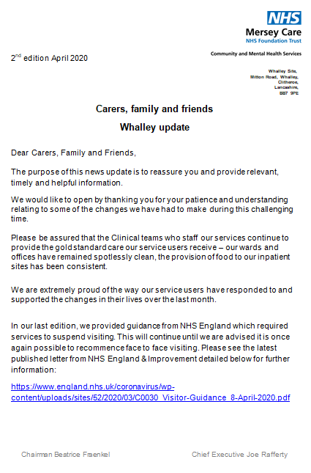
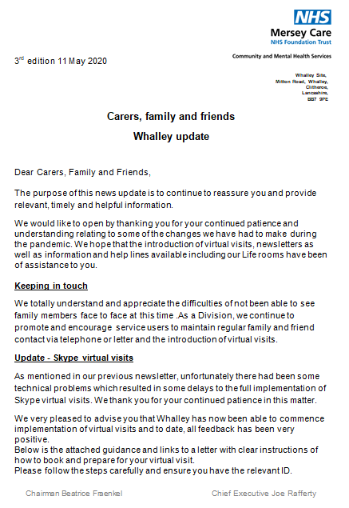
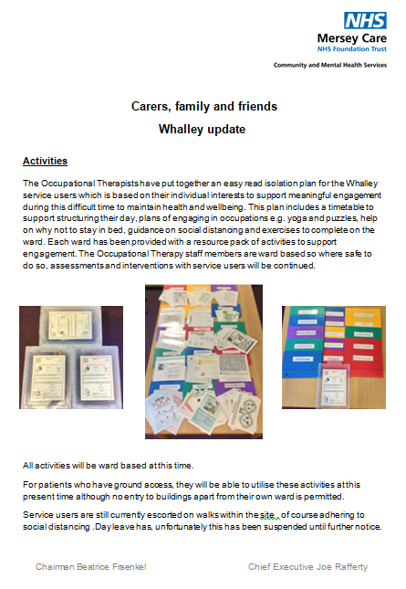
Communication with family and carers

Slide 14
Communication with family and carers
How did it go?
We have received positive feedback from family and carers about the support they have received to maintain contact with their loved ones.
The newsletter has been well received and family and carers have reported to have found them helpful.
The implementation of ‘virtual visits’ has been a great comfort and positive experience for service users and their families /carers.
What was the main learning from this?
While there has been an increase of anxiety around family members being in hospital during this challenging time, the use phone calls to discuss the ongoing changes has supported the MDT to keep the increase at a minimum. While utilizing Skype the families and carers have been able to see the PPE staff are now wearing and a number have commented that seeing this has decreased the anxieties further.
Notes:
Here it would be useful to note that as a Trust we have challenged some of our previous thoughts about the use of technology in secure services

Slide 15
Communication with service users
What was the problem?
Service users were experiencing confusion, anxiety and distress about COVID-19 and the necessary changes made to the hospital to comply with government guidance. There was concern that this would lead to an increase in incidents of violence and aggression.
What did we do?
Accessible information has been produced to support service users to understand and retain advice around social distancing, hand washing, PPE, changes to therapy and activities, and family and carer visiting. These are displayed on the wards and discussed during community meetings.
Therapy and medical staff have maintained contact with service users via letter, telephone and video calls.
Guidance and resources have been produced for staff about how best to communicate with service users when wearing PPE.
Activity and resource packs have been produced to support the continuity of therapeutic and meaningful activity.
Service users have been supported to contribute to their ward rounds via telephone or video calls.
Updating care plans & positive behaviour support plans
Non-verbal. Sitting and being with
Visual learning- pepper & soap experiment.

Slide 16
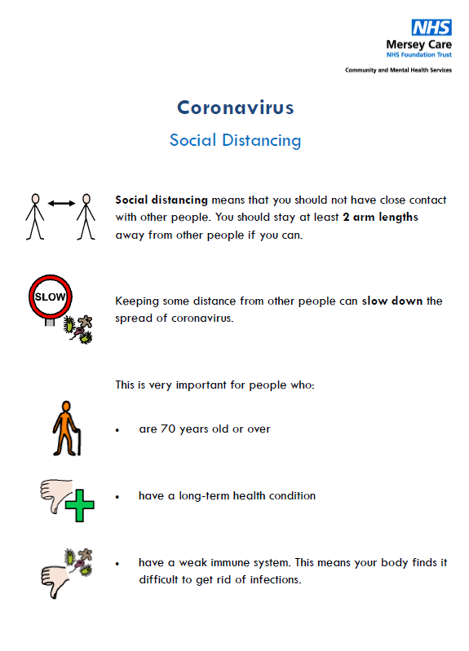

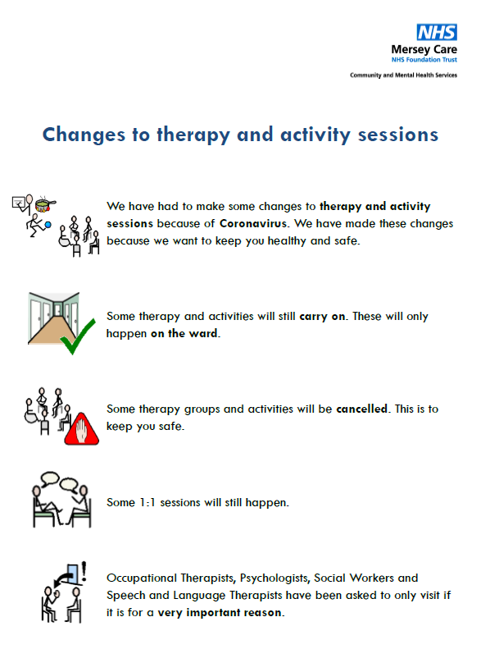

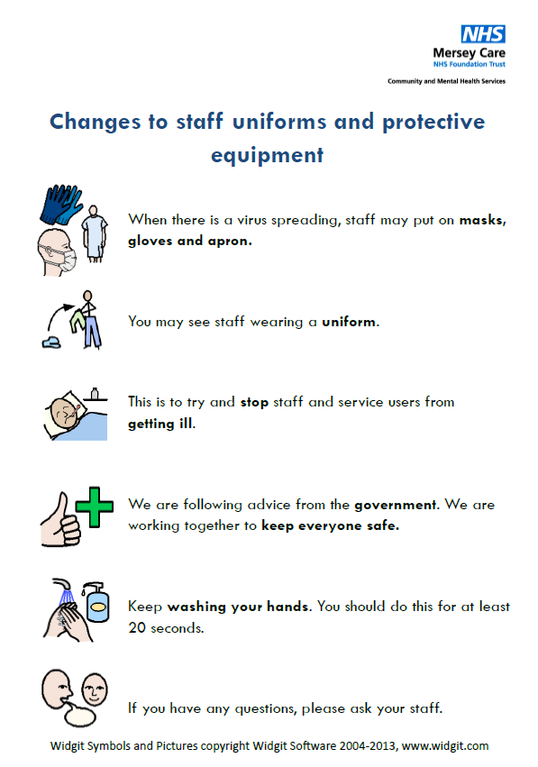

Communication with service users

Slide 17
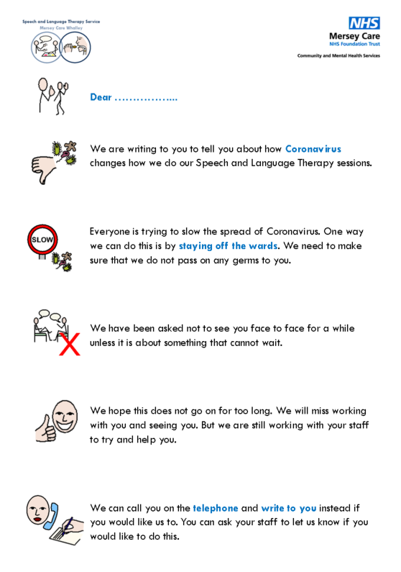
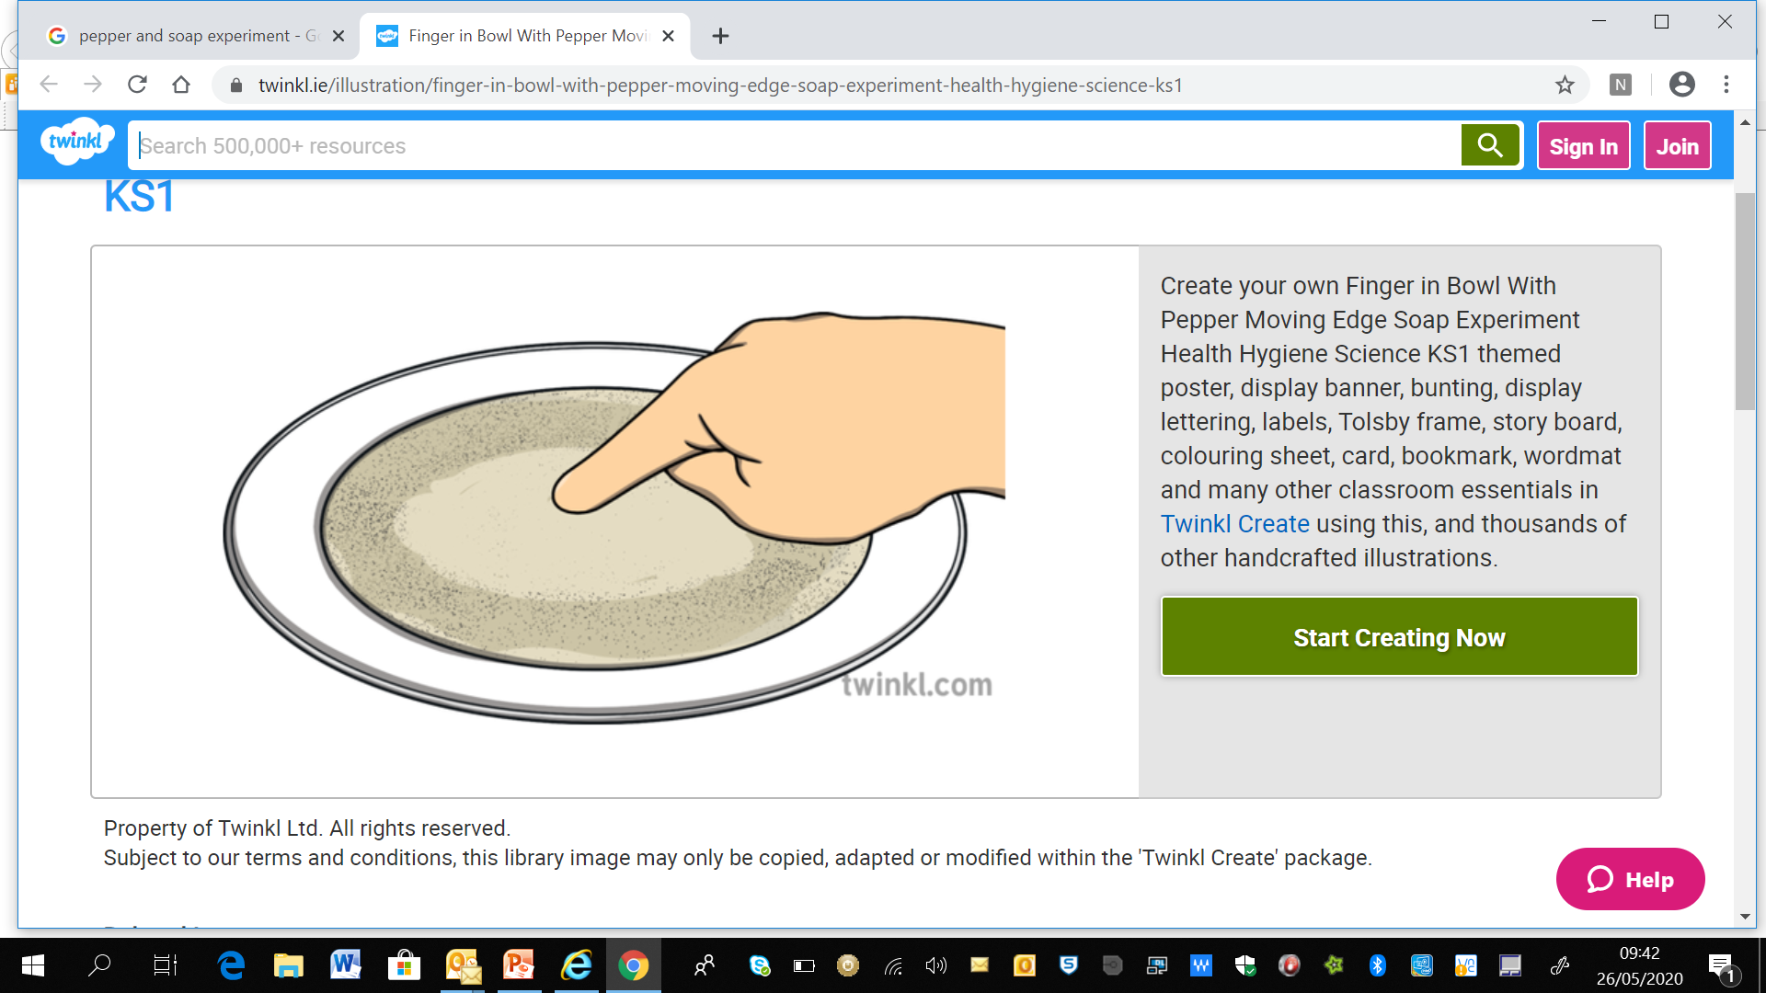
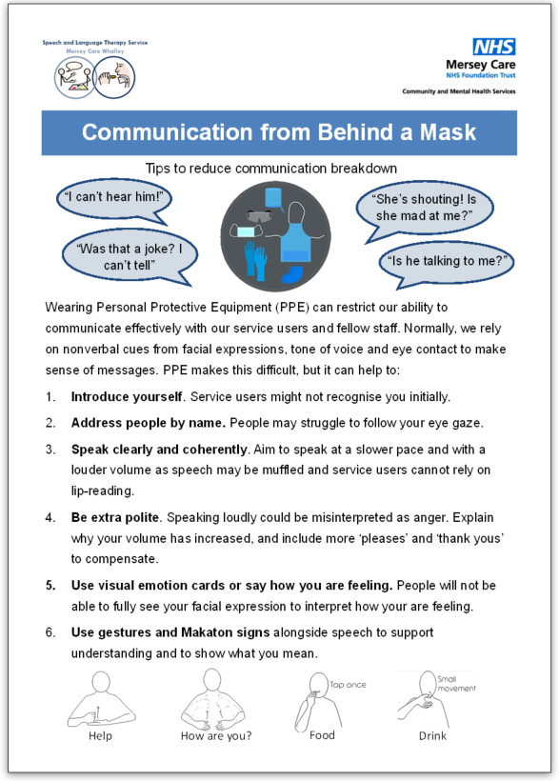
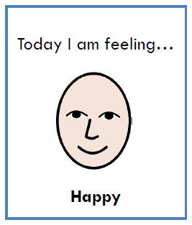
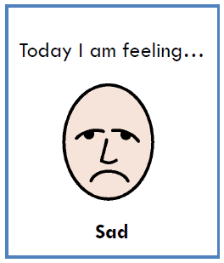
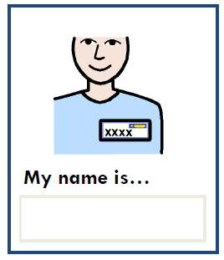
Communication with service users

Slide 18
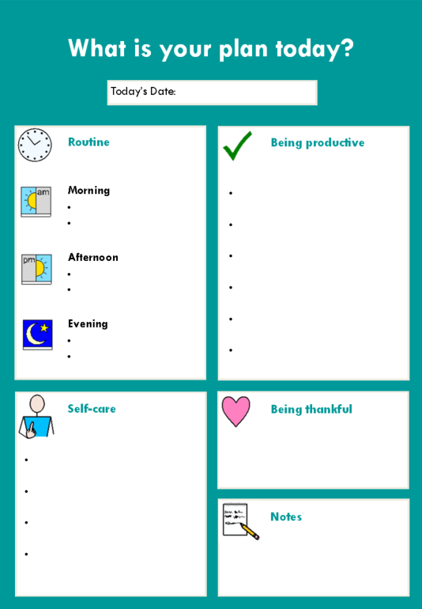
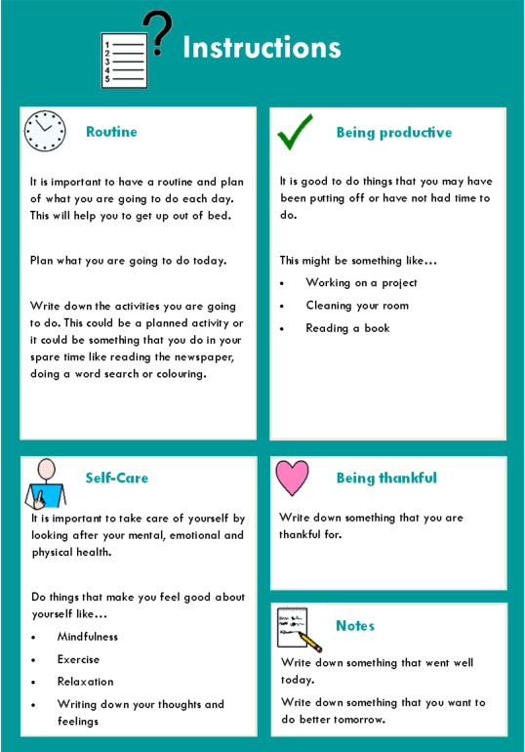
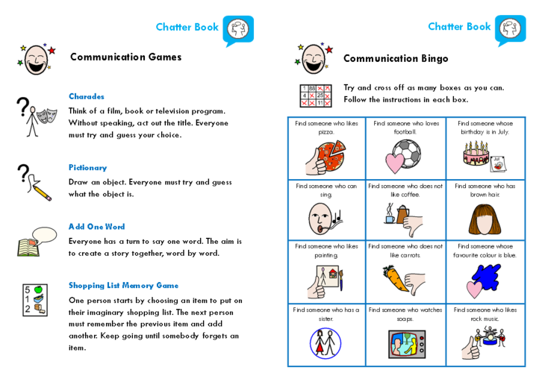
Communication with service users

Slide 19
Communication with service users
How did it go?
We have received some positive feedback from service users about how they have been helped to understand the changes in the hospital that have occurred due to COVID-19.
What was the main learning from this?
Lots of anxiety and distress about COVID-19 can be avoided by ensuring service users are supported to understand the important changes and why they are needed. Anxiety and distress can lead to behaviours that challenge, which could result in increased restrictive practices. By being proactive and ensuring information is accessible, this is helping to avoid this.
Staff gave me easy read about why I can’t go on trips.
I don’t mind not being able to go out. I know why this can’t happen.

Slide 20
Communication with staff
What was the problem?
Staff needed information about COVID-19 and changes to working practices communicated to them in a timely and concise way to ensure guidance could be implemented correctly and without delay. We needed to balance Covid-19 restrictions with least restrictive.
What did we do?
Daily ward manager meetings and staff receive daily COVID-19 briefings by email. These are also printed out and displayed in nurses’ stations for staff who may more difficulty accessing their emails.
Senior leaders have attended wards frequently to offer advice and reassurance.
Staff have access to helplines for advice about well-being, PPE, infection control, swab testing etc.
There is a COVID-19 page on the staff intranet which includes latest advice, guidance and resources.
Blanket restrictions have been recorded per ward and are being reviewed at the RRP monitoring group
Staff rest spaces and increased availability to reflective practice to ensure a safe space for staff
Skype calls with the Chief Executive and Exec Board
Trust wide Facebook group

Slide 21
Communication with staff
How did it go?
Staff have been able to access information about COVID-19 in a number of different ways. Although at times advice and guidance has changed often, staff have been able to respond to this quickly to ensure best practice and to keep service users and families and carers updated. As a trust we have set up a Covid-19 centre with a senior nurse who will contact staff who are isolating.
What was the main learning from this?
While the information around Covid-19 has been rapidly changing the use of social media and weekly briefing emails have been effective in updating staff members. By being understanding towards staff members rapidly changing needs and it has eased anxieties for the staff members in work and those who are isolating due to being in the high risk category.
There is a weekly briefing that is sent out and kept in the MDT stations.
The Trust has sent out all the information staff need to know.

Slide 22
What’s next? Improvement ideas
We are exploring how to source face masks with a clear window for lip reading. There are challenges with ensuring these masks meet PPE guidance.
We are introducing a weekly coproduced Positive Newsletter where service users can write articles and share photos of all the good things that are happening on the wards or that they have heard about on the news or in the newspapers.
We are implementing more video conferencing for teletherapy to ensure service users can continue to access their therapies.
To ensure we keep some of the new ways of working (e.g. skype to family) post Covid-19

Slide 23
Our
‘How Are You Doing?’ story
Steve Andrews
Associate Director Leadership

Slide 25
Questions

Slide 26
Reflections

