Slide 1

Thank you for joining today’s learning set! The event will start at 10:00.
In the meantime, please use the chat to introduce yourself and tell us the artist and title of a song that brings you joy.

Slide 2
Welcome
Learning Set 2
Dr Amar Shah, National Improvement lead for Mental Health
8th September 2021

Slide 3
Housekeeping
Please mute your microphone unless you are speaking.
Please make use of the chat function to introduce yourself to the group, ask questions or leave a comment!
If you experience any technical difficulties, please email enjoyingwork@rcpsych.ac.uk.
All presentation slides and recordings will be made available on the RCPsych Enjoying Work page shortly after today’s event.

Slide 4
Today’s agenda

Slide 5
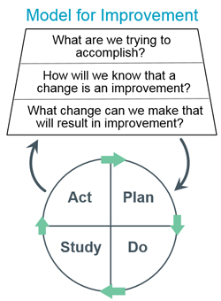
Our aim
To enhance staff wellbeing and create joy in work
Aim

Slide 6
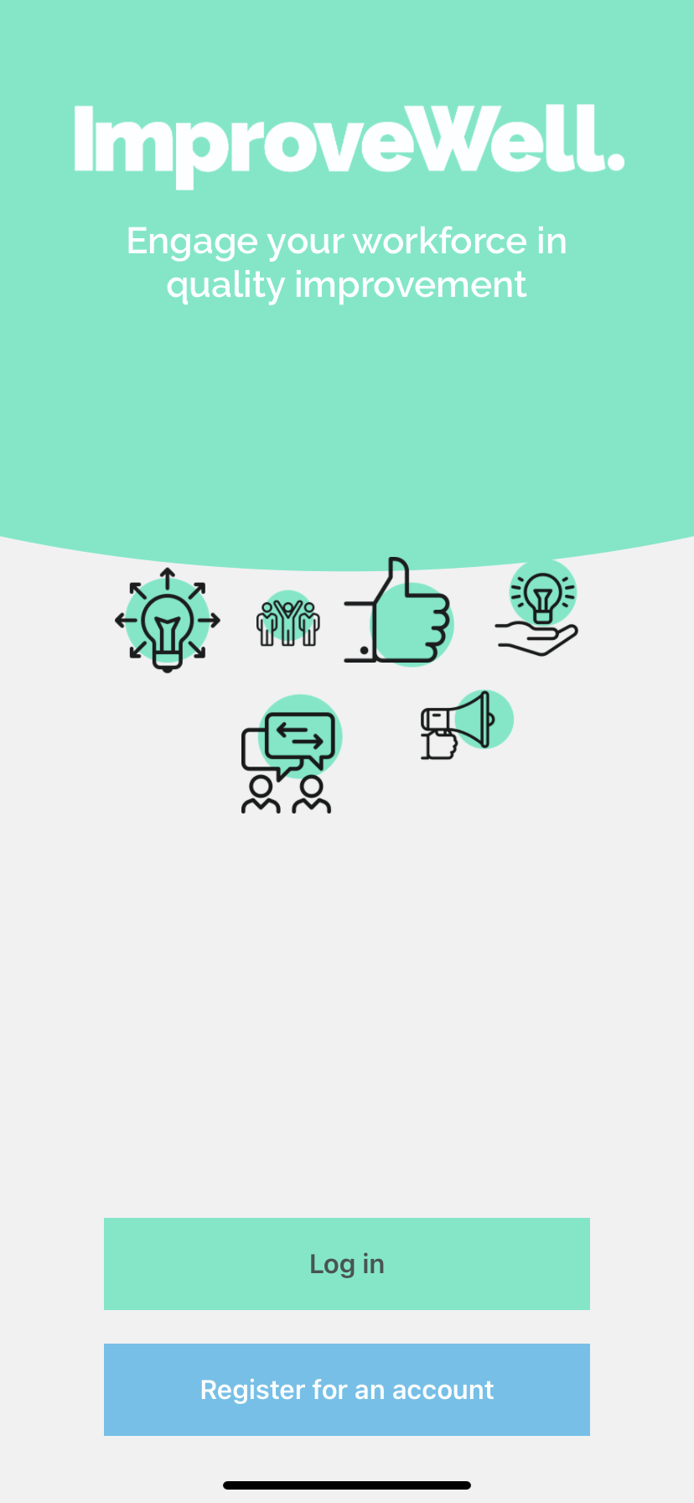
Measurement Plan
Weekly data collection via the ImproveWell app to measure:
Joy in work (weekly)
The percentage of people in the team who have enjoyed being at work on a frequent basis each week
Burnout (weekly)
The percentage of people in the team who experience no symptoms of burnout
Recommending your team as a place to work (weekly)
The percentage of people in the team who are extremely likely to recommend their service/team as a place to work

Slide 7
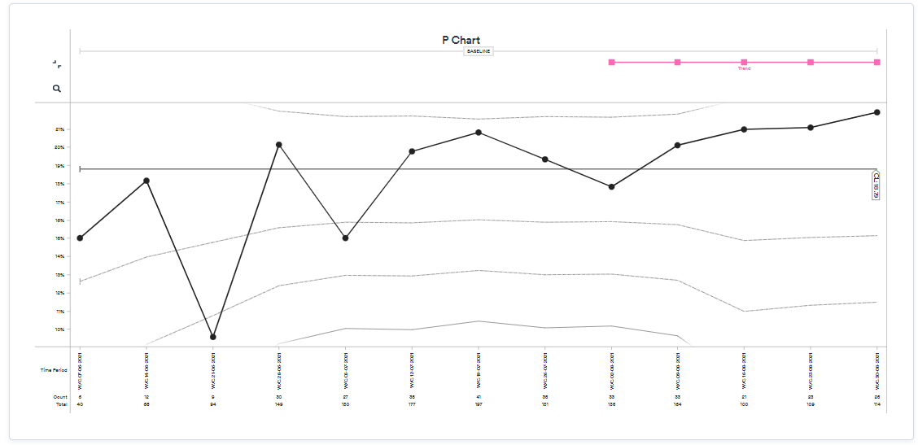
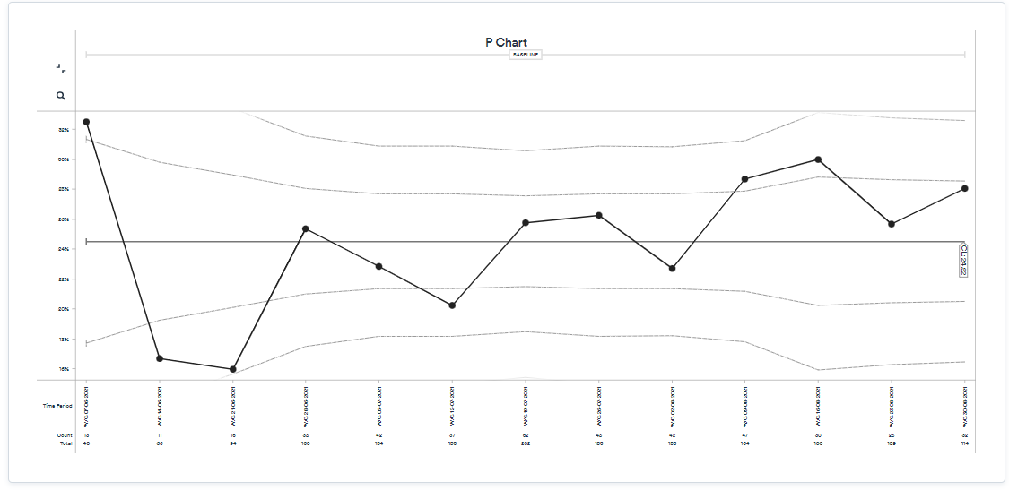
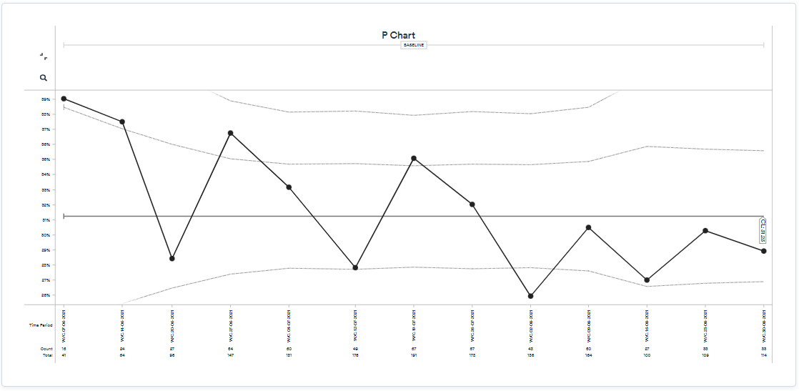
People who have enjoyed being at work on a frequent basis
People who experience no symptoms of burnout at work
People who are extremely likely to recommend their team as a place to work

Slide 8
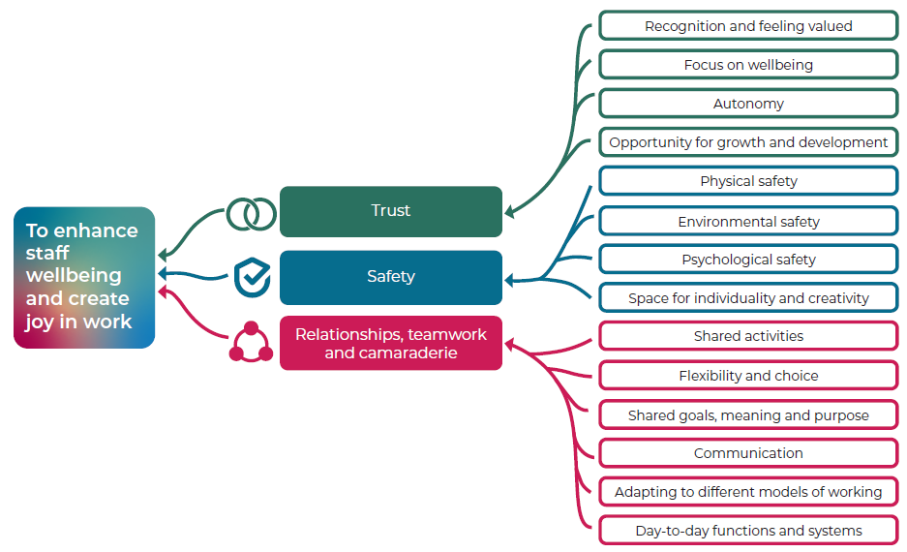
Driver diagram

Slide 9
PDSA Cycles
ACT
Scale up?
Try something else?
Next cycle?
Ready to implement?
PLAN
What is your
aim?
What do you predict will happen?
Who? When? How? Where?
What might happen if we try something different?
What’s next?
STUDY
Complete data analysis
Compare to predictions
Summarise
DO
Carry out plan
Document problems
Look at your
data
Did it work?
Let’s try it!

Slide 10
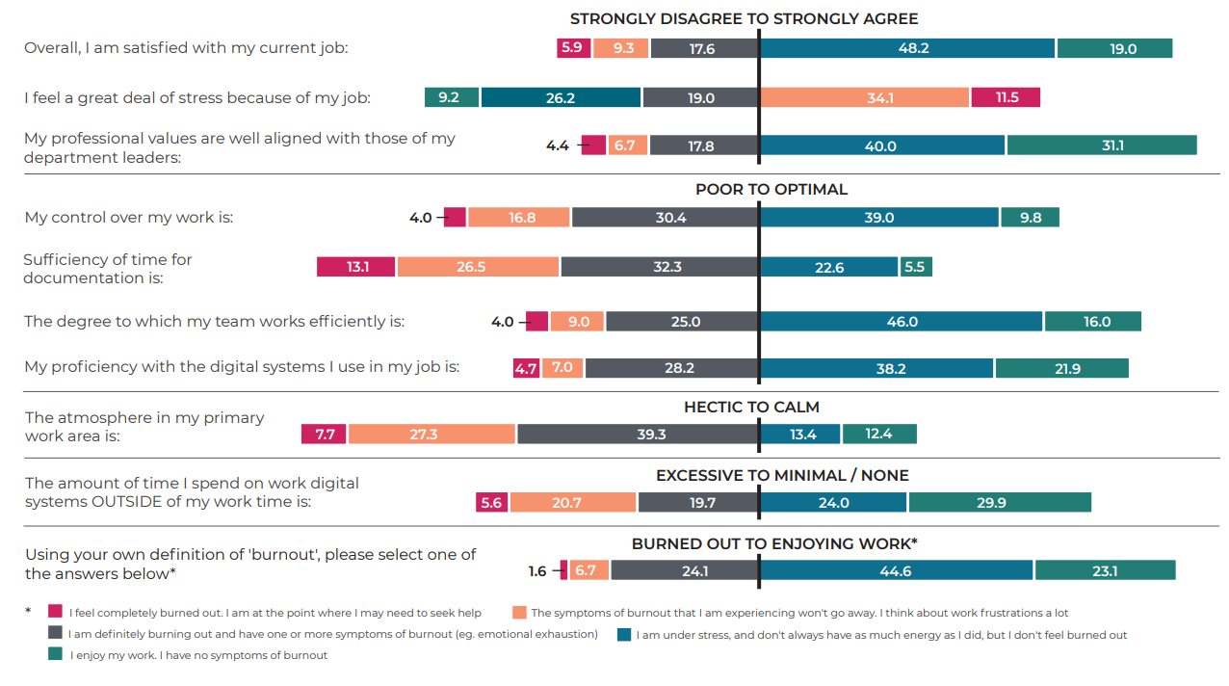
Mini Z survey results

Slide 11
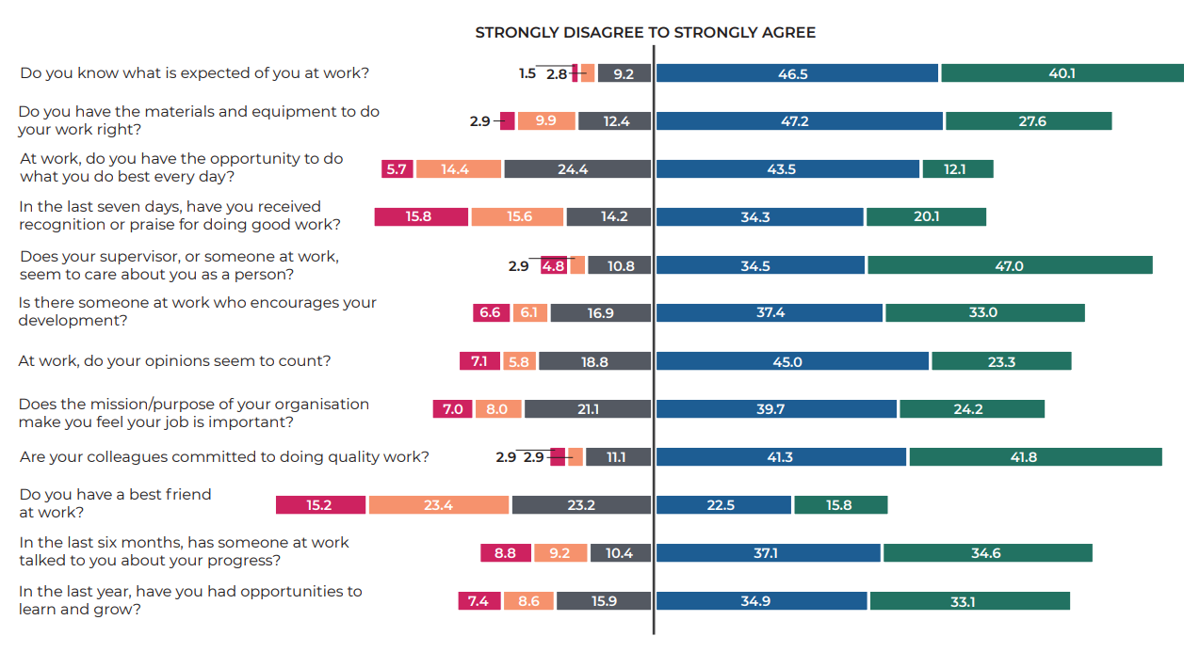
Gallup 12 results

Slide 12
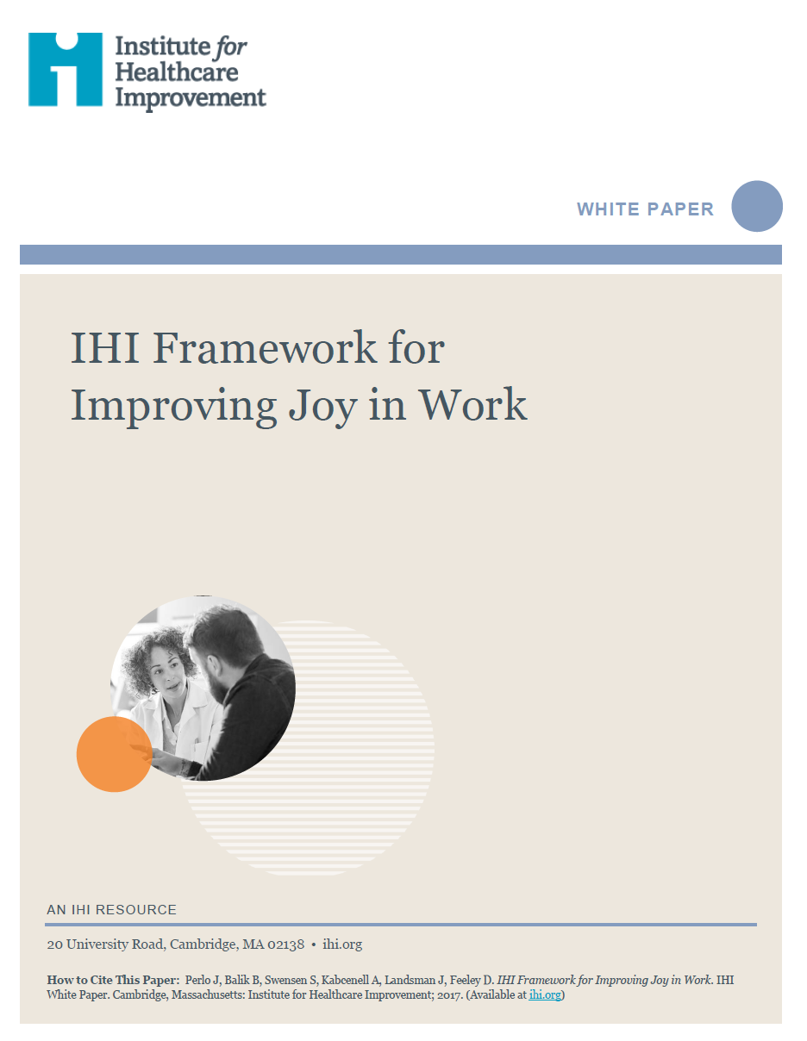
Evidence base and joy in work framework
Dr Amar Shah, National Improvement lead for Mental Health

Slide 13
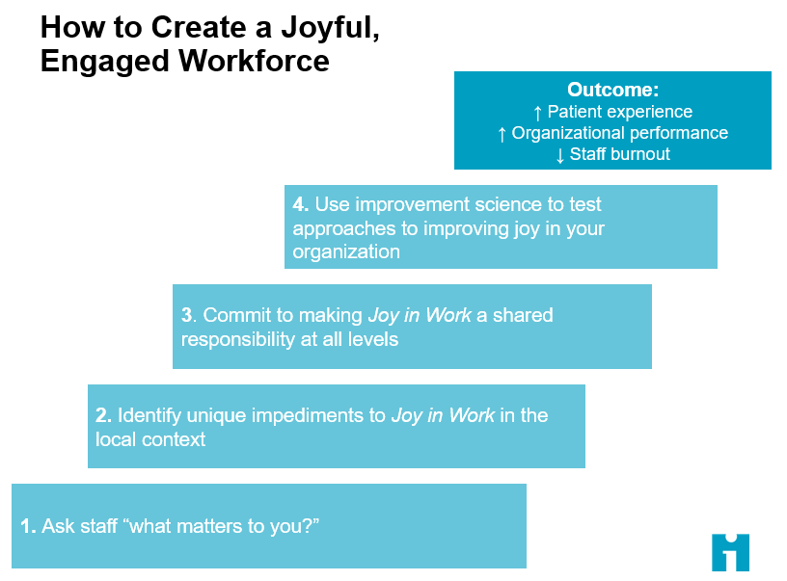

Slide 14
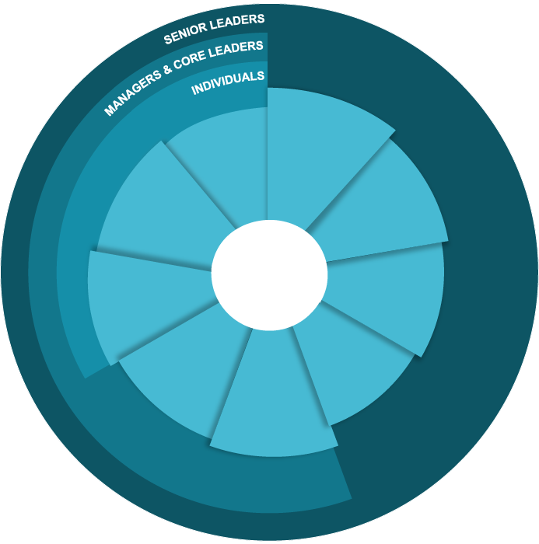
Critical Components for Ensuring a Joyful, Engaged Workforce
Interlocking responsibilities at all levels
Real Time
Measurement
Physical & Psychological
Safety
Wellness & Resilience
Meaning & Purpose
Happy
Healthy
Productive
People
Daily Improvement
Autonomy
& Control
Camaraderie
& Teamwork
Recognition
& Rewards
Participative Management

Slide 15
Critical Components for Ensuring a Joyful, Engaged Workforce
Interlocking responsibilities at all levels
Real Time Measurement:
Contributing to regular feedback systems, radical candor in assessments
Wellness & Resilience:
Health and wellness self-care, cultivating resilience and stress management, role modeling values, system appreciation for whole person and family, understanding and appreciation for work life balance, mental health (depression and anxiety) support
Real Time
Measurement
Physical & Psychological
Safety
Wellness & Resilience
Meaning & Purpose
Happy
Healthy
Productive
People
Daily Improvement
Autonomy
& Control
Daily Improvement:
Employing knowledge of improvement science and critical eye to recognise opportunities to improve, regular, proactive learning from defects and successes
Camaraderie
& Teamwork
Recognition
& Rewards
Participative Management

Slide 16


Slide 17
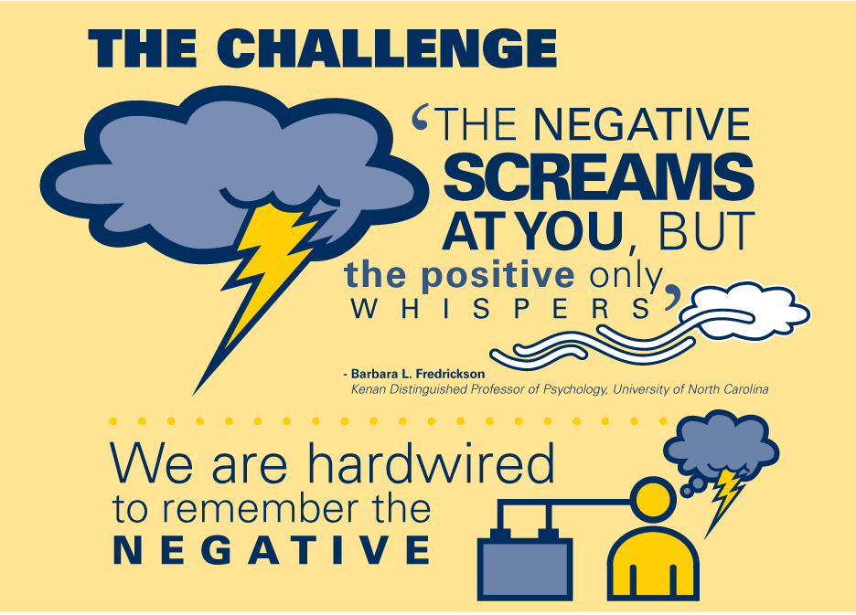

Slide 19


Slide 20
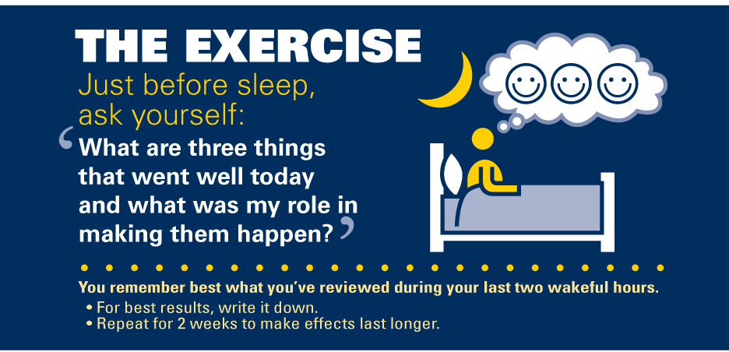

Slide 21

Bolier L, Haverman M, Westerhof G, Riper, H et. al. Positive psychology interventions: a meta—analysis of randomized controlled studies. BMC Public health 2013, 13:119

Slide 22
Critical Components for Ensuring a Joyful, Engaged Workforce
Interlocking responsibilities at all levels
Real Time
Measurement
Physical & Psychological
Safety
Wellness & Resilience
Meaning & Purpose
Happy
Healthy
Productive
People
Daily Improvement
Autonomy
& Control
Camaraderie
& Teamwork
Recognition
& Rewards
Participative Management
Participative Management:
Co-production of Joy, leaders create space to hear, listen, and involve before acting. Clear communication and consensus building as a part of decision making
Camaraderie & Teamwork:
Commensality, social cohesion, productive teams, shared understanding, trusting relationships

Slide 23


“mutual trust and friendship among people who spend a lot of time together”
State of the American Workplace

Slide 24


Slide 25
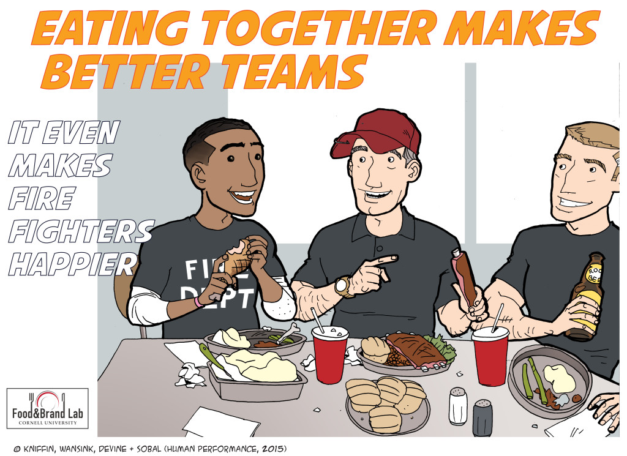
Kevin M. Kniffin; Brian Wansink; Carol M. Devine; Jeffery Sobal; Human Performance 2015, 28, 281–306.

Slide 26
Team vs Group?
Distinguishing factors:
Commitment
Purpose
Relationship
Typically no more than 12 members who:
  Have shared objectives in common
  Need to work together to achieve these objectives
  Have defined roles in the team
  Meet regularly to review performance and to improve

Slide 27

Reflexivity
Teams are more productive, effective and innovative to the extent that they routinely take time out to reflect upon their objectives, strategies, processes and environments and make changes accordingly.
Schippers, West & Dawson, 2012, Journal of Management
Tannembaum & Cerasoli, 2013, Human Factors

Slide 28
Critical Components for Ensuring a Joyful, Engaged Workforce
Interlocking responsibilities at all levels
Physical & Psychological Safety:
Equitable environment, free from harm, Just Culture that is safe and respectful, support for the 2nd Victim
Meaning & Purpose
Daily work is connected to what called individuals to practice, line of site to mission/goals of the organization, constancy of purpose
Real Time
Measurement
Physical & Psychological
Safety
Wellness & Resilience
Meaning & Purpose
Happy
Healthy
Productive
People
Autonomy & Control:
Environment supports choice and flexibility in daily lives and work, thoughtful EPR implementation
Daily Improvement
Autonomy
& Control
Camaraderie
& Teamwork
Recognition
& Rewards
Recognition & Rewards:
Leaders understand daily work, recognising what team members are doing, and celebrating outcomes
Participative Management

Slide 29

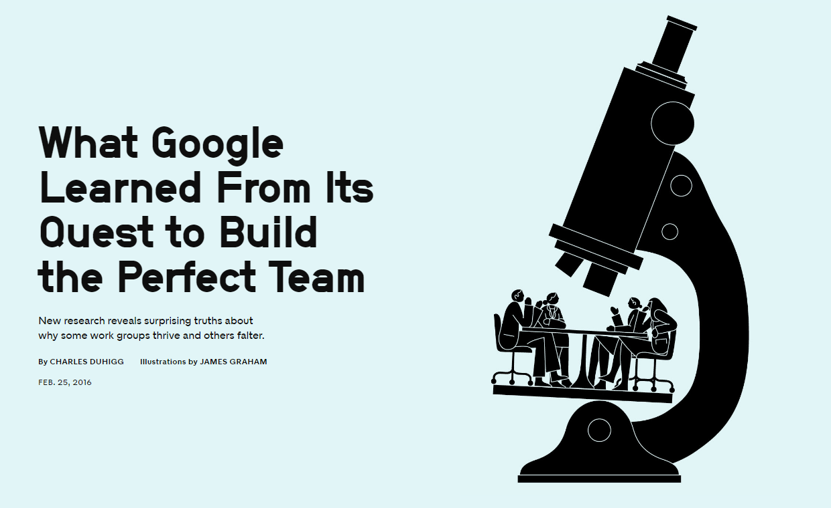

Slide 30
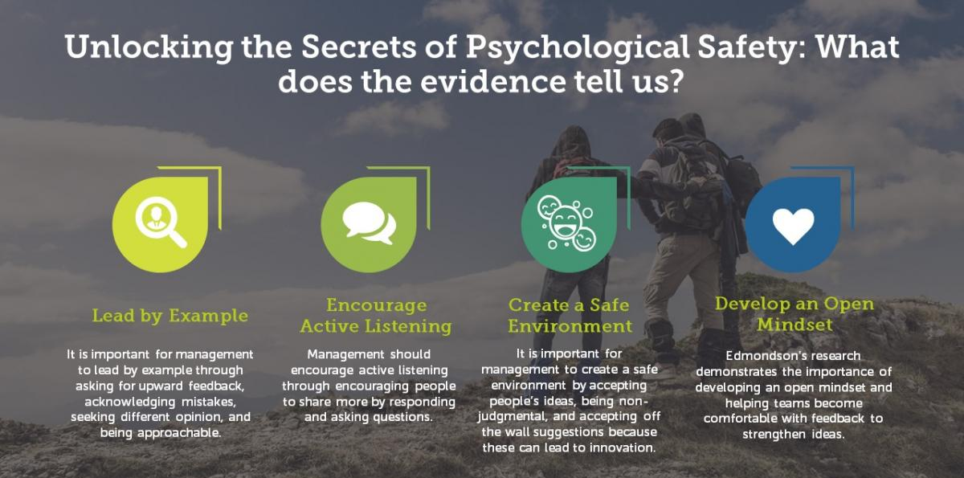


Slide 31
Critical Components for Ensuring a Joyful, Engaged Workforce
Interlocking responsibilities at all levels
Real Time
Measurement
Physical & Psychological
Safety
Wellness & Resilience
Meaning & Purpose
Happy
Healthy
Productive
People
Daily Improvement
Autonomy
& Control
Camaraderie
& Teamwork
Recognition
& Rewards
Participative Management

Slide 32
Theory of change – moving from ideas to testing
QI coaches (NCCMH)

Slide 33
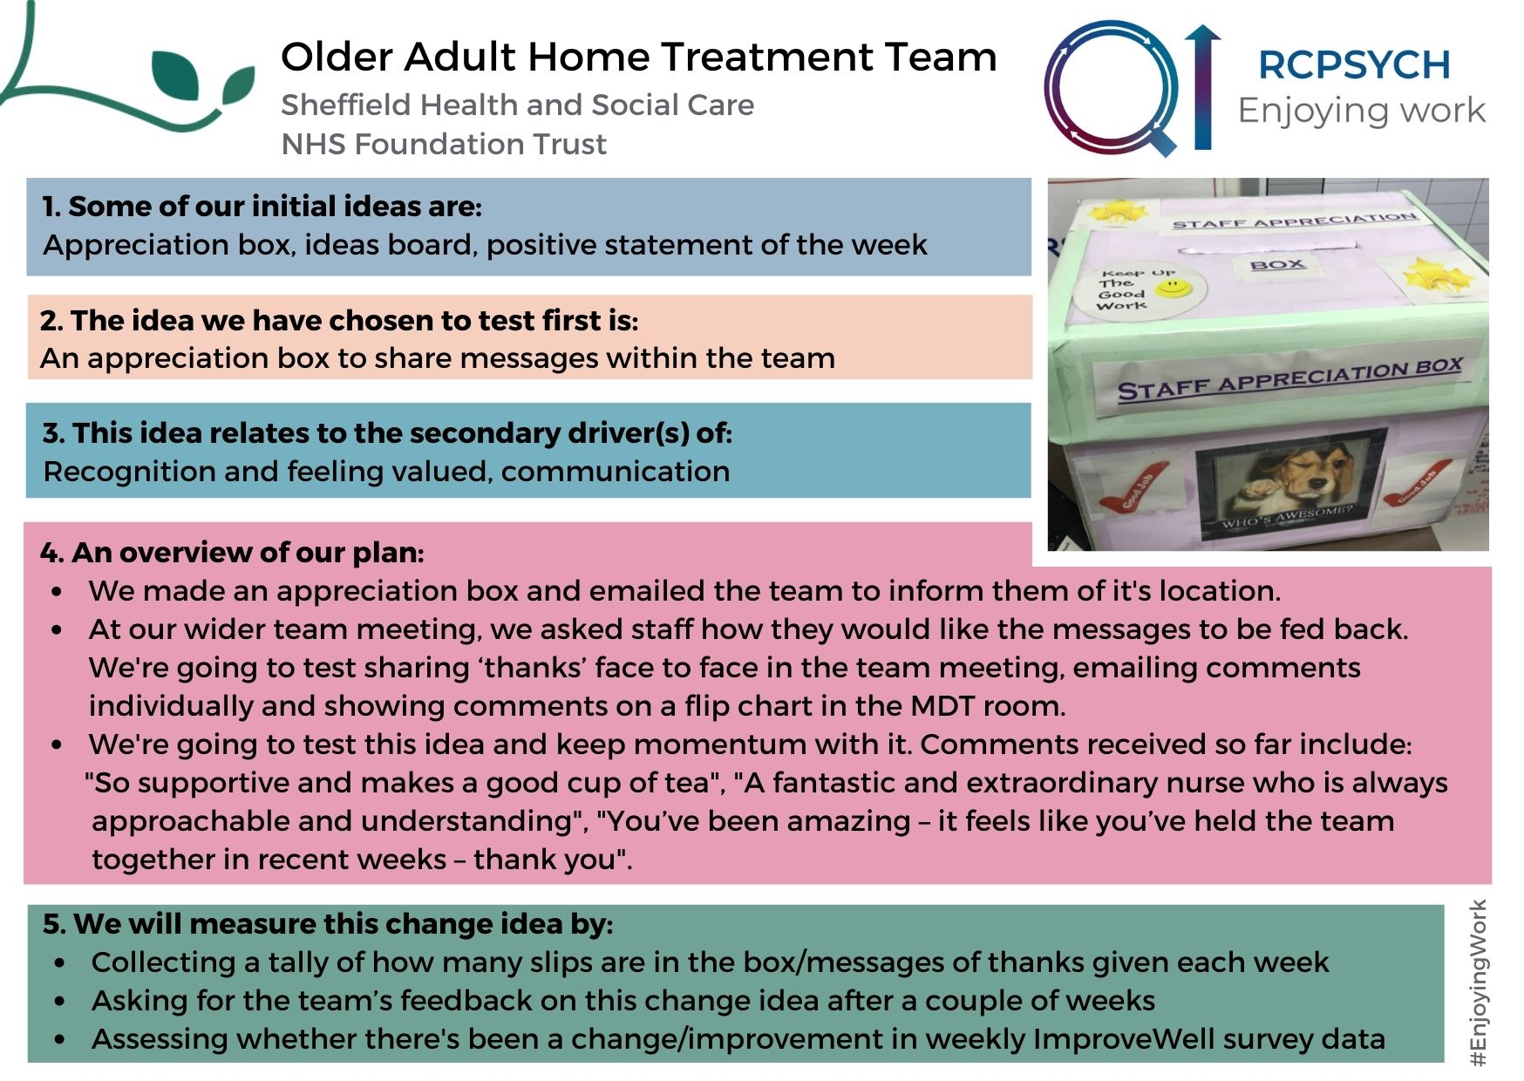

Slide 34
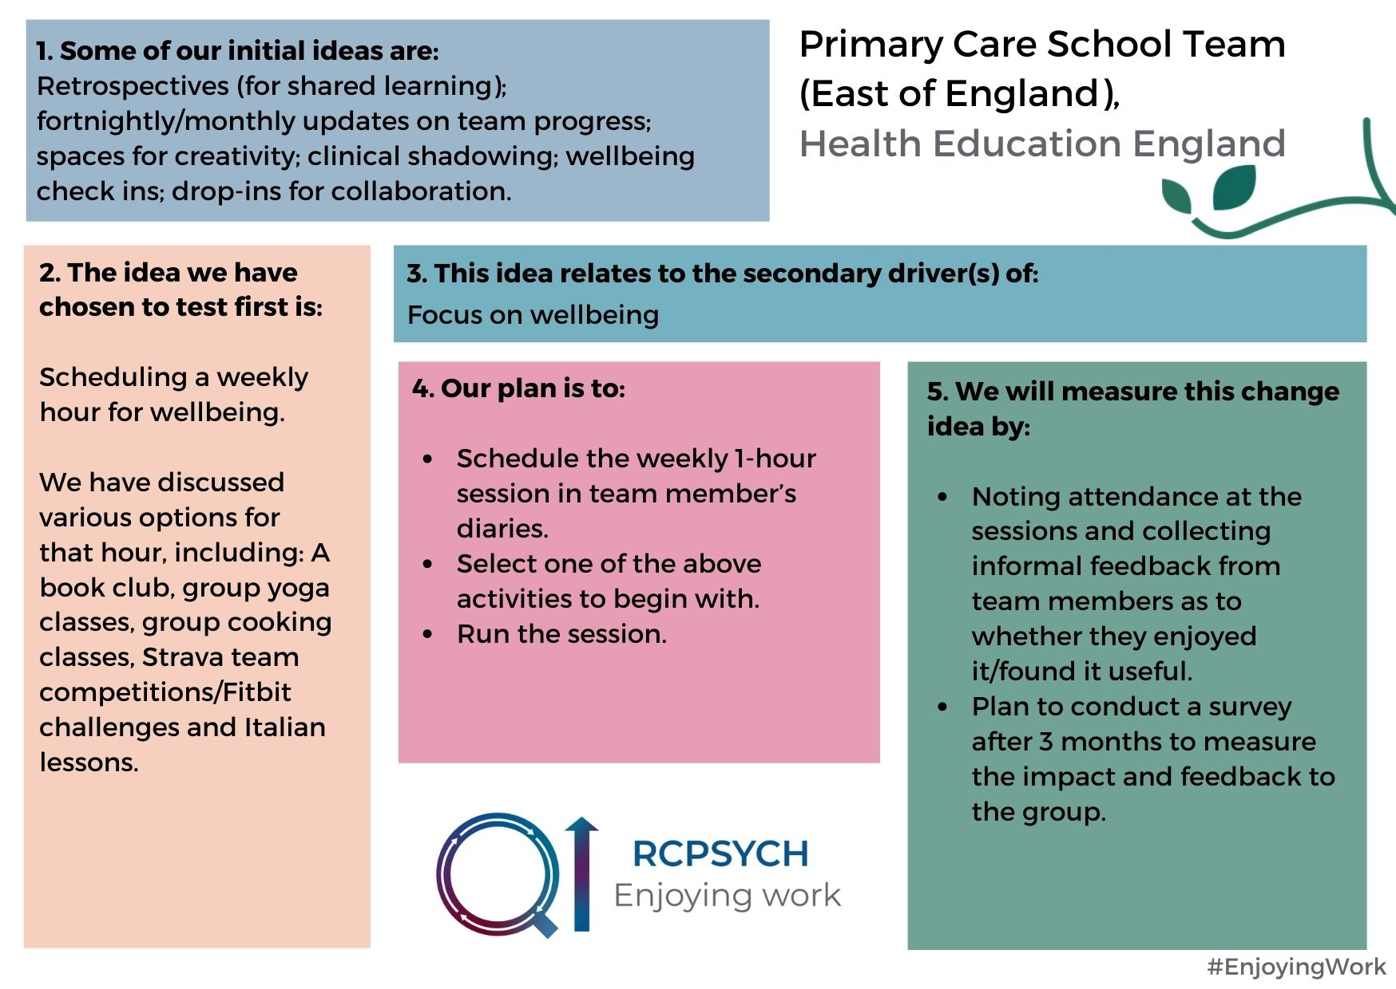

Slide 35
Break

Slide 36
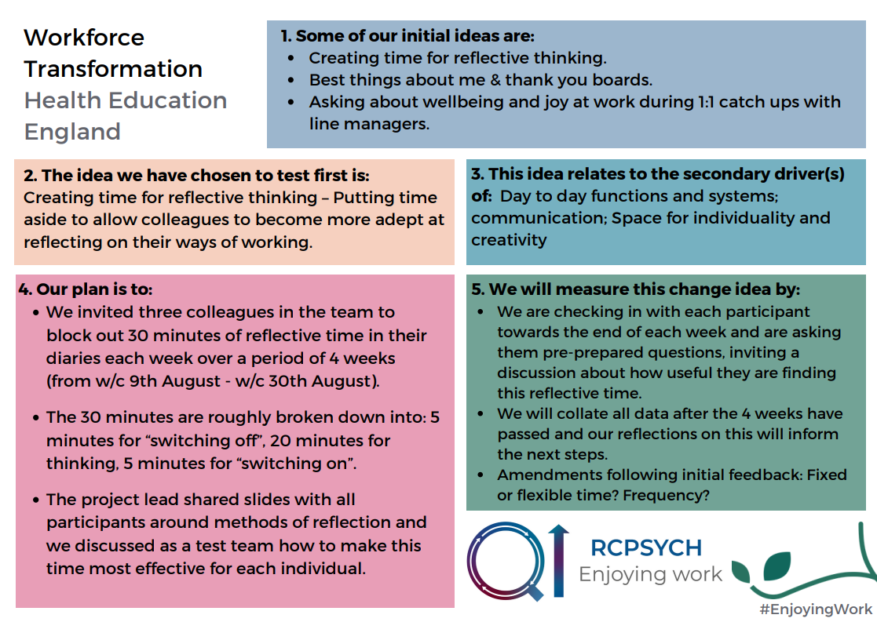

Slide 37
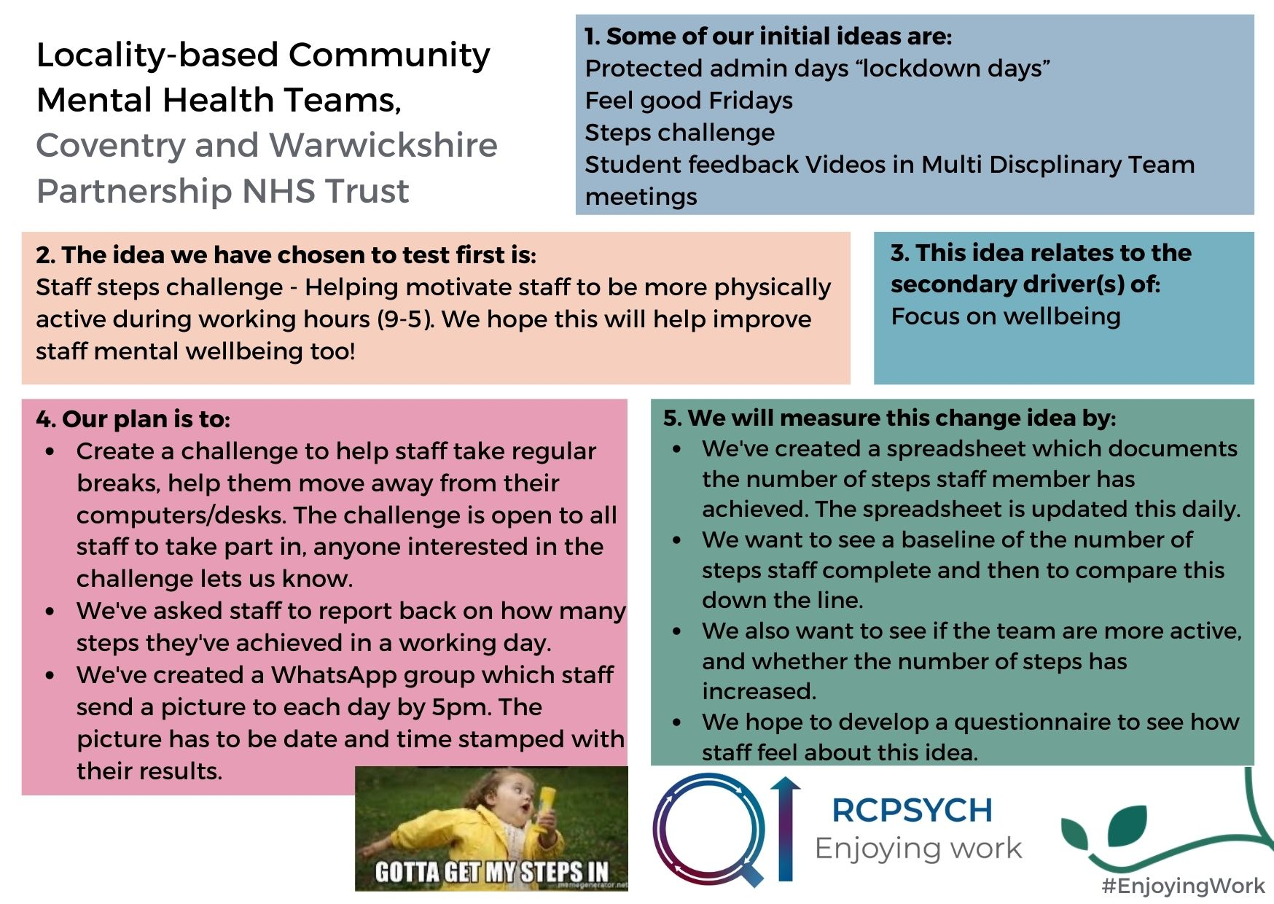

Slide 38
Breakout – running your project QI coaches (NCCMH)

Slide 39

Instructions:
Click Breakout Rooms in your meeting controls. Hover your pointer over the number to the right of breakout room you wish to join, click Join, then confirm by clicking Join. Click Leave Room to return to the main session.

Slide 40
Change ideas to test next
Renata Souza, QI Coach (NCCMH)

Slide 41
Instructions
Inspired by today, we’re going to think about what change idea(s) you would like to test next.
You will shortly be randomly allocated into breakout rooms of 3 people and have 10min to discuss ideas you might want to test over the next few weeks and how you might test them.

Slide 42
Instructions
Following your breakout group discussions please share the change ideas you are going to test next via Menti. A link will be provided in the chat shortly or you can go to www.menti.com and enter the code:
64 13 20 4

Slide 43
Closing – next steps
Tom Ayers, Director (NCCMH)

