Slide 1
Welcome
Learning Set 3
Dr Amar Shah, National Improvement lead for Mental Health
16th November 2021

Slide 2
Housekeeping
Please mute your microphone unless you are speaking.
Please make use of the chat function to introduce yourself to the group, ask questions or leave a comment!
If you experience any technical difficulties, please email enjoyingwork@rcpsych.ac.uk.
All presentation slides and recordings will be made available on the RCPsych Enjoying Work page shortly after today’s event.

Slide 3
Today’s agenda
10:45 – 13:00 | All attendees to join the meeting
11:00 – 11:05 | Welcome | Dr Amar Shah, National Improvement Lead for Mental Health (NCCMH)
11:05 – 11:25 | Health Education England’s HR & OD Team: Our Enjoying Work Project | Ella Hughes, Project Manager Health Education England
11:25 – 11:55 | Rapid cycles of testing: Quality & Commissioning team, Health Education England Winchester CAMHS team, Sussex Partnership NHS Foundation Trust Long Term Neurological Conditions team, Sheffield Health & Social Care Trust | QI Coaches, (NCCMH)
11:55 – 12:05 | Break
12:05 – 12:50 | Data: What does it mean? How can we get more? | QI Coaches, (NCCMH)
12:50 – 12:55 | Sharing your positive changes | Tom Ayers, Director (NCCMH)
12:55 – 13:00 | Close | Tom Ayers, Director (NCCMH)

Slide 4
Health Education England
HR & OD Team

Slide 5



Our Enjoying Work Collaborative
Human Resources and Organisational Development

Slide 6
Why Project Management
Continuous Improvement
Dedicated resource
Proven way to plan, monitor and drive progress
Enables:
  Collaboration
  Creation and testing of initiatives
  Benefit measurement
  Decision making
  Reporting of progress

Slide 7
Why our Collaborative is not a 'Project'
Enjoying work is a mindset and a movement for our team - it is a way of being.
We collaborate, communicate, invent, test, learn and improve for the purpose of gaining joy at work individually and collectively.
This work does not have an end date
Truly about continuous improvement
We are a Collaborative Group, not a Project Team
The is work done by us all for us all

Slide 8
Our
Working
Structure
Wider Team
External Facilitator
RCPSYCH
Change Champions
Business Change Manager
Project Manager
& PMO
Sponsor
Data Champion
Notes:
Champions of change to create a more enjoyable working experience for all.
The Enjoying Work Collaborative is a core objective within our everyday roles in HR OD.
We have protected time to dedicate to our roles in the Collaborative.

Slide 9
Roles and Responsibilities
Business Change Manager | Project Manager | Project Management Officer | Data Champion | Change Champion | Wider Team
Accountable for delivery of the Collaboratives overall outcomes. | Responsible for overseeing management of the Collaboratives delivery. | Responsible for supporting the Project Manager to oversee management of the Collaboratives delivery. | Responsible for the management of the Collaboratives data platforms and for the management and analysis of colleague engagement data. | Responsible for delivery of allocated Workstreams (mini projects). Responsible for supporting the management of the Collaboratives delivery. | Responsible for engaging with the Enjoying Work Collaborative, providing feedback to the Collaborative, and for delivery of assigned tasks on an ad hoc basis.

Slide 10
How we got started
Project Initation/Information Document (PID)
  Background/Context
  Outcomes
  Scope - in scope & out of scope
  Benefits
  Resources
  Work packages and timeline
  RAIDD Log – Risks, Issues, Assumptions, Decisions, Dependencies
  Communications
  Budget
  Business as Usual
Terms of Reference
  Purpose
  Aims and Objectives
  Operating Principles
  Core membership
  Quoracy
  Meetings, frequency and attendance
  Secretariat
  Review and approval

Slide 11

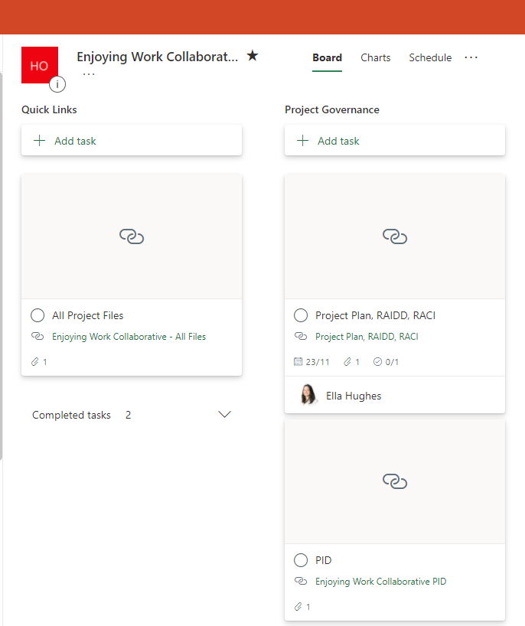
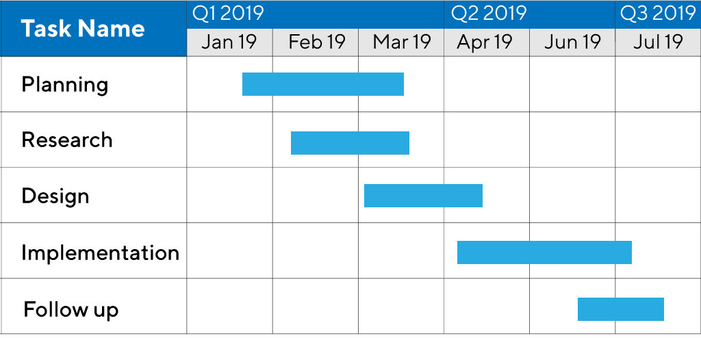
How we manage tasks now
Project Management
RAIDD – Risks, Issues, Assumptions, Decisions, Dependencies
Action Log
Gantt Chart
Collaborative Task Management
MS Planner and Office 365

Slide 12
EWC Plan on a Page
Equality, Diversity & Inclusion
Best Place to Work
Employee Experience
Values & Behaviours
Reward & Recognition
Relationships & Comradery
Talent & Development
Consultation & Engagement
Safety & Trust
Fun Sessions
Roundtable discussions
Org Chart and Responsibilities
ImproveWell Surveys
Chat and Relax sessions
Meetings, Vlogs and Webinars
Responsible
Inclusive
Confident
Fair

Slide 13
Rapid Cycles of Testing
Quality & Commissioning, Health Education England
Winchester and Test Valley CAMHS, Sussex Partnership NHS Foundation Trust
Long Term Neurological Conditions, Sheffield Health & Social Care Trust

Slide 14
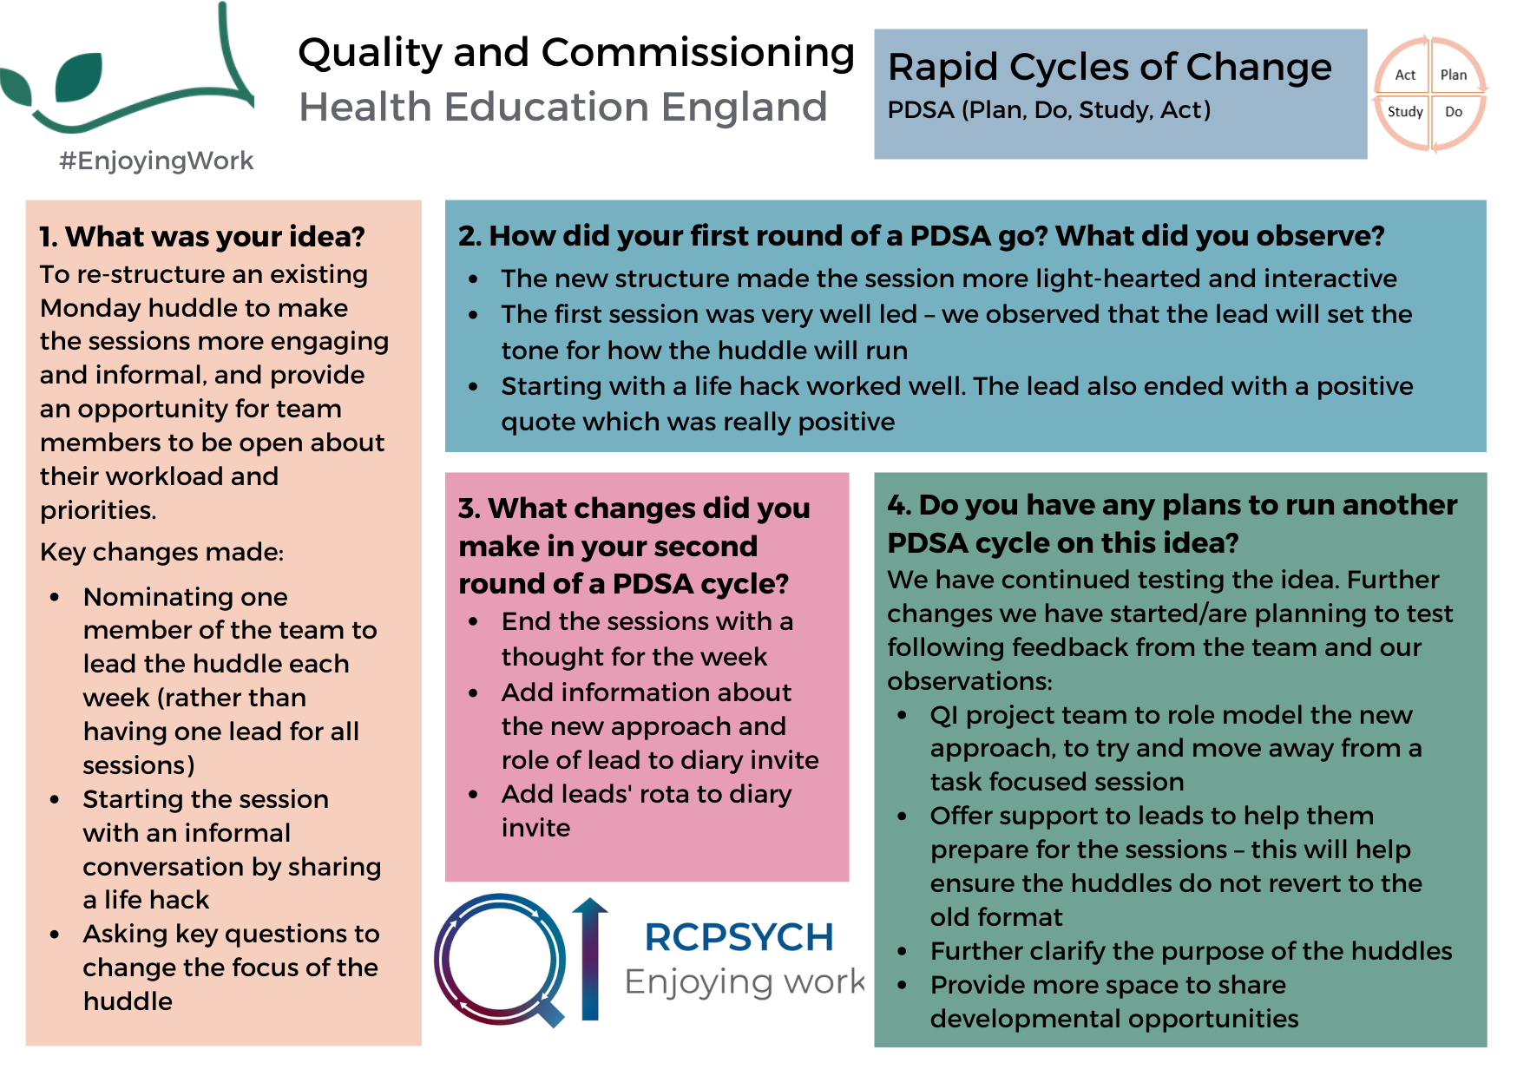

Slide 15
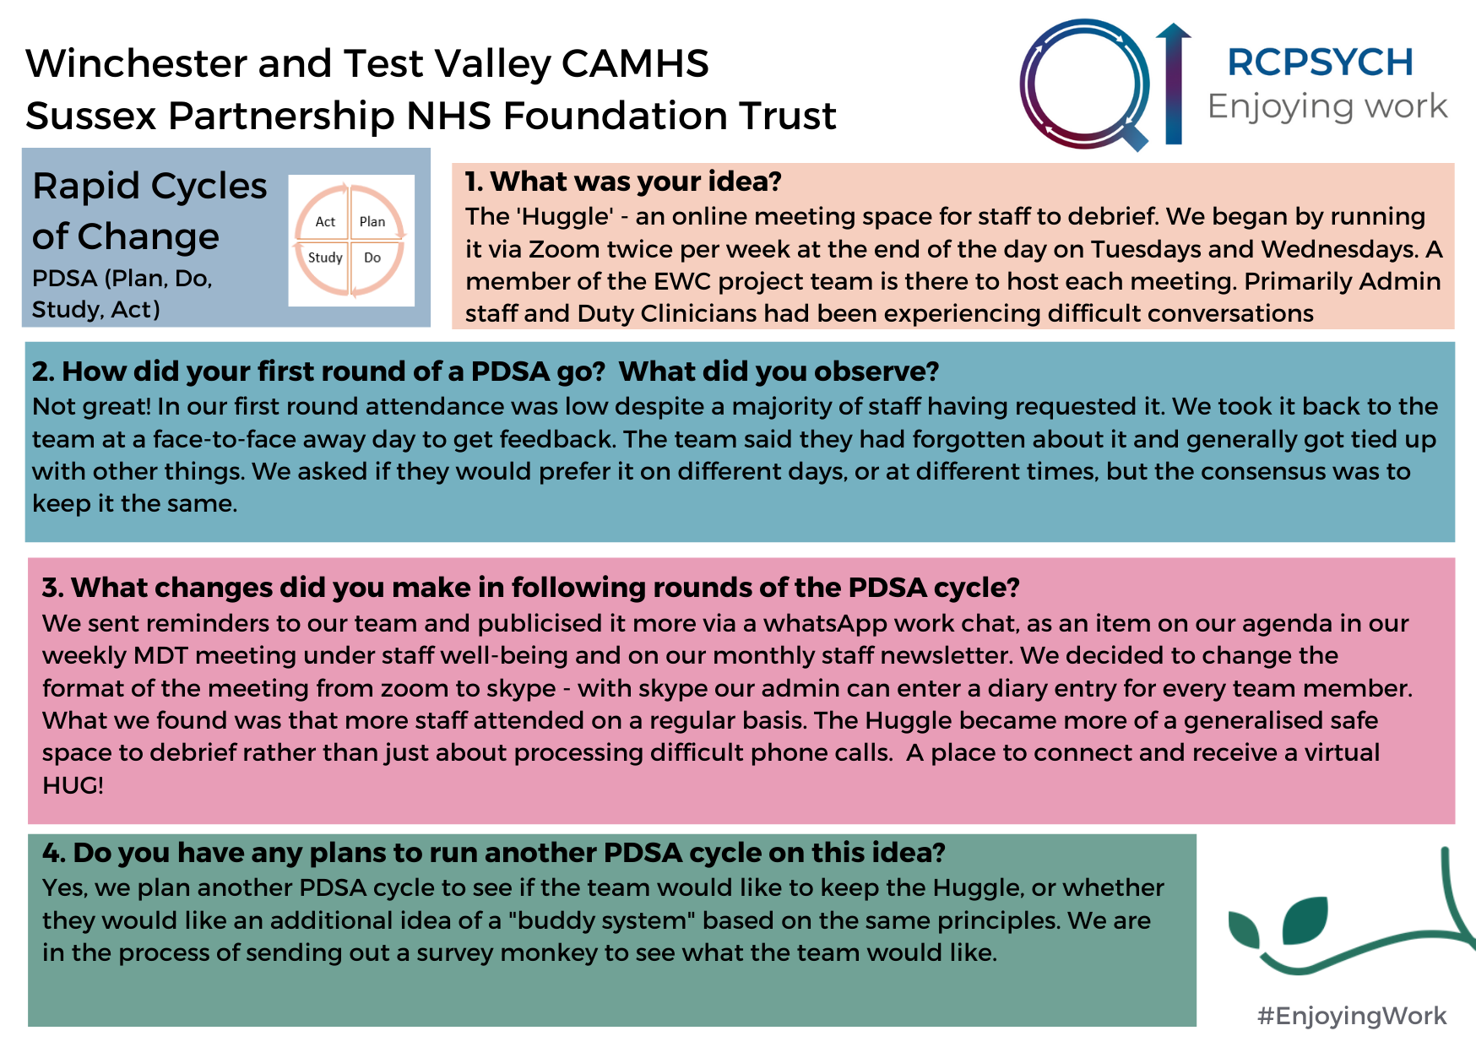

Slide 16
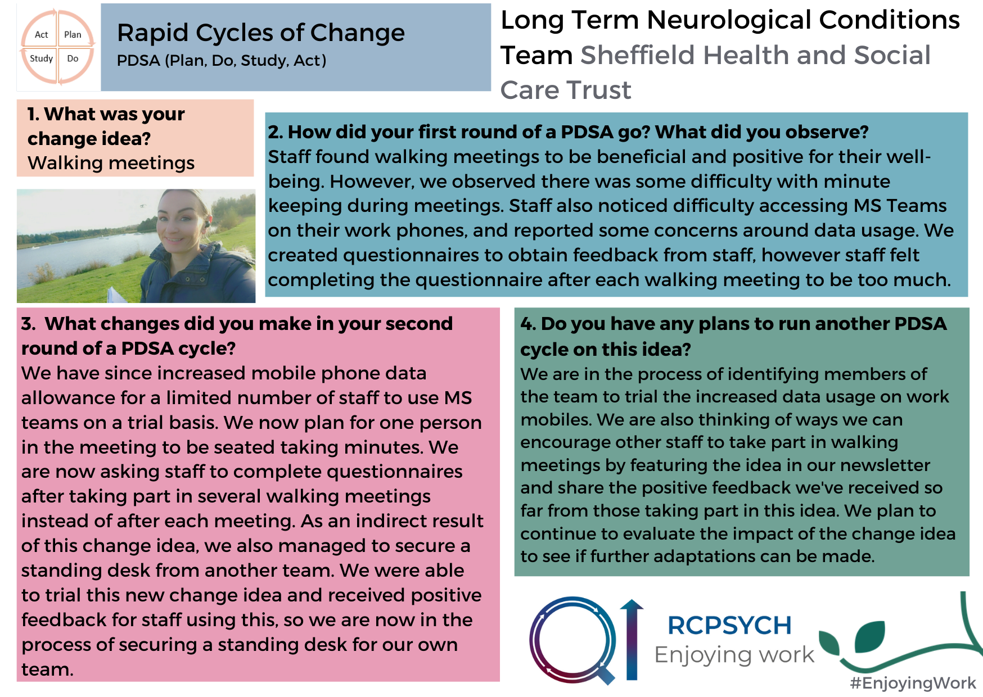

Slide 17
Break
10 minutes
We’d like to encourage you to use the break to do something that will bring you joy!

Slide 18
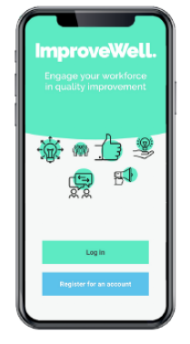
DATA
What does it mean?
How can we get more?
Notes:
In this session we are going to start taking a bit more of a look at the data you have all been collecting through the weekly surveys and take you through why we collect data in QI, why it is important and how we can use it for learning.

Slide 19
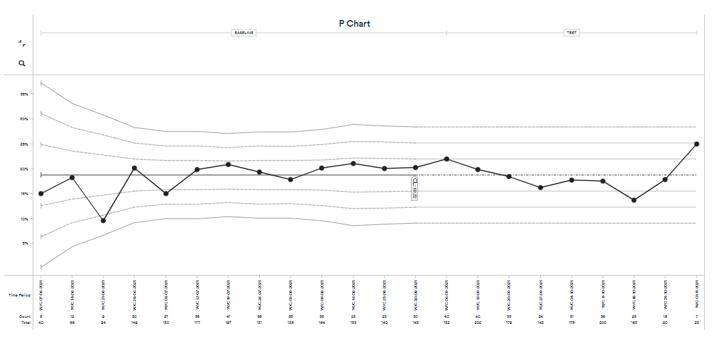
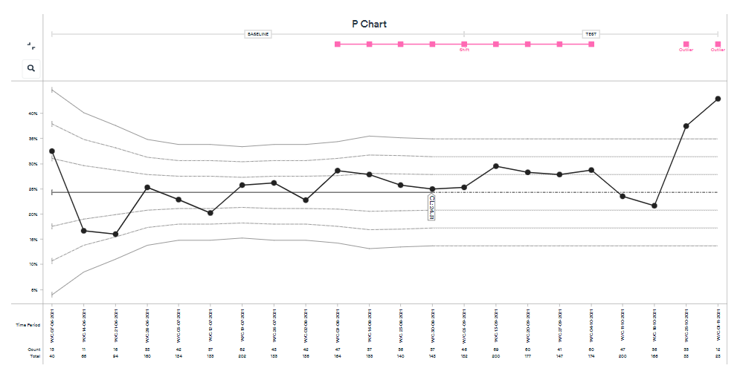
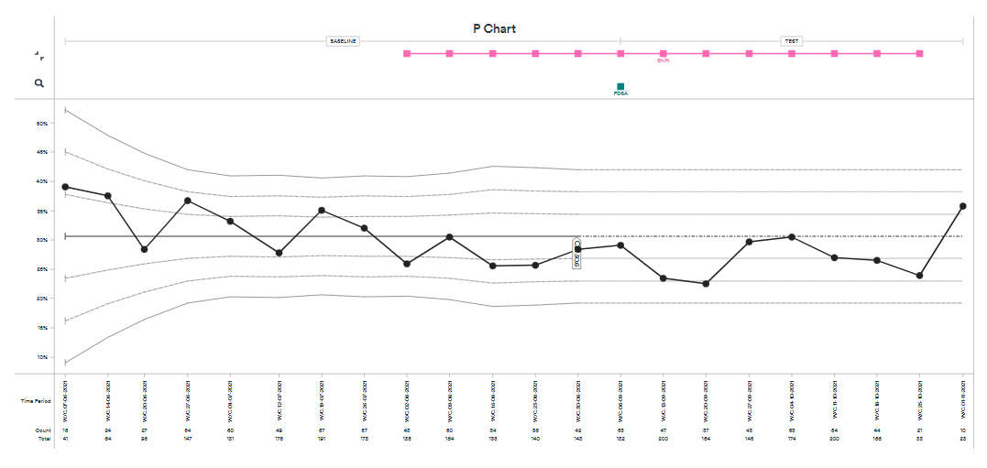
Percentage of people who have enjoyed being at work on a frequent basis
Percentage of people who experience no symptoms of burnout at work
Percentage of people who are extremely likely to recommend their team as a place to work
Notes:
Throughout the collaborative so far the QI coaches have been taking all of your survey responses and inputting them into a website called LifeQI which is a platform we use for several different things, one of them being to upload, display and analyse your data. This produces a graph called a Statistical Process Control chart (or SPC chart). Here you can see the SPC charts for each of our 3 outcome measures for all teams on the collaborative (aggregate data). You will all also have your own 3 charts for the data from your own teams.
But how do you use these charts and why should you care?

Slide 20
Average mortality from coronary artery bypass graft procedure
Before and After the Implementation of a New Protocol
WOW!
A “significant drop”
from 5% to 4%
5.2
5.0%
Percent Mortality
4.0%
3.8
Time 1
Time 2
Conclusion -The protocol was a success! A 20% drop in the average mortality!
Notes:
In quality improvement we are tracking data over time. Collecting data at regular intervals throughout the project, in the case of this collaborative through weekly surveys. Collecting real-time data is useful for multiple reasons and here I want to give you an example of why we’re doing this and not just doing a comparison between your data from the first week of the collaborative and your most recent week’s data.
Here you can see a project that was looking at the implementation of a new protocol related to coronary artery bypass graft procedures and its effects on mortality. In this example data is collected at two distinct time points - time 1 and time 2. Looking at this data the new protocol was a great success and reduced average mortality by a massive 20%.
However, if you were to collect data over time, like you are doing, there is more you can learn which may tell a slightly different story.

Slide 21
Average CABG Mortality
Before and After the Implementation of a New Protocol
A second look at the data
9.0
Protocol implemented here
Percent Mortality
5.0
CL = 4.0
1.0
24 Months
Now what do you conclude about the impact of the protocol?
Notes:
In actual fact if we look at the full picture, mortality had already decreased in the couple of months before the new protocol was introduced. It appears that mortality rates then started to rise (albeit not to previous levels).
Collecting data in real-time helps us to understand what led to the decrease? What was happening when rates started to rise again?
Tracking data over time gives us a much richer story.

Slide 22
Why use SPC charts and data over time?
Used to study how a system or process changes over time. They can help us understand when there is something special in our data that we should pay attention to (special cause variation) and what is just normal variation, changes in the data that are due to regular, natural or ordinary causes (common cause variation).
Best tool to help us understand:
Variation in a system or process
If a change idea is actually leading to an improvement
Whether any improvement has been sustained

Slide 23
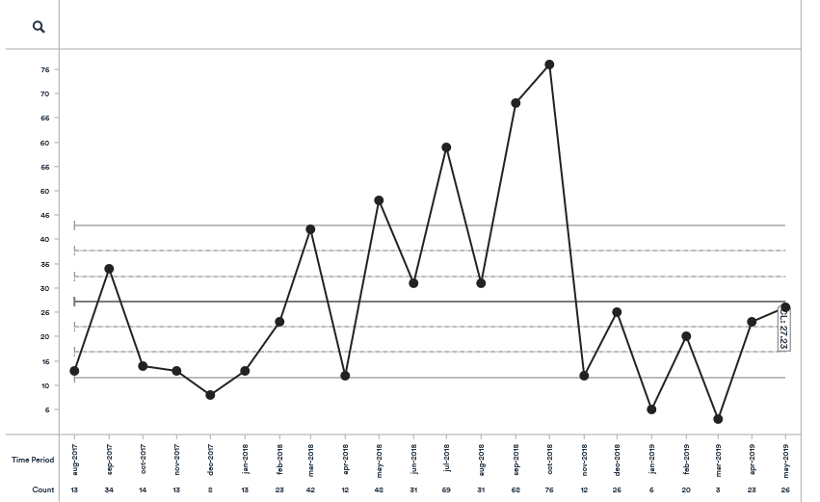
The anatomy of a control chart
Upper Control Limit
Mean
Lower Control Limit
Notes:
Here is what an SPC chart looks like and what you will see when you start to look at your data on LifeQI.
On the X axis you have data in some sort of chronological order e.g. Jan, Feb, Mar (or week commencing date)
On the Y axis you have the measure of interest e.g. percentage (of people who reported no symptoms of burnout)
The mean is the line running through the middle, also known as the average.
As you can see, there are some extra lines going across the chart. These are the upper and lower control limits which help us understand variation in our data. Within any process there is going to be some natural variation and the control limits define the boundaries of expected random variation above/below the mean.

Slide 24
5 Rules of Special Cause Variation in a Control Chart
RULE 1: Shift
RULE 2: Trend
RULE 3: Three sigma variation
RULE 4: Two out of three
RULE 5: 15 or more data points hugging the mean
Notes:
So how do we know whether something is special cause or common cause variation? There are 5 rules to help us interpret a control chart and see if we have special patterns in our data.

Slide 25
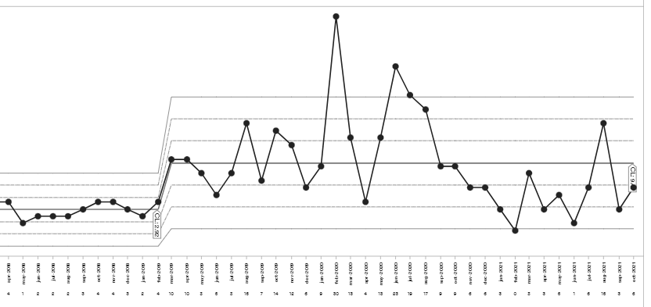
RULE 1: Shift
Notes:
Eight or more consecutive points either all above or all below the centre line (mean).
Indicates a sustained change in your data. In this case your mean and control limits no longer reflect your data and would be recalculated (as you can see in this example).
Values that fall on the mean do not add to or end a shift. In this case you would skip the value that falls on the mean and keep on counting.

Slide 26
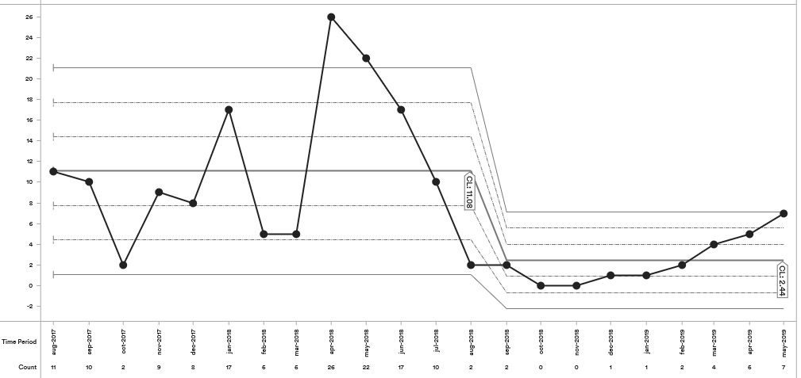


RULE 2: A trend
Notes:
Six or more consecutive points all going up or all going down.
If two or more points in a row are the same value (repeats), ignore the extra repeats when counting.

Slide 27
RULE 3: Three Sigma Violation
Notes:
If you have a data point that exceeds either the upper or lower control limits, this is a demonstration of a special cause. When this happens we need to have a think about what might have caused this special variation.
Think about if there was anything in particular happening at work or within your team that might help explain it?

Slide 28
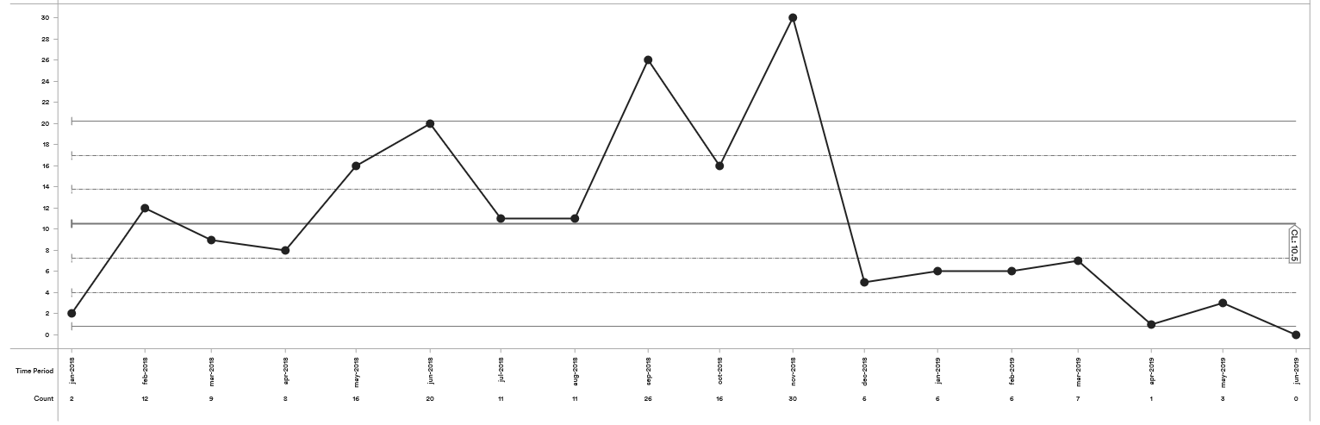
RULE 4: Two out of three
Notes:
When you get two out of three consecutive points in the outer one-third of the chart.
The points don’t have to be in the same outer one-third i.e. one point could be in upper outer one-third and another in lower outer one-third.

Slide 29
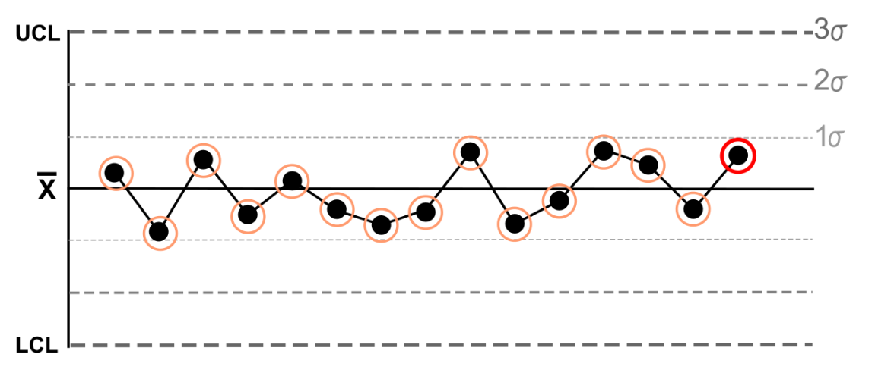
RULE 5: 15 or more data points hugging the mean
Notes:
15 or more consecutive data points hugging the centre line (the inner one-third of the chart).

Slide 30
Percentage of people who have enjoyed being at work on a frequent basis
Notes:
Let’s take another look at the aggregate data slides we saw at the beginning of this presentation.
Here is the aggregate data for the outcome measure related to joy in work. According to the rules of a control chart there are no special causes identified in this data. Nothing has occurred yet to cause a significant change in the data (yet).

Slide 31
Percentage of people who experience no symptoms of burnout at work
Notes:
Here is the aggregate data for the outcome measure related to burnout. Here you can see a shift in the data as marked on the chart in pink. As per the rules of a control chart this would suggest a sustained change (in this case a sustained increase in the number of people reporting no symptoms of burnout).
However, this shift crosses the time period where the ‘baseline’ period ends and the ‘testing’ period begins (marked on the top of the chart). The baseline period has been set by our team and the end of this marks the point in the collaborative where most teams had collected their baseline data and started to test change ideas. In this case the shift started before most teams started tested any changes. Only 5 points fall above the mean after the end of the baseline period, not enough for a shift, and so this change in the data can’t be attributed to changes ideas being tested by you.
If the shift after the baseline ends had continued to 8 or more consecutive points above the mean then this would have shown special cause during the testing phase and therefore could have been a result of changes you have been testing.

Slide 32
Percentage of people who are extremely likely to recommend their team as a place to work
Notes:
Here is the aggregate data for the outcome measure related to recommending your team as a place to work.
Here you see a shift in the data below the mean with eight consecutive points during the testing phase. However, the fifth data point is on the mean so we skip that and keep counting. This gives us seven consecutive points which is not a shift and so there is no special cause variation during the testing phase for this outcome measure.
Even if there had been a shift you may be thinking that surely that is a bad thing as in this case it would suggest the percentage of people rating their team highly has actually fallen. This is not uncommon in QI in the early stages of data collection and does not necessarily mean something bad. Because data in QI is collected at regular intervals and is usually simple to collect it often provides more accurate data than other methods of data collection. As it took a few weeks for teams to get used to the data collection it may have taken that time to get more accurate data.

Slide 33
SUMMARY
Collect data over time so we can see patterns and learn from the data in real time
Use SPC charts to differentiate common cause variation and special cause variation
There are 5 rules of special cause variation in a control chart
Particularly interested in shifts as these suggest a sustained change in data
Your QI coach can give you access to your charts and help your team to understand your own data

Slide 34
DATA COLLECTION
How can we get more?
Notes:
We have spent some time looking at understanding your data, but we also should take a step back and look again at data collection. In order to learn as much as we can from our data we need to collect enough of it and collect it consistently. For this collaborative this means getting as many of your team to complete the weekly surveys each and every week. Many of our teams are still looking at ways they can improve this and ideas that have shared around this will be available on our website Enjoying Work Collaborative | Royal College of Psychiatrists (rcpsych.ac.uk).

Slide 35
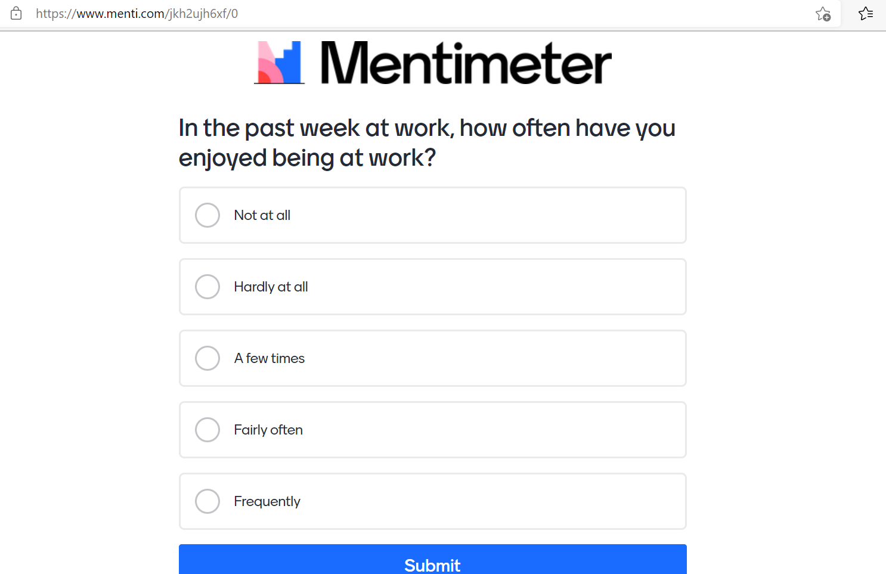

Slide 36
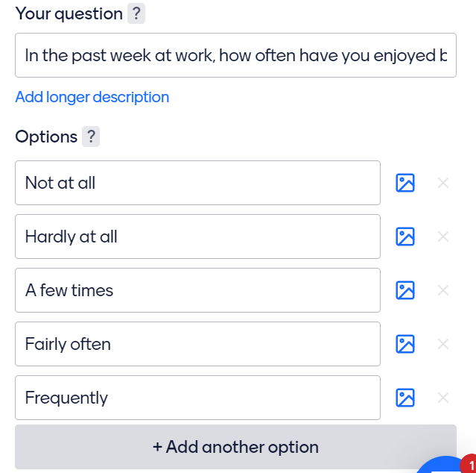

Slide 37
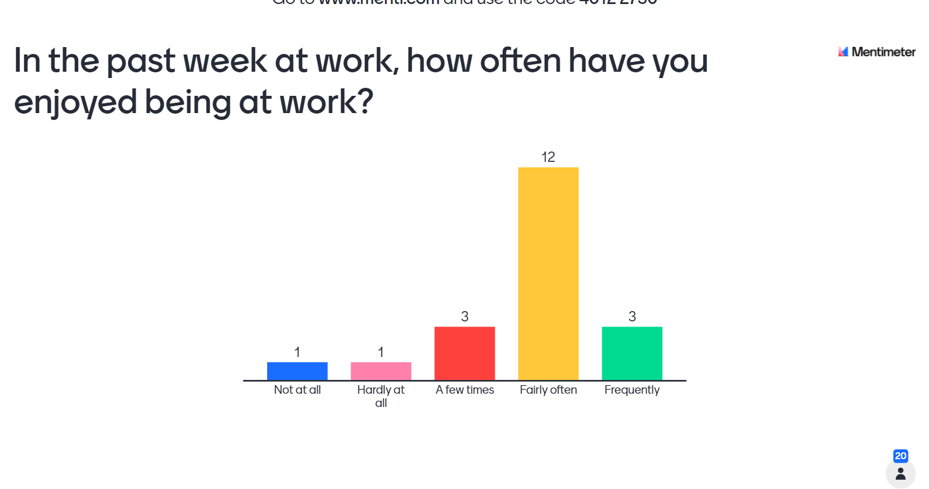

Slide 38
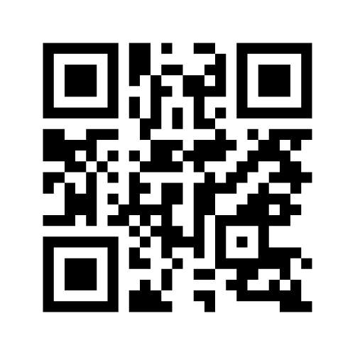
Menti - Top tips and ideas for data collection
Go to www.menti.com (we will add a link in the chat too) and enter the code:
3737 8400
or scan the QR code shown here

Slide 39
Breakout Room Exercise
Please reflect on the ideas just shared on Mentimeter. Will you now be trying anything differently for data collection?

Slide 40
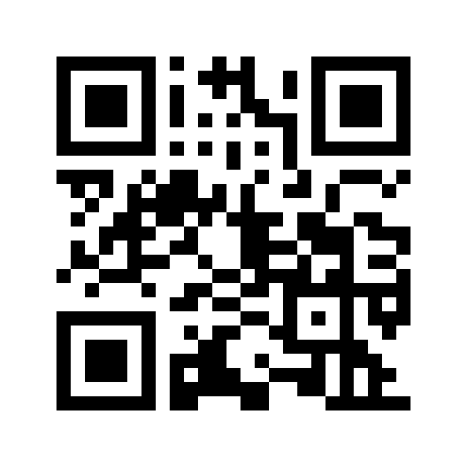
Menti – Sharing your positive changes
Go to www.menti.com (we will add a link in the chat too) and enter the code:
4124 3752
or scan the QR code shown here

Slide 41
Close
Tom Ayers
Director (NCCMH)

