Slide 1


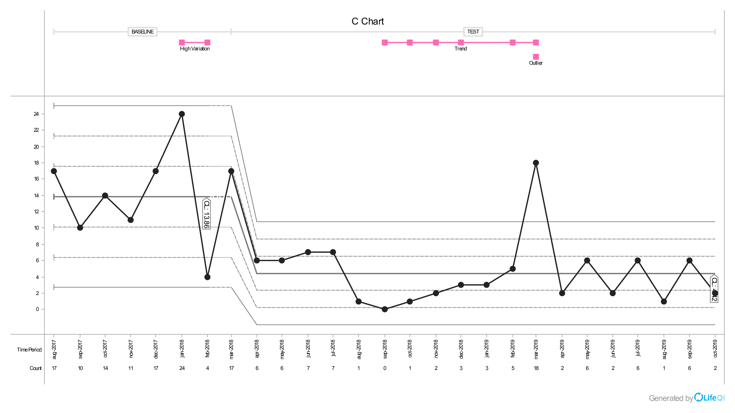
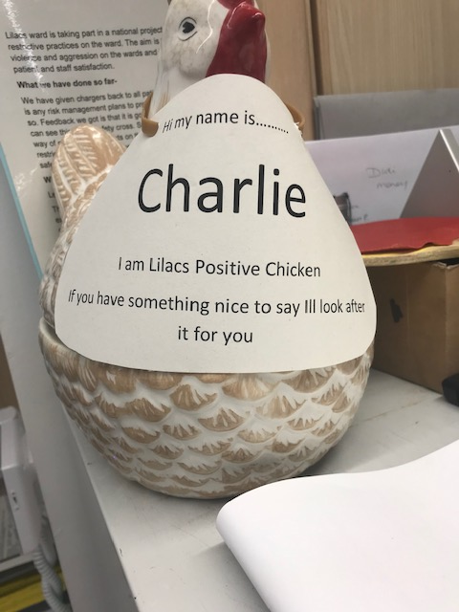
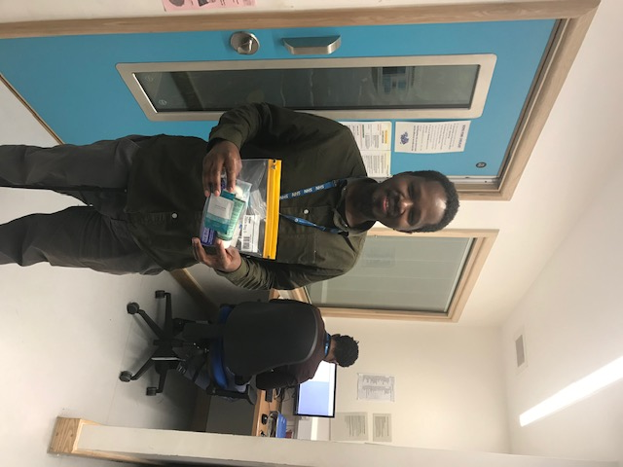
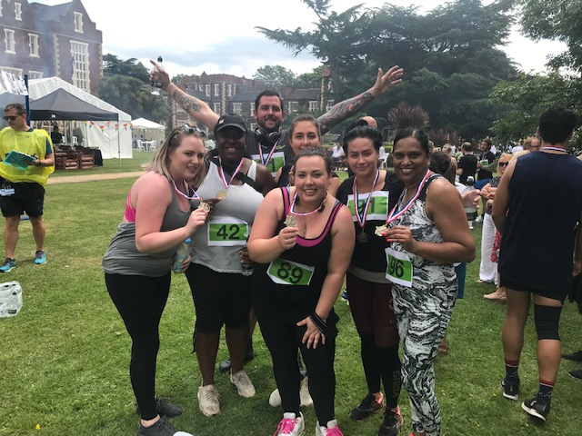
Trust Logo
Lilacs ward
Hannah Jones
Reflecting on our project
A space for you to add your data/chart or team photo (or both!)
Change ideas we have tested include:
Changes we have seen on the ward
Carers letters on admission
Self care packs on admission
Charlie the positive chicken
Team building
Fund raising
Phone chargers kept with patients
“here to help” lanyards
Extended visiting hours
Meal times changed
Feed back Fridays (positive messages and thank you’s for the week)
Charlie the positive chicken
Going home checklists
Staff meals with patients
Opening office door where possible
Twitter page
There has been a significant change in the culture on the ward, we went from the highest levels of violence, aggression and self harm to one of the lowest rating wards in these categories.
We have overall had a 70% reduction in rapid Tranquilization usage and also a 50% reduction in restraint over the last 2 years
We did move wards halfway through the project so the ward environment itself has changed for the better
My main goal throughout this project was to ry and improve the quality of wokring life for my staff as without them the project would not have taken off the ground
We have also had a significant reduction in complaints, carers feel more informed and at ease to speak with staff re their loved one Staff have really taken positively to this change and I have seen huge changes in the language used to describe incidents, the changes are here to stay!
What our patients, staff and carers say
Looking to the future
I cant honestly say a single negative thing about this project
The freedom we were given to implement change ideas was phenomenal
Also the support that the RRP team gave us over the course of the project was amazing, even the learning days were great, I tried to rotate the staff attending as much as possible to ensure that everyone got a chance to go and learn and come back with fresh ideas
I wish it didn’t have to end!
The changes we have made are here to stay!
We ensured that all change ideas were given enough time to assess if they made an impact, if they made a change we continued, if they didn’t we stopped (we have not had to stop anything yet
The staff do not want to go back and really enjoy the changes they have made
I don’t think the changes will stop as they are so proud of how far we have come and what a significant impact we have made
All ideas were co produced with staff and patients which is the reason I think it was so successful for us here at lilacs ward

