Slide 1

Sophie Pilgrim
Director

Slide 2
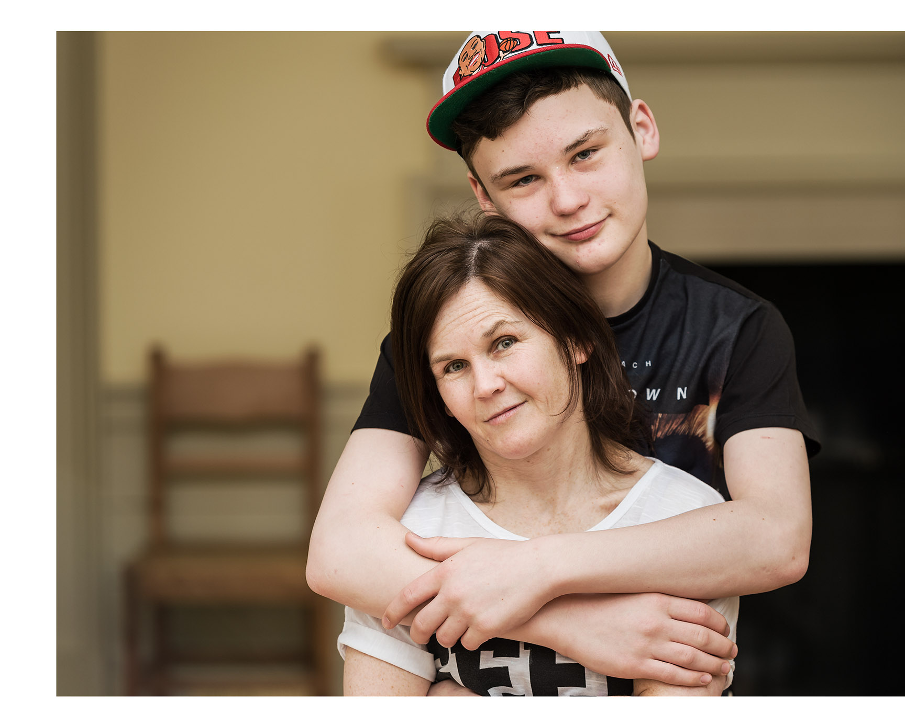
Kindred supports 700 families a year… a small number have autism, LD and mental health issues

Slide 3
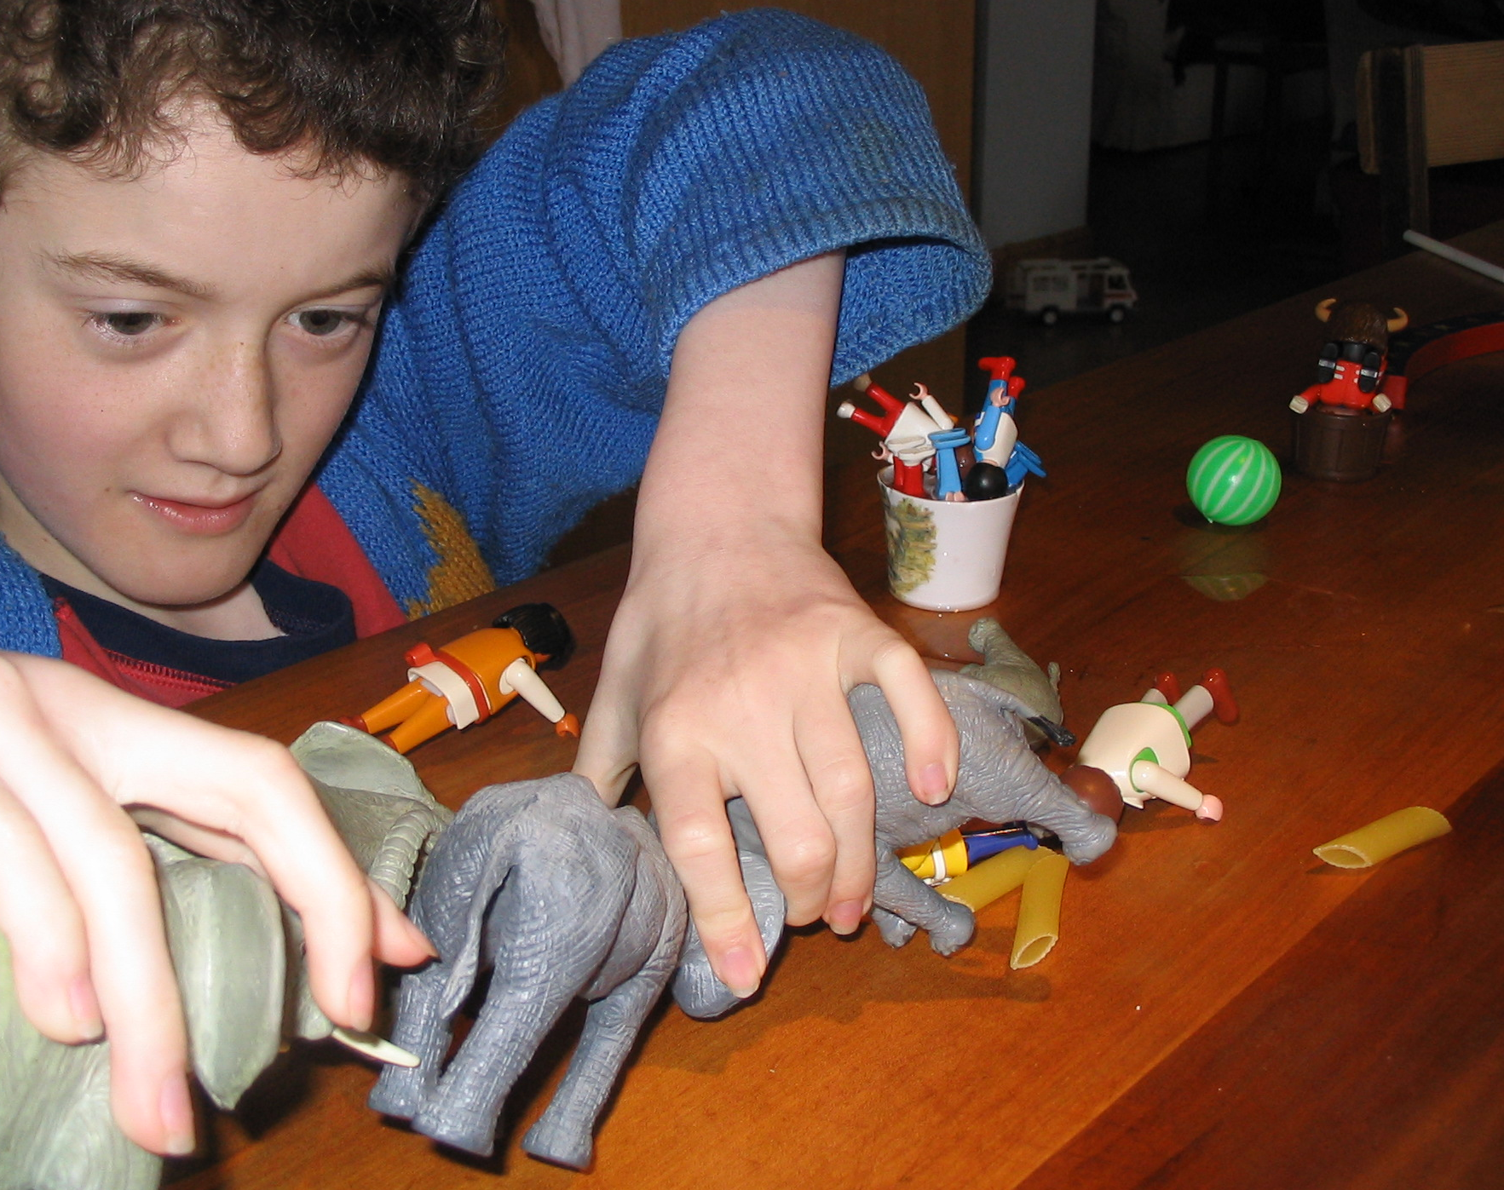
Kindred is a parent led charity

Slide 4
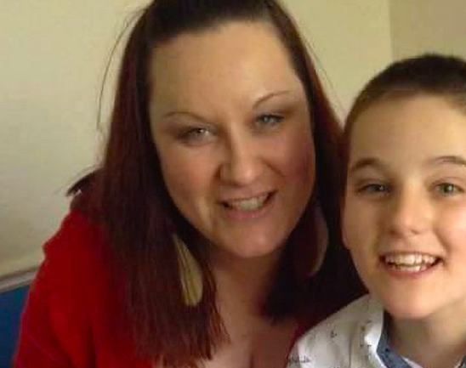
Rian and his mum, Charlie

Slide 5
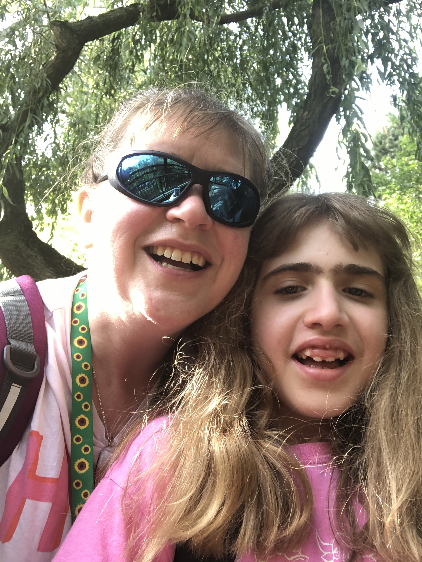
Disability Discrimination Claims (ASN Tribunals)
Transport to school:
Drivers and escorts trained in CPR and First Aid (for epilepsy)
Vehicles are big enough (wheelchair accessible and ensuring children are far enough apart)
Journey time
Shared transport
Ratio of adults
Getting dropped at respite care

Slide 6

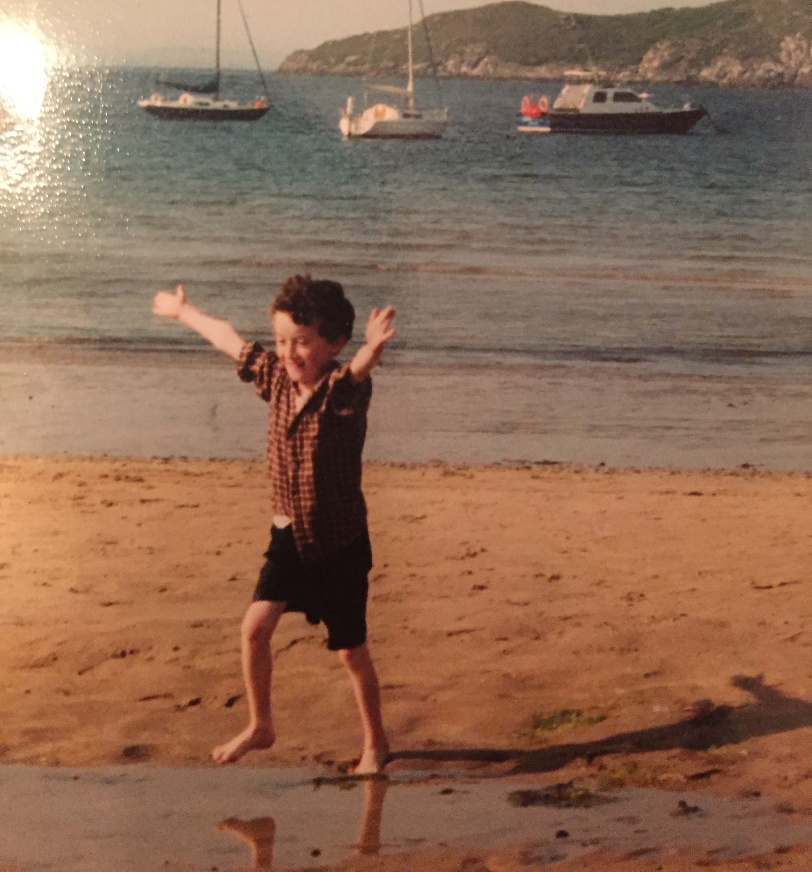
Callum and Anthony

Slide 7
Conclusions from a parent perspective
Improve decision making regarding significant care packages
Invest in CAMHS LD Teams (address the discrimination against this group of children in terms of psychiatric services)
- Fund a National LD CAMHS Professional Network

