Slide 1


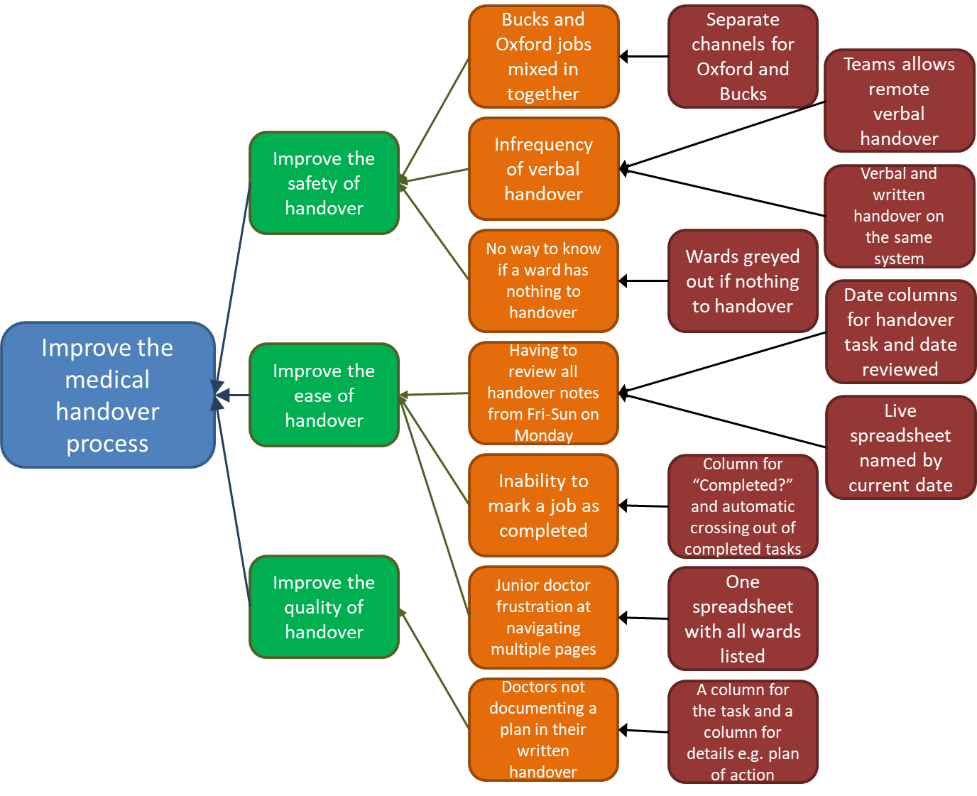
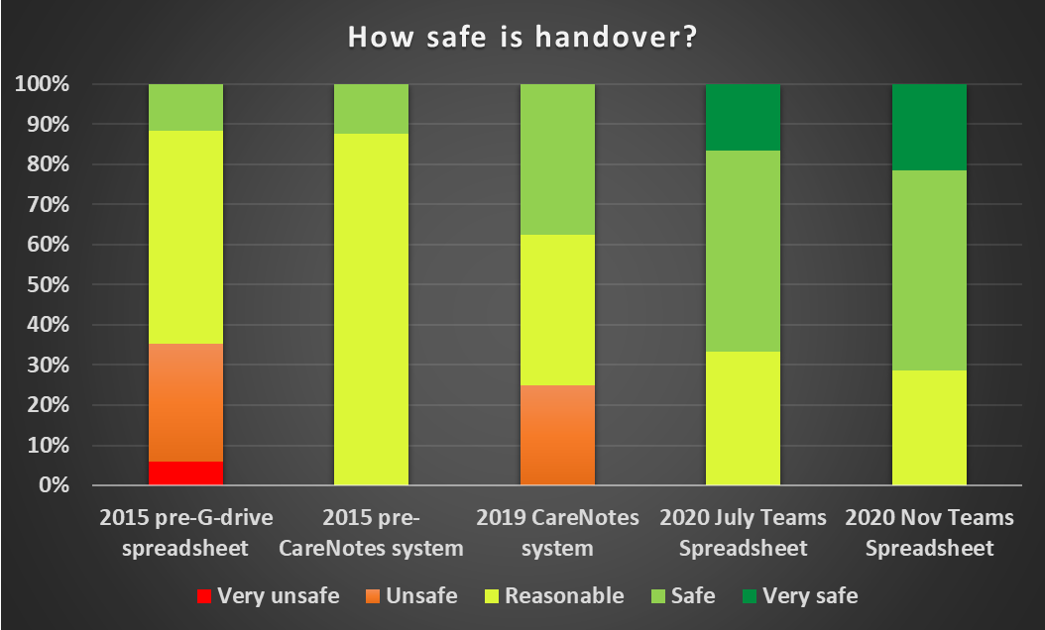
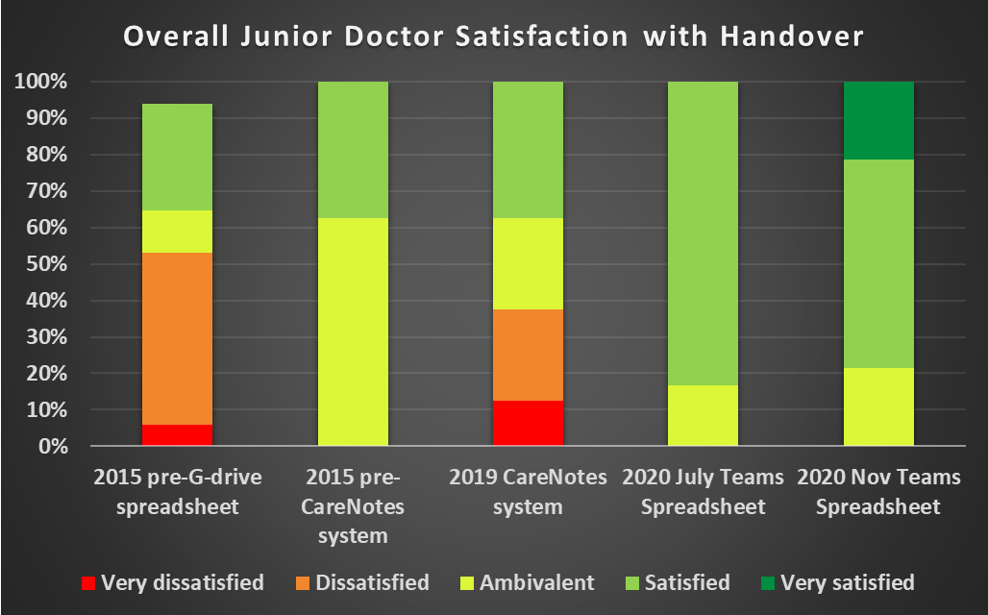
Improving the Safety of Medical Handover in Oxford Health: A Quality Improvement Project
Dr Emma New (CT3)
A new Teams-based handover system that delivers a safer and easier handover
Aims
Background
Aim
How did you involve service users and carers in this work?
Method
Tests of Change
To design and implement a new handover system within a large mental health trust based on trainee views
To improve that system based on further trainee feedback
Before August 2015, there was no formalised handover system within the Trust. This prompted the establishment of the Handover Improvement Project, consisting of 5 PDSA cycles with changes at each stage. The first two cycles produced:
2015: G-drive-based spreadsheet per ward system
2017: Handover notes in CareNotes – searched for by note type and date
Junior doctors’ views on handover surveyed 2019
Liaison with IT to discuss possible new handover options
Handover Team and channels created
Conditionally formatted handover spreadsheet created
Video tutorial created and new system rolled out in Oxford March 2020
Junior doctor opinion surveyed again July 2020
Changes made and system rolled out in Bucks
Junior doctor opinion surveyed again November 2020
Driver diagram
Results from Junior Doctor Surveys on Handover
Conclusions
The new Teams system has significantly improved the safety of handover, the satisfaction of junior doctors with the handover process, and has been found easier to use than the previous CareNotes system. It has also improved the frequency with which written handover is occurring and made it easier for ward teams to get hold of the evening doctor to verbally handover. Overall, the new Teams handover system has been significantly beneficial to the handover process and positively received by the doctors using it.
Acknowledgements: Thanks to Drs Clacey and Fielding for leading early PDSA cycles in the project
Contact information: emma.new@oxfordhealth.nhs.uk

