Slide 1
Delirium in older adults
Tier 3

Slide 2
Delirium
Delirium is an aetiologically nonspecific syndrome
It can include disturbances of
Consciousness and attention
Perception
Thinking
Memory
Psychomotor behavior
Emotion
Sleep-wake cycle

Slide 3
Course of delirium
Usually transient and of fluctuating intensity
Most cases recover within 4 weeks or less
However, some may take up to 6 months
The delirious state may be superimposed on, or progress into, dementia. (ICD-10, 1992.)
Delirium is associated with increased length of hospital stay, functional decline, increased morbidity and mortality and increased rates of institutionalization

Slide 4
Types
Hyperactive - most easily recognized type, this may include restlessness (for example, pacing), agitation, rapid mood changes or hallucinations, and refusal to cooperate with care.
Hypoactive - may include inactivity or reduced motor activity, sluggishness, abnormal drowsiness, or seeming to be in a daze. This is often missed
Mixed - both hyperactive and hypoactive signs and symptoms. The person may quickly switch back and forth from hyperactive to hypoactive states.

Slide 5
Causes
Causes are often complex and multifactorial
D Drugs including: opioids, anticholinergics, steroids, benzodiazepines,
  antidepressants, sedatives, dehydration, detox, deficiencies, discomfort (pain) -dementia
E Electrolytes (sodium, glucose, calcium ), elimination abnormalities,
environment
L Lungs (hypoxia), liver, lack of sleep
I Infection, iatrogenic events, infarction (cardiac, cerebral)
R Restricted movement/mobility, renal failure/removal of alcohol
I Injury, impaired sensory input, intoxication
U UTI, unfamiliar environment
M Metabolic abnormalities (glucose, thyroid), metastasis (brain)
COVID causes delirium

Slide 6
Symptoms
Acute onset
Fluctuating course
Inattention
Disrupted sleep pattern
Reduced awareness
Reduced alertness
Altered consciousness & a change in cognition
Hallucinations – usually visual
Fleeting delusions
Labile affect
Orientation – variably impaired
Memory – immediate & recent impairment

Slide 7
Predisposing Factors
Factors that have been identified as predisposing a patient to develop a delirium include:
Advanced age
Cognitive impairment
Severity of underlying illness
Depression
Dehydration
Sensory impairment
Functional impairment
Physical health conditions – stroke, neurological diseases, chronic renal or hepatic diseases

Slide 8
Precipitating Factors
Events related to either hospitalisation or associated treatments can precipitate the development of delirium:
Surgical procedures – high incidence due to multiple insults to the body
Infection
Electrolyte imbalance
Disruption to sleep cycle
Change in medication regimes / multiple medications / medication errors
Pain
Unfamiliar environment
Poor nutrition / hydration
Constipation
Drug / alcohol withdrawal

Slide 9
Pathophysiology
Delirium = acute medical condition.
Pathophysiology is poorly understood.
Likely related to multiple physiological mechanisms that affect neurotransmission, inflammation and stress responses.
Disease and / or trauma leads to a physical stress response.
Stress response overwhelms the individual due to deranged neurotransmitter release and uptake.

Slide 10
Diagnosis
Clinical assessment is key
Consider using Confusion Assessment Method (CAM) as a screening tool or 4AT
Get an accurate history from someone who knows the patient

Slide 11
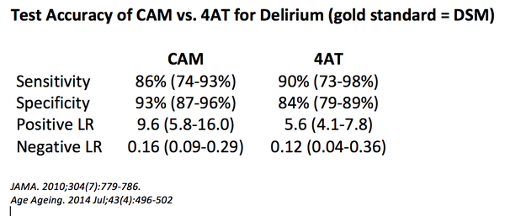
3+ – possible delirium + cog impairment
1-3 – possible cognitive impairment
0 – delirium unlikely

Slide 12
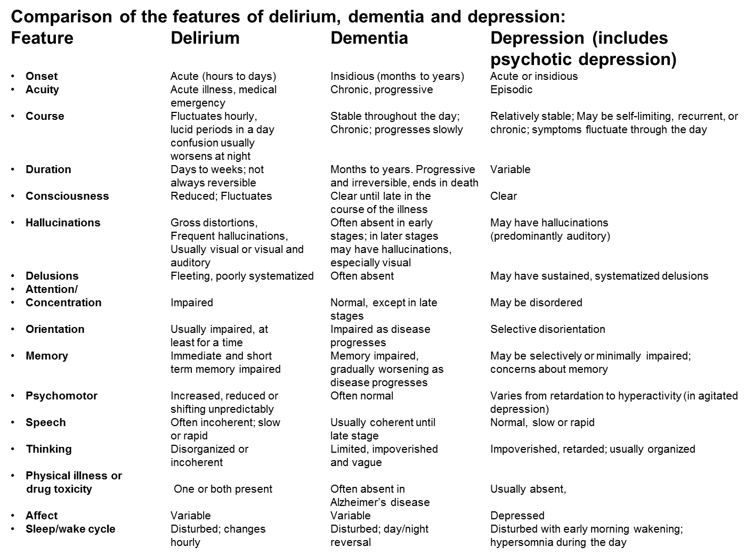

Slide 13
Management
Address any infection and pain
Ensure adequate hydration and nutrition
Ensure glasses, hearing aids etc. are accessible
Attention to the environment is essential.
Quiet area or side room; limit staff changes
Adequate lighting, minimise noise, provide a clock the patient can see
Gentle repeated reorientation and to avoid confrontation
Try to maintain normal sleep-wake cycle
EXPLANATION is KEY
Explain cause and likely course to patient, relatives and carers
Address anxiety; patients with delirium are often frightened
Explain the organic cause of behaviour and symptoms

Slide 14
Management
Identify the underlying cause and treat appropriately
Manage the symptoms of delirium whilst the cause is found
Prevent injury and delirium complications—falls, wandering, harming self or others, skin breakdown, aspiration
Address predisposing & precipitating factors as appropriate

Slide 15
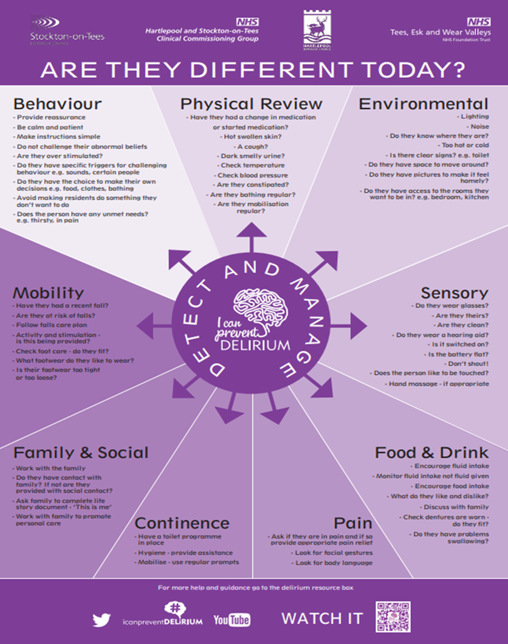

Slide 16
Management
Non-pharmacological measures to manage symptoms should be tried first which can include nursing in a single room, reorientation, using of appropriate lighting, offering reassurance
Assess for short term use of low dose antipsychotic medication if patient is disturbed by hallucinations or severe agitation and aggression.
Sedatives and hypnotics can prolong delirium therefore they should be used judiciously and in minimal doses
Combative and physically dangerous patients may require urgent reassessment

Slide 17
Delirium resources
HEE NE > PG Dean > Faculty of Patient Safety > Delirium Project
This link has link to animated videos on delirium awareness and
on being delirium ready.
Patient video (europeandeliriumassociation.org) This is the link
to powerful video of what it is like to experience delirium.
Leaflets for patients and relatives: https://www.rcpsych.ac.uk/mental-health/problems-disorders/delirium

