Slide 1
Depression in older adults
Tier 3

Slide 2
What is depression?
A syndrome- a group of signs and symptoms that occur together and characterise depression
To confirm a diagnosis:
  The symptoms must be on most days for at least two weeks causing significant social or functional impairment
It is NOT a normal experience = NOT inevitable with ageing – hence should not be ignored

Slide 3
Signs and Symptoms of depression
Depressed mood with negative thinking
Disturbed sleep - Early Morning Wakening
Lack of enjoyment and interest
Reduced energy levels and lack of motivation
Slowness of body and mind
Self-esteem and self-confidence are almost always reduced
Ideas of guilt or worthlessness are often present
Reduced appetite and weight loss
Loss of libido
Depressive delusions regarding poverty, physical illness or nihilistic in nature
Thoughts of self harm and suicide

Slide 4
Differences in presentation
    Older adult may present with different symptoms to younger adult
    Anxiety instead of mood
    Agitation and restlessness including inability to keep still, constant pacing, irritability
    Personality changes
    Preoccupation with physical symptoms like faintness or dizziness, pain, weakness, constipation, tiredness.
    Unexplained functional decline (walking /incontinence)
    Memory problems ( memory impairment-self-reported)
    Minimisation or denial that they have depression

Slide 5
Prevalence of depression in older adults
Prevalence in community 3-15%.
GP surgeries 15-20%.
Care home residents 15-20%.
General / acute hospital 20% - could be as high as 40%.
More common in women than men

Slide 6
Depression and Suicide
Older adults tend to have higher rates of completed suicide.
About 1in 4 older adults who attempt to end their lives complete suicide
About 2/3 have depression.

Slide 7
Risk factors for developing Depression in older adults
Physical illness: pain, Parkinson’s, recent MI, strokes, TIAs, cancer
Loss of sight or hearing
Vascular and Lewy Body dementia
Excess alcohol use
Bereavement
Being a carer
Loss of independence/home/ social network
Loneliness
Past history of deprivation / abuse in their youth
Past history of depression
Certain prescription medications

Slide 8
Why is depression missed ?
Older person with depression | Staff
Older adults may not report low mood due to stigma | Staff may not consider the diagnosis and recognition is often low
Older adults may not be able to express themselves | Staff may believe that depression is justified/ normal
Depression is expressed via bodily symptoms | Staff may feel ill equipped to deal with the distress
Older person may feel ashamed of feeling depressed | Staff may be worried about drug side-effects
Older adults may not use the term depression | Staff may believe depression is untreatable

Slide 9
Risks
Risks associated with having depression as an older adults include
Increased mortality in older adults with depression especially from cardio vascular causes
Self-neglect
Neglect of other physical illnesses
Possibility of suicide
Risk of increased cognitive impairment
Increased risk of institutionalisation

Slide 10
Assessment
History and clinical picture
Risk assessment around self neglect /self harm/suicidal thoughts
Collateral history
Rule out physical health ,medication causes
Two question screening test for depression
Assessment scales could be used…
  Becks’ depression inventory
  Geriatric Depression Scale
  Hospital Anxiety and Depression Scale
  Cornell Scale

Slide 11
Simple questions to screen for depression
Two-question screening test
During the last month, have you often been bothered by feeling down, depressed or hopeless?
During the last month, have you often been bothered by having little interest or pleasure in doing things?
Answering yes to either of these questions is considered a positive test result, warranting further assessment.

Slide 12
GDS – Geriatric Depression Scale
Choose the best answer for how you have felt over the past week:
1. Are you basically satisfied with your life? YES / NO
2. Have you dropped many of your activities and interests? YES / NO
3. Do you feel that your life is empty? YES / NO
4. Do you often get bored? YES / NO
5. Are you in good spirits most of the time? YES / NO
6. Are you afraid that something bad is going to happen to you? YES / NO
7. Do you feel happy most of the time? YES / NO
8. Do you often feel helpless? YES / NO
9. Do you prefer to stay at home, rather than going out and doing new things? YES / NO
10. Do you feel you have more problems with memory than most? YES / NO
11. Do you think it is wonderful to be alive now? YES / NO
12. Do you feel pretty worthless the way you are now? YES / NO
13. Do you feel full of energy? YES / NO
14. Do you feel that your situation is hopeless? YES / NO
15. Do you think that most people are better off than you are? YES / NO
Answers in bold indicate depression. Score 1 point for each bolded answer.
A score > 5 points is suggestive of depression and warrants follow-up comprehensive
assessment.
A score > 10 points is almost always indicative of depression.

Slide 13
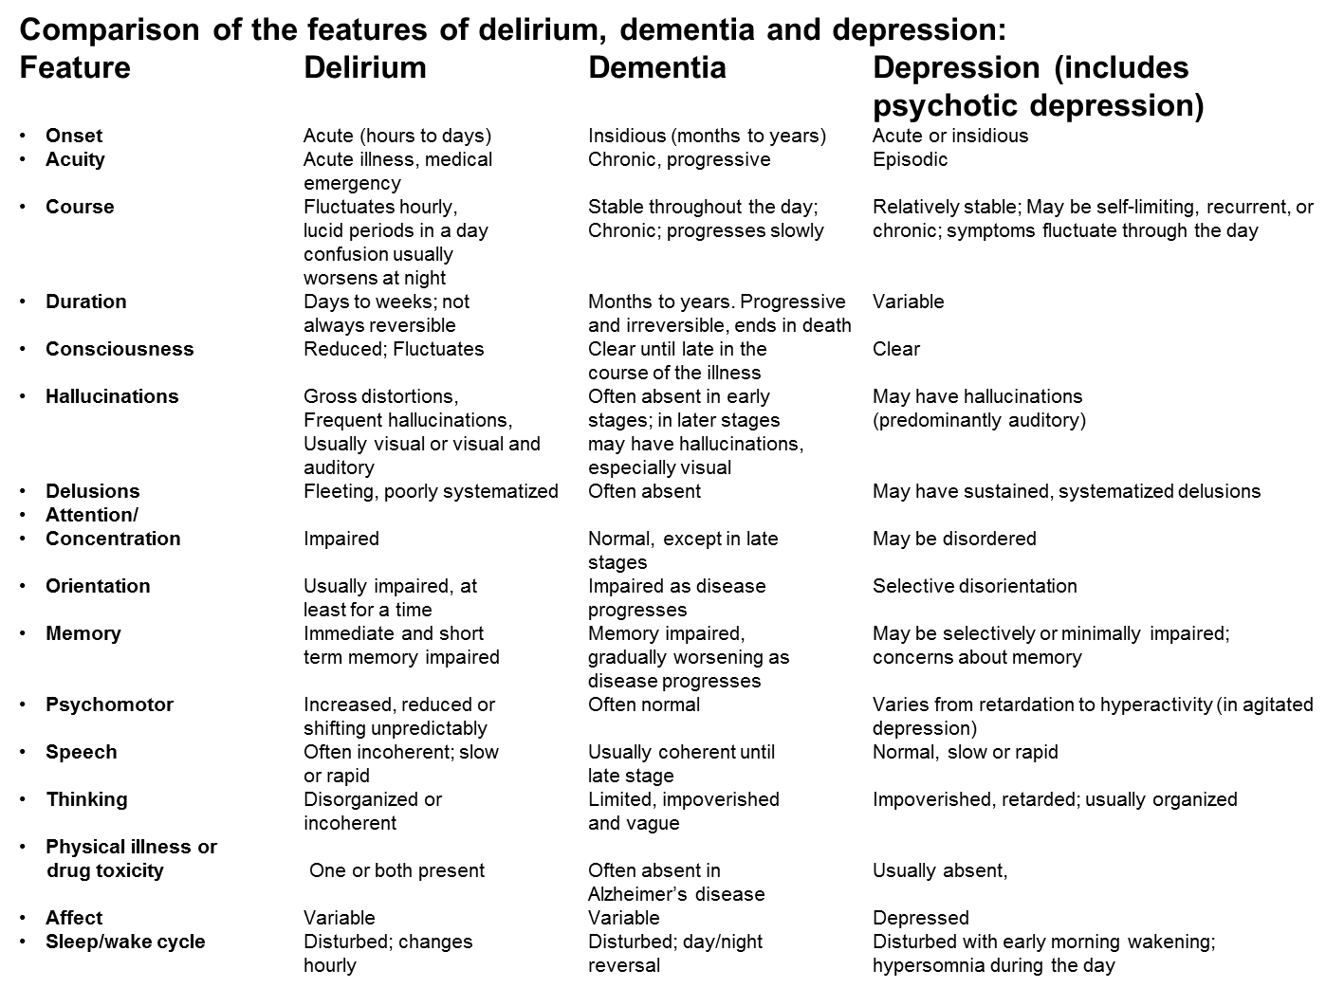

Slide 14
Management
Investigate and treat any biological factors such as some particular illnesses or medication issues
Reduce any psychological factors such as difficulties with relationships
Reduce any social factors, such as isolation and lack of stimulation
Psychological therapies are effective so consider referral to IAPT
Medications can also help
Refer to Old Age Psychiatry if moderate to severe depression with no response to treatment

Slide 15
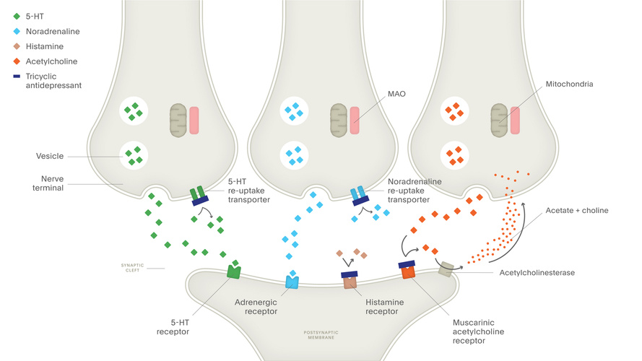
How do antidepressants work

Slide 16
Medications
Antidepressants:
Selective Serotonin Reuptake Inhibitors (SSRIs) (most commonly used)
Serotonin Serotonin and Noradrenaline Reuptake Inhibitors (SNRIs)
Tricyclics
Monoamine Oxidase Inhibitors (MAOI)
Remember antidepressants can be effective but also carry higher risk of side effects because of multiple medical comorbidities and drug-drug interactions in cases of polypharmacy.
Mood stabilisers such as Lithium

Slide 17
Common side effects of SSRIs
Headache
Feeling agitated, shaky or anxious
Dizziness
Blurred vision
Gastro intestinal disturbances especially indigestion
Insomnia / drowsiness / abnormal dreams
Sexual dysfunction
Also in older adults increase risk of falls and low Sodium
NB Serotonin syndrome
Notes:
Adverse effects
SSRIs are less sedating and have fewer antimuscarinic and cardiotoxic effects than tricyclic antidepressants (section 4.3.3). Paroxetine has the most significant antimuscarinic effects.
The following adverse effects are common to all SSRIs, but the risk and extent varies: gastro-intestinal effects (dose-related, including abdominal pain, constipation, diarrhoea, dyspepsia, nausea, vomiting), dry mouth, changes in appetite, weight gain or loss, taste disturbances, anxiety (usually with initial treatment), asthenia, dizziness, drowsiness, difficulty concentrating, headache, insomnia, abnormal dreams, palpitations, tremor, yawning, sexual dysfunction (see also Sexual Dysfunction Associated with Antidepressants and Antipsychotics—Prescriber Update, March 2015), sweating, rash (consider discontinuation—may be sign of impending serious systemic reaction, possibly associated with vasculitis); less commonly bruxism, bradycardia, tachycardia, flushing, postural hypotension, hypertension, oedema, raised cholesterol, syncope, coughing, pharyngitis, rhinitis, sinusitis, malaise, fever, chills, amnesia, ataxia, confusion, euphoria, hypomania or mania (see Cautions above), movement disorders, dyskinesias, seizures, changes in blood sugar, hyponatraemia (see Hyponatraemia and antidepressant therapy), micturition disorders, bleeding disorders (including ecchymoses and purpura), arthralgia, myalgia, visual disturbances (including mydriasis), tinnitus, alopecia, pruritus; rarely hepatic disorders, arrhythmias, QT-interval prolongation, paraesthesia, serotonin syndrome (see Serotonin Syndrome), hyperprolactinaemia (e.g. galactorrhoea), menstrual disturbances, priapism, angle-closure glaucoma, photosensitivity; also reported discontinuation reactions (see Discontinuation above), dysphagia, pancreatitis, angioedema, anaphylaxis, anaphylactoid reactions, dyspnoea, pulmonary inflammation, pulmonary fibrosis, aggression, depersonalisation, suicidal behaviour (see Suicidal behaviour and antidepressant therapy), neuroleptic malignant syndrome-like events, hypothyroidism, toxic epidermal necrolysis, Stevens Johnson syndrome
Serotonin syndrome
Serotonin syndrome (or serotonin toxicity) is an uncommon but potentially life threatening drug reaction that results from excess serotonergic activity at central nervous system and peripheral serotonin receptors. It can develop from excessive doses of a single serotonergic drug but more commonly occurs when combinations of serotonergic drugs are used together, particularly when these drugs act to increase serotonin via different mechanisms. Examples of drugs that can cause serotonin syndrome include antidepressants (especially SSRIs and clomipramine), lithium, St John’s wort, pethidine, tramadol, and linezolid.
Onset of symptoms is usually rapid, occurring within hours or days (most commonly within 24 hours) following the initiation, dose escalation, or overdose of a serotonergic drug, the addition of a new serotonergic drug, or an inadequate washout period between stopping a serotonergic drug and starting an irreversible MAOI. The symptoms may range from mild to life-threatening. Severe toxicity, which is a medical emergency, usually occurs with a combination of serotonergic drugs, one of which is generally an MAOI.
The excess serotonin activity produces a triad of specific symptoms including neuromuscular, autonomic and mental status changes, although features from each group may not be seen in all patients.
Neuromuscular effects: hyperreflexia, myoclonus, tremor, ataxia, rigidity, restlessness, nystagmus, trismus.
Autonomic effects: shivering, sweating, fever, hypertension, tachycardia, nausea, diarrhoea, salivation, tachypnoea.
Mental status changes: confusion, hypomania, agitation, headache, coma.
Management depends on the severity of symptoms. In all suspected cases the precipitating drug(s) should be discontinued; this generally results in resolution of symptoms within 24 hours, however symptoms may persist if the drug involved has a long half-life, has active metabolites, or a prolonged duration of action. Other management is largely supportive by controlling agitation, hyperthermia, and autonomic instability

Slide 18
Therapies
Psychological therapy such as Supportive psychotherapy, Cognitive behavioural Therapy (CBT) , Interpersonal therapy
ECT may be indicated for severe depression
Treating depression is worthwhile
Treatment response is usually good like younger adults

Slide 19
Course and Prognosis
Average length of depressive disorder 6 months but 25% have episodes of more than one year.
10-20% develop chronic depression.
80% of patients with major depression will experience further episodes.
On average people with major depression will experience 5 further episodes.
One third of depressed patients do not complete remission between episodes.

Slide 20
Preventing depression
Address any physical health issues early
Identify sensory impairments and manage
Life story reviews - find time to sit and chat
Listen & share-Give genuine time, take an interest
Build therapeutic relationships
Encourage activities which are enjoyable
Encourage exercise if possible
Identify depressive symptoms early

Slide 21
Key points to increase detection of depression
Think Depression-If you are aware of depression you will be less likely to miss it
Be aware of risk factors
Look for functional decline
Watch for significant symptoms
Ask directly about their mood
Resources :
Depression in Older People-animated video https://www.youtube.com/watch?v=mrqgaLnQ5zQ

Slide 22
Resources
Depression in Older People-animated video https://www.youtube.com/watch?v=mrqgaLnQ5zQ
MPC_05_06 Where There’s Depression, There’s Hope | Where There’s Depression, There’s Hope (mindedforfamilies.org.uk)
This is an easy to access website for older adults and their families which has good advice about symptoms and treatment of depression in older adults

